Slide 1
Hydroelectric Power
John C. Bean
Outline
The Science of Hydropower
Common Hydropower: Conventional & Run of the River
Less Common Hydropower: Pumped Storage Hydro & Tidal Barrage or Lagoon
Today's U.S. hydropower
Limits of Hydropower / Objections to Hydropower
Drought & Climate Change
Carbon Footprint of Concrete
Disruption of Fish Migrations
Impact on Rainforests and Tropical River Deltas
Possible Liberation of Soil Mercury
Alternate visions of tomorrow's hydropower:
U.S. Department of Energy vs. the Nature Conservancy
(Written / Revised: February 2020)

Slide 2
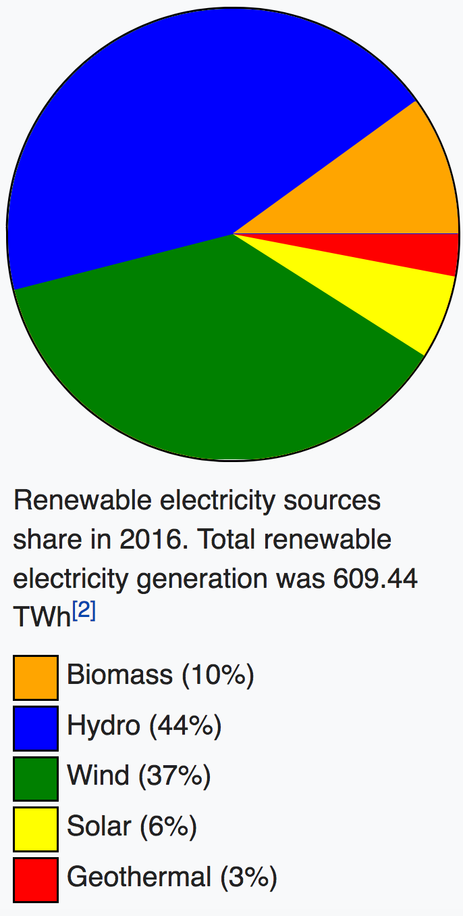
Hydroelectric Power
In this and the following note set we'll examine power from hydro and wind
These technologies have a lot in common:
- They both extract energy from flows
- They are the current U.S. renewable leaders:
Hydroelectric = 44% of renewables
Wind = 37% of renewables
(US Energy Information Administration 2016)
Figure source: en.wikipedia.org/wiki/Renewable_energy_in_the_United_States
Original data source: https://www.eia.gov/totalenergy/data/monthly/
U.S. Electricity Sources
(renewable only)

Slide 3
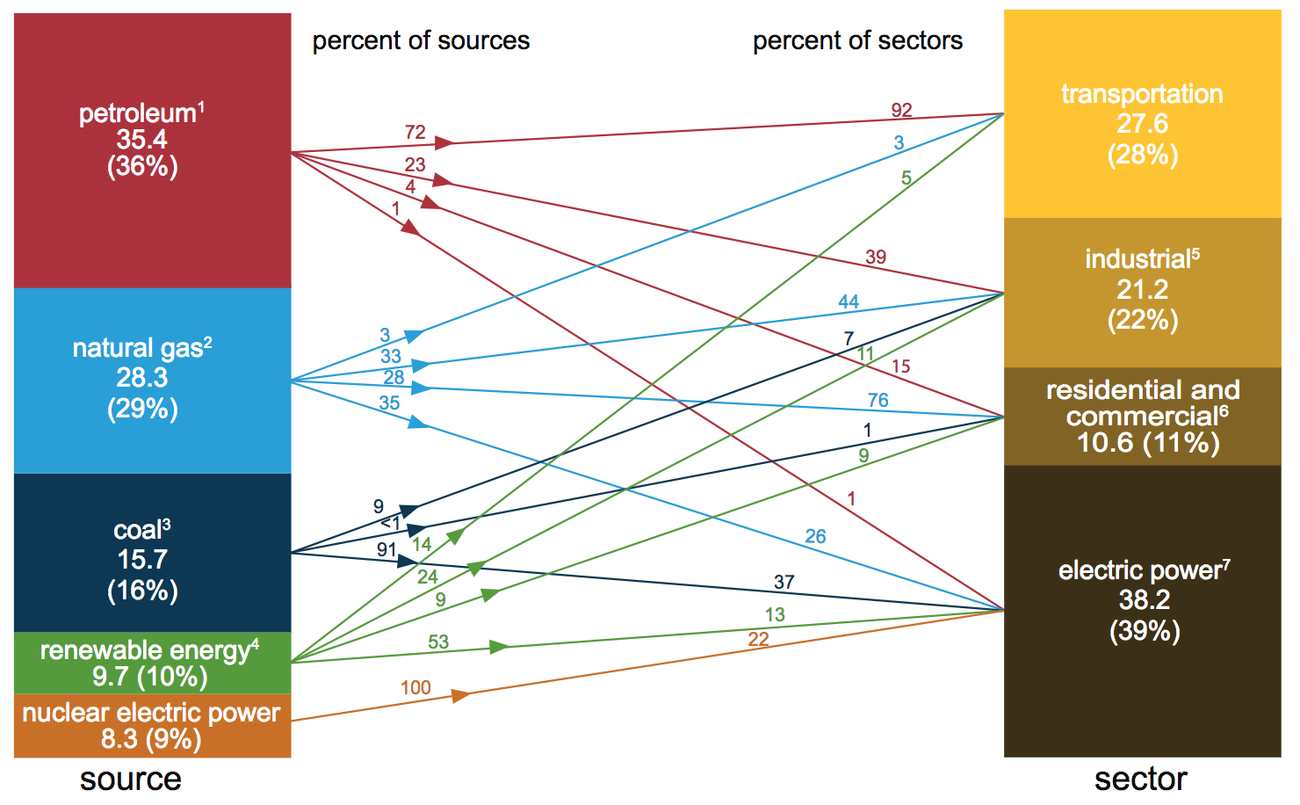
But those "renewable only" numbers must be put into perspective:
Also from the U.S. Energy Information Administration, for 2015: ¹
TOTAL Renewable Electric Power = 13%
Hydro = 44% of 13% = 5.72% of U.S. Electric Power TOTALING ONLY
Wind power = 37% of 13% = 4.81% of U.S. Electric Power 10.5% OF US POWER
2016 EIA documents cited in U.S. Production & Consumption (pptx / pdf / key) notes
indicated that the hydro + wind total grew to 11.86% a year later
Contribution to Electric Power
ALL Renewables
1) https://www.eia.gov/totalenergy/data/monthly/pdf/flow/css_2015_energy.pdf

Slide 4
Even at those disappointingly small percentages:
Hydro, at 6.3% of U.S. electrical power in 2016, still qualified as our
2nd biggest low-carbon-footprint power source (behind only nuclear at 19.7%) ¹
(Hydro's low-carbon-footprint claim will be re-examined later in this note set)
Moreover, along with nuclear, hydroelectric plants are the largest U.S. plants ²
With many dams producing 2-3 GW (and Grand Coulee reaching ~ 7 GW)
Vs. 1-2 GW per typical nuclear plant site (often consisting of two reactors)
Vs. ~ 0.6 GW typical for fossil fuel plants
Finally, effectively alone among U.S. electrical power sources,
hydroelectric power can be quickly, easily and economically
ramped up or down to meet immediate electrical power demand
Which greatly mitigates the Grid's need for separate energy storage
And/or the need for "base load" vs. "peak load" power plant technologies
1) These numbers are from my U.S. Energy Production and Consumption note set
2) https://en.wikipedia.org/wiki/Hydroelectric_power_in_the_United_States

Slide 5
You'd think such attributes would make hydro a "go to" source of power
But instead, hydroelectricity is more: "Black sheep" / "He who must not be named"
For instance, I own a dozen textbooks with titles incorporating phrases such as:
"Sustainable Energy"
"Energy & the Environment"
"Environmental Engineering"
"Energy Systems Engineering"
"Engineering & the Environment"
"Design of Renewable Energy Systems"
"Energy Use and the Environment"
NOT ONE of those textbooks has a full chapter about hydroelectricity
Many have only a couple of pages
Most have only a few paragraphs
I'll thus try to explain BOTH hydropower technology AND its current predicament
Because, I fear we may not have luxury of taking ANY technology off the table!

Slide 6
The Science of Hydroelectricity: It's all about gravitational potential energy
At least if we suppress extraneous losses due due to water turbulence
Which we can do by using smooth pipes (rather than splashy waterfalls)
Then, the energy lost by water flow over a dam = its gravitational potential energy:
E_{gravity} = M g h g = Surface gravity = 9.8 m / s²
h = height But measured from where?
We don't need to know because only the change in height is important
Δ E_{gravity} = M g Δh Then, using water's density (ρ_{water}) of 1 Mg/m³
Energy_density = ρ_{water} g Δh = (1 Mg/m³)(9.8 m/s²) Δh = 9.8 (kilo-Joules/m⁴) Δh
Multiplying this by the water's flow (in units of volume per time)
We find that for water falling over a dam of height Δh (using 1 kJ = 1 kW-sec):c
P_{hydro} = 9.8 (kW-sec / m⁴) x Flow x Δh

Slide 7
The first common hydropower technology = "Conventional"
Conventional = River + Large Dam + Large Reservoir
Which I'll represent as (editing out the surrounding valley & going for essentials):
Dam: Tall vertical concrete structure OR
much broader earth/rock fill structure
Reservoir (trapped in valley/basin)
extending for miles to dozens of miles
Pipes or tunnels (called Penstocks)
routing water from reservoir to "Power House"
Power House with generators
(which MUST to be below the dam)

Slide 8
What about those water tunnels/penstocks?
In many cases they don't pass THORUGH body of dam (which could weaken it)
But their inlet height IS important. For instance, if inlet is too low in reservoir:
Over a dam's long life (100+ years) sediment can accumulate in the reservoir:
Blocking flow to Power House!
An Introduction to Sustainable Energy Systems: WeCanFigureThisOut.org/ENERGY/Energy_home.htm

Slide 9
On the other hand:
If inlets are too HIGH in reservoir:
In a bad year the surface of reservoir may fall below inlets:
Reservoirs are sized to cope with low rainfall seasons within a given year
and even with the occasional entirely dry year
Better lower this opening!

Slide 10
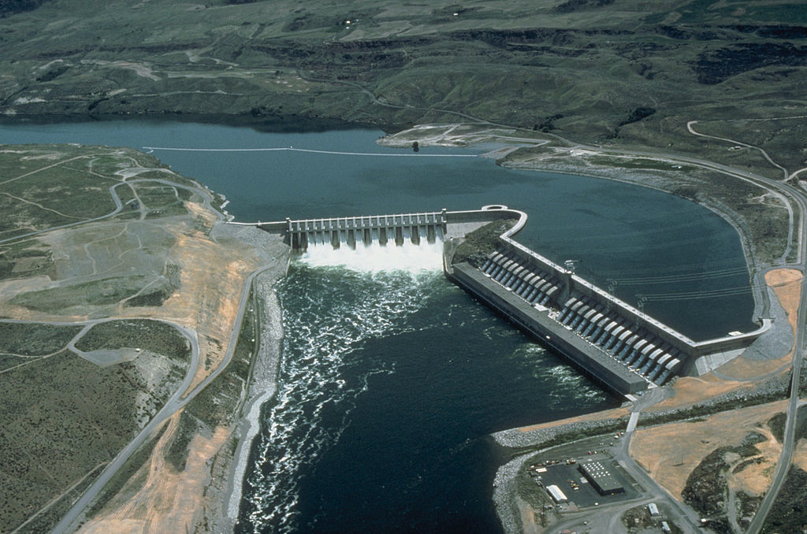
The second common hydropower technology = "Run of the River" (ROR)
Run of the River = River + Minimal Dam + Minimal Reservoir
The name suggests something like this (right out of the 1800's):
There ARE dams, but they are comparatively low, capturing only a limited reservoir
As seen here at the Columbia River's Chief Joseph ROR hydroelectric dam:
Photo: http://upload.wikimedia.org/wikipedia/commons/thumb/6/6c/Chief_Joseph_Dam.jpg/1024px-Chief_Joseph_Dam.jpg

Slide 11
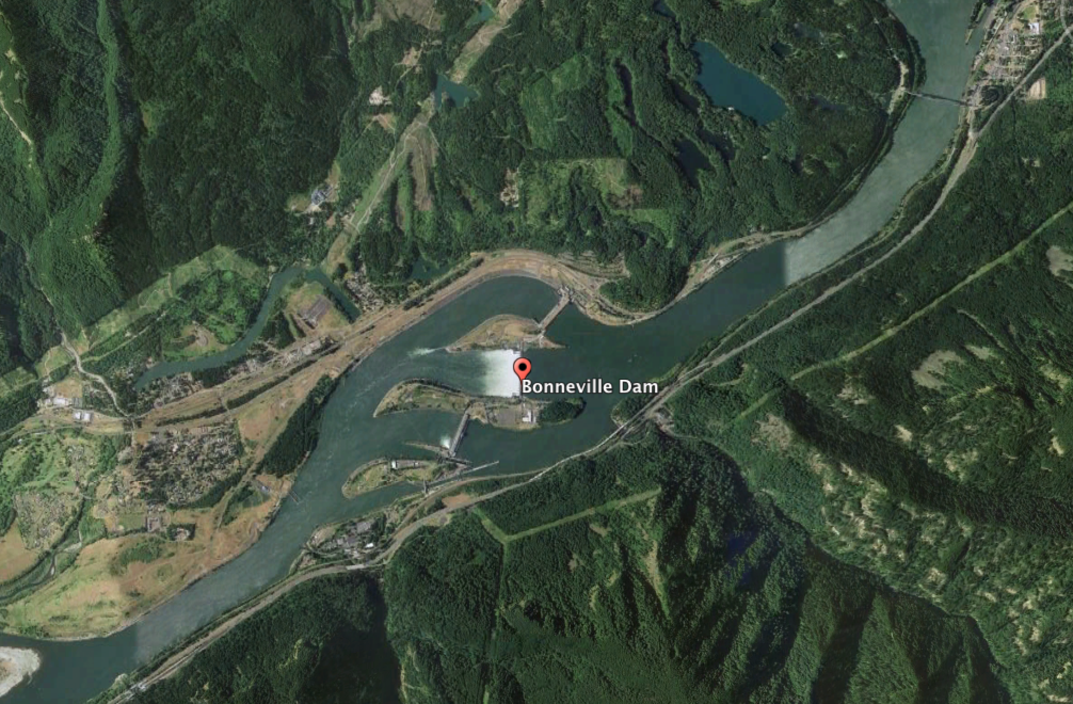
Minimal ROR reservoir size is also evident in this Google Earth photo:
Which is of another Columbia River ROR dam, at Bonneville
Its reservoir is so small that it's hard to tell which side of the dam is upriver
Only the foam gives it away: The river is flowing right to left
The Columbia is ideal for ROR dams in that while surrounding countryside is ~ flat,
a massive prehistoric flood produced a narrow steep-walled canyon,
which now funnels a reliably snow & rainfall-driven Northwestern river

Slide 12
Confined & reliable flows boost the hydropower equation's first variable:
P_{hydro} = 9.8 (kW-sec / m⁴) x Flow x Δheight
U.S. hydroelectricity is very strongly focused upon high flows
As achieved in conventional dams holding back massive reservoirs
Which were often marketed based on their added recreational attributes
As was the case for both Lake Mead and Lake Powell in Arizona
Or as can be achieved for ROR dams spanning large, reliable, high-flow rivers
But ROR's can cost less and have less environmental impact than conventional dams:
- Affecting a much smaller area
- Impacting rivers more lightly (e.g., by enabling bypass "fish ladders")
And ROR power can be quite large, as with the Columbia's
Grand Coulee (6.8 GW), Chief Joseph (2.6 GW), and The Dalles (2 GW) dams
Grand Coulee is in fact our #1 U.S. hydroelectricity producer!

Slide 13
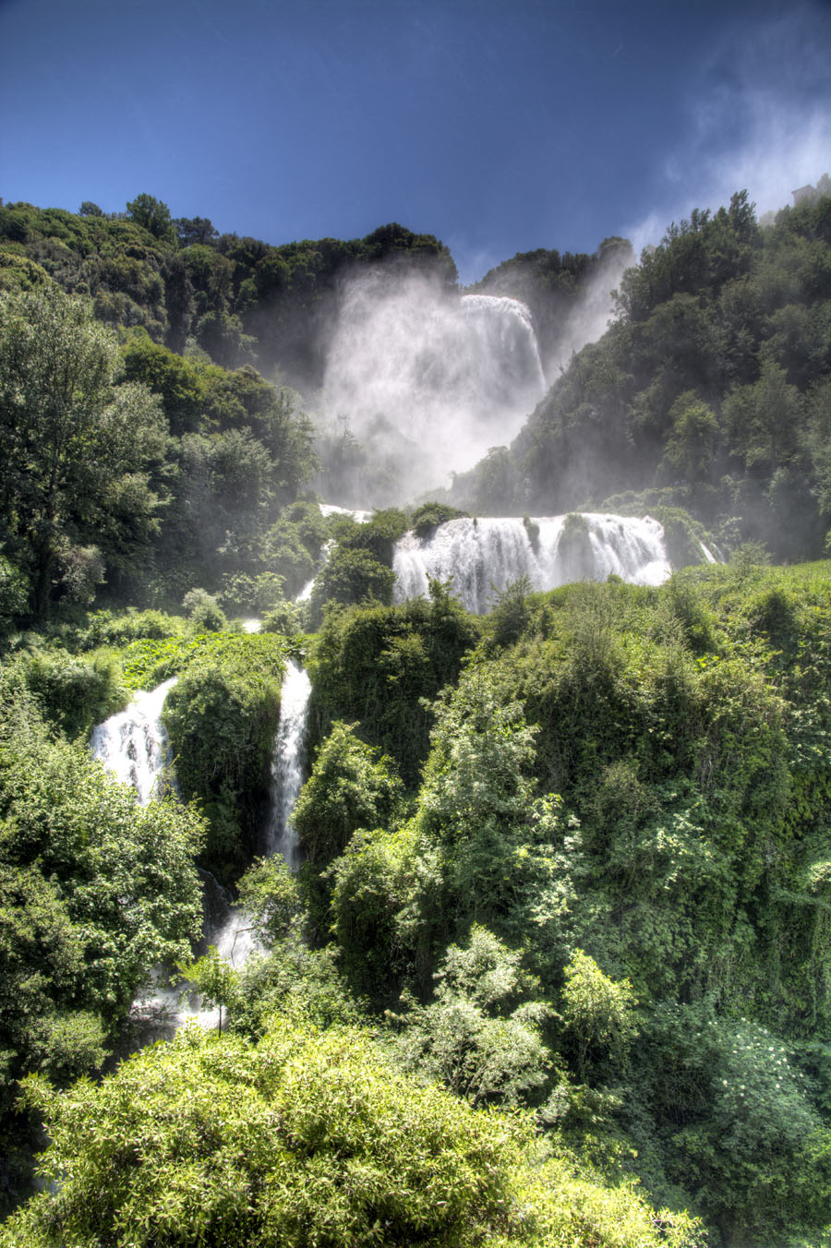
But in the mountains, Europeans often work the equation differently:
By opting, instead, to emphasize a ROR's second variable:
P_{hydro} = 9.8 (kW-sec / m⁴) x Flow x Δheight
Here, for instance, is a particularly picturesque ROR hydropower plant
that I photographed during a visit to Italy:
OK, so this wasn't quite the COMPLETE plant!

Slide 14
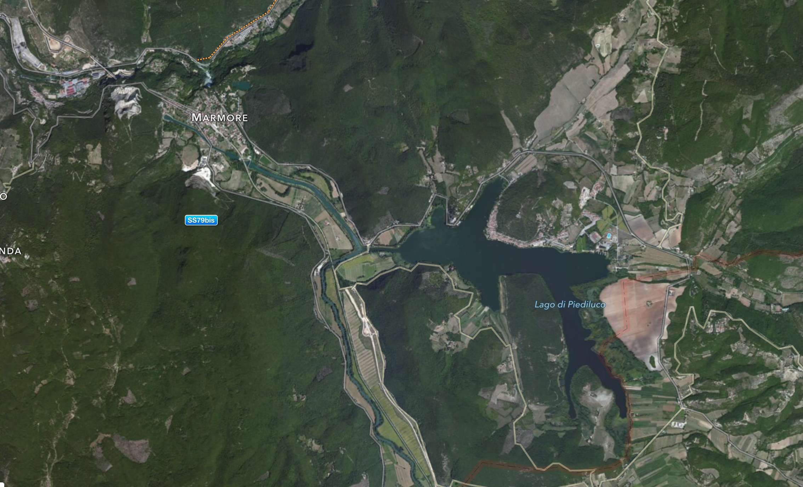
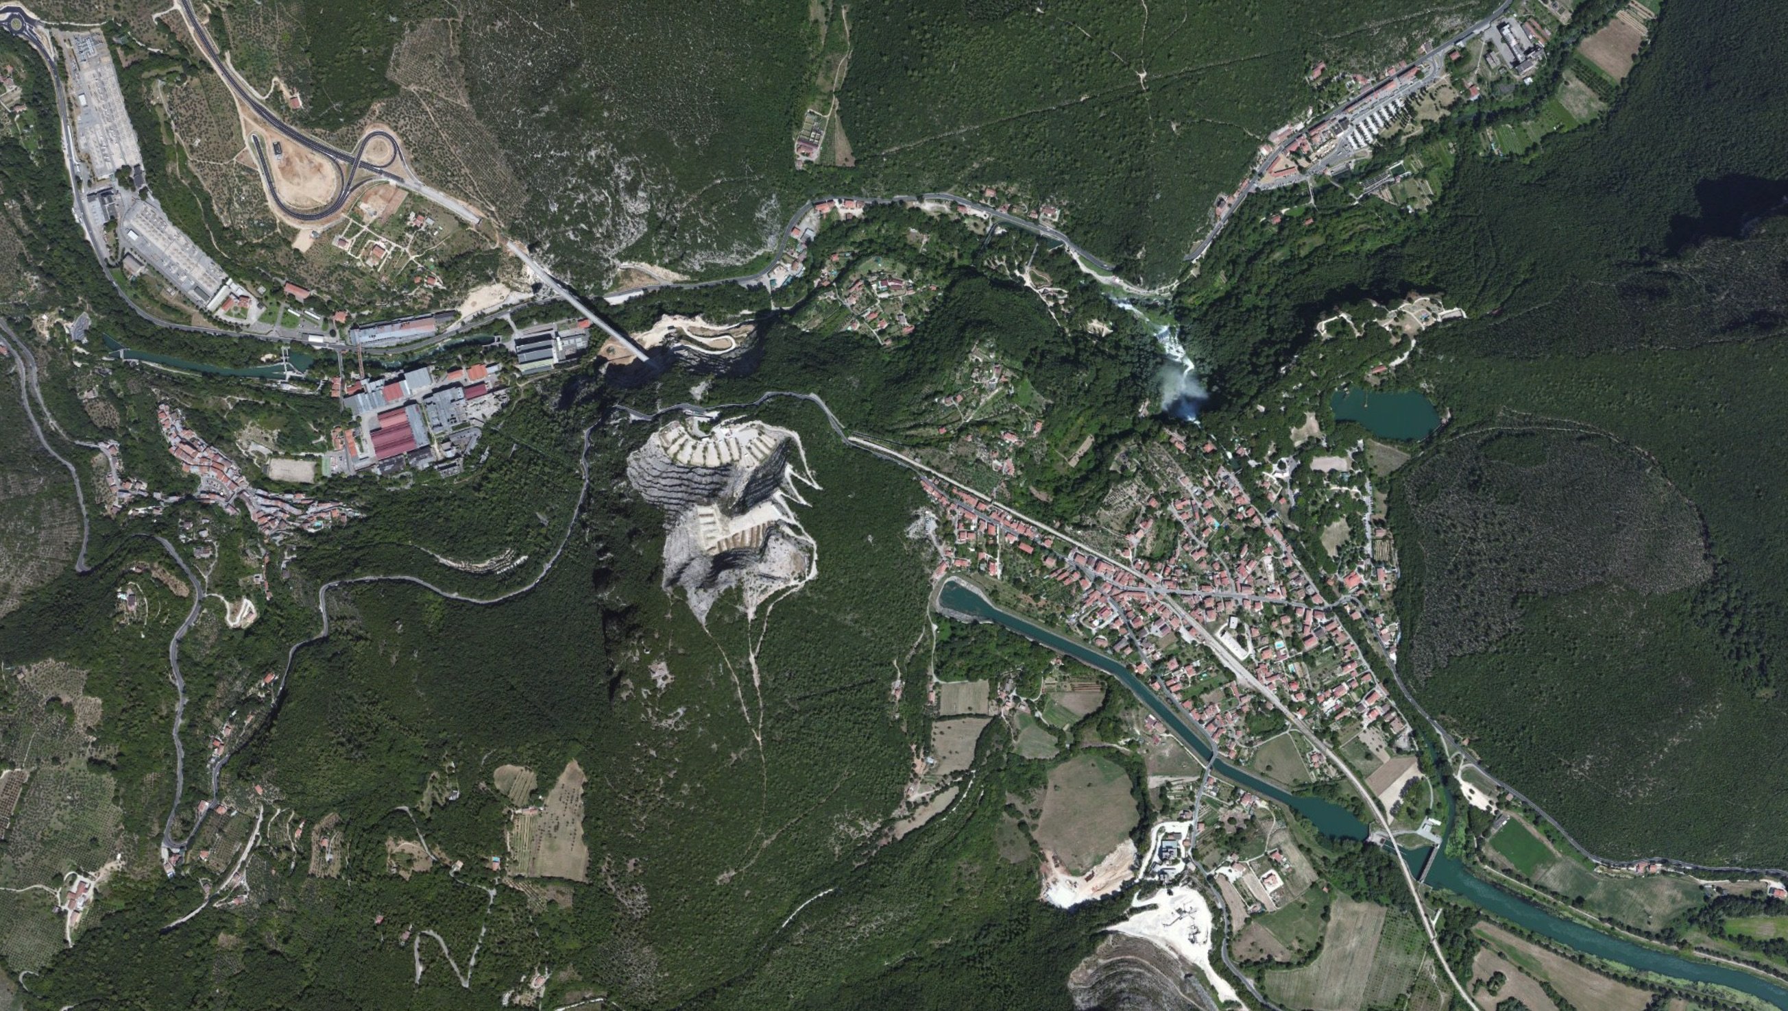
Satellite photos of the COMPLETE plant:
Located at the "Cascata delle Marmore"
Near Terni, in Umbria (central) Italy
It has essentially no dam
It has only a small lake
Its key engineering was done in 271 BC:
When Roman engineers diverted water
from a marshy / malarial plateau
over a cliff into an adjacent valley
Photos: Apple Maps

Slide 15
Looking more closely:
4) The power plant's generator house
3) Penstock (tunnel) descending 165 meters down from the plateau
1) Roman channel & waterfall
(the Cascata delle Marmore)
2) Modern (1929) diversion stream
Plus: Modern switchable floodgate
Photos: Apple Maps

Slide 16
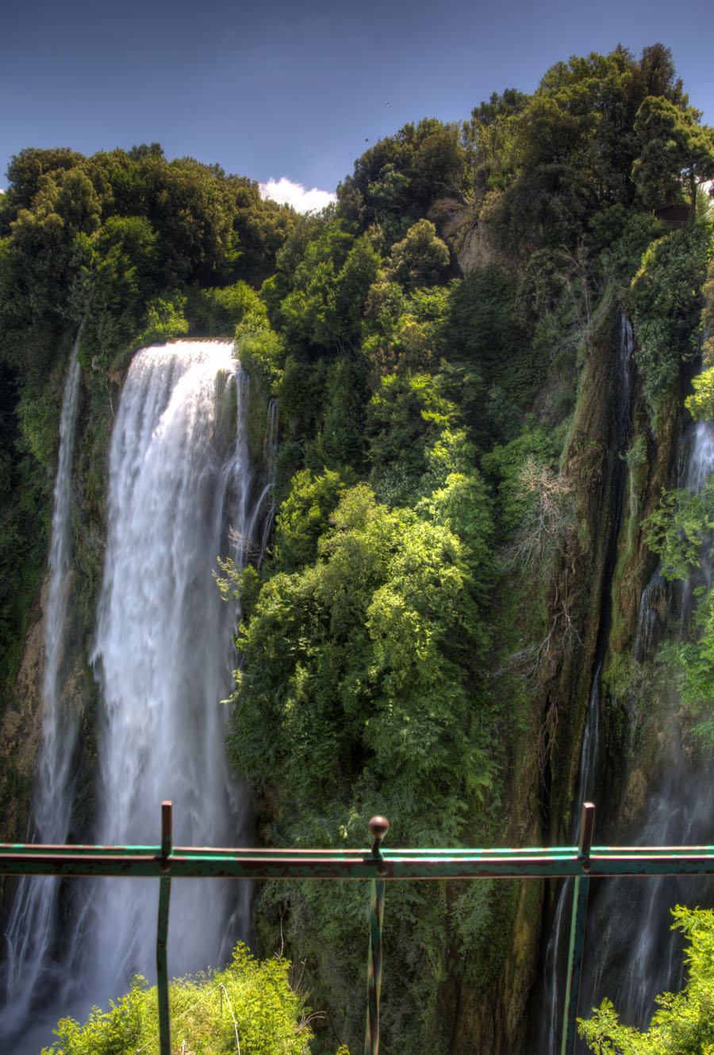
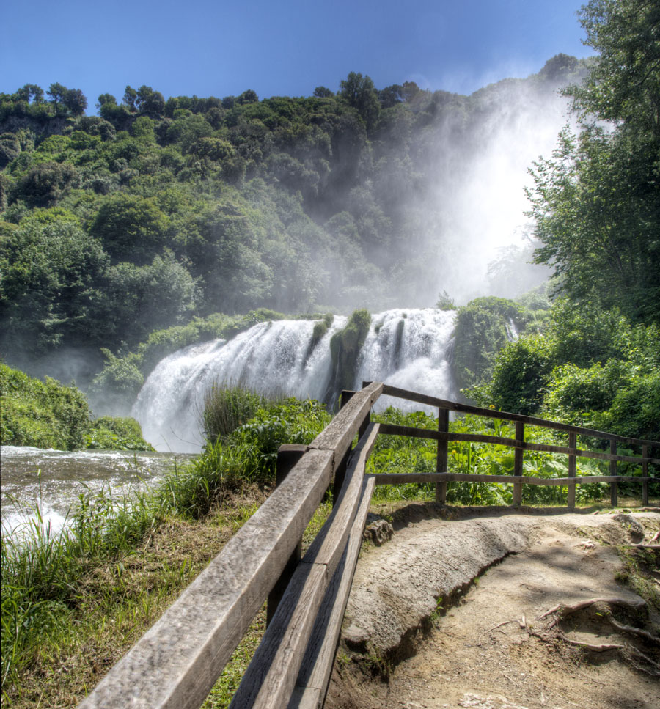
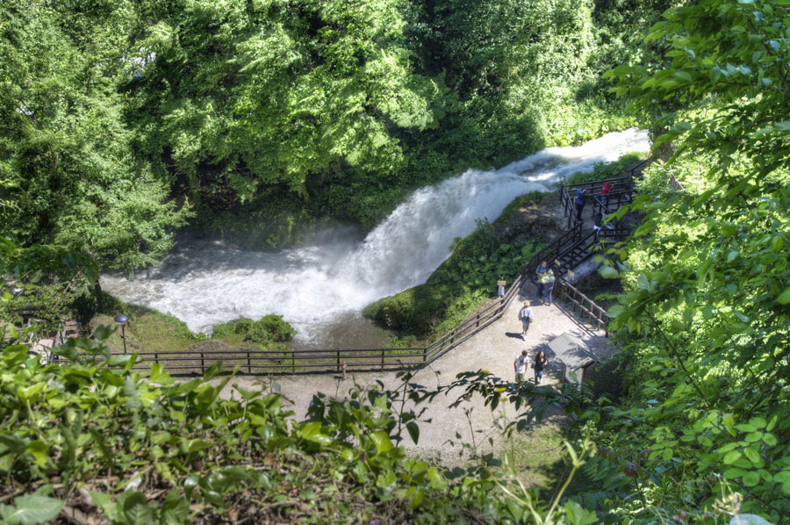
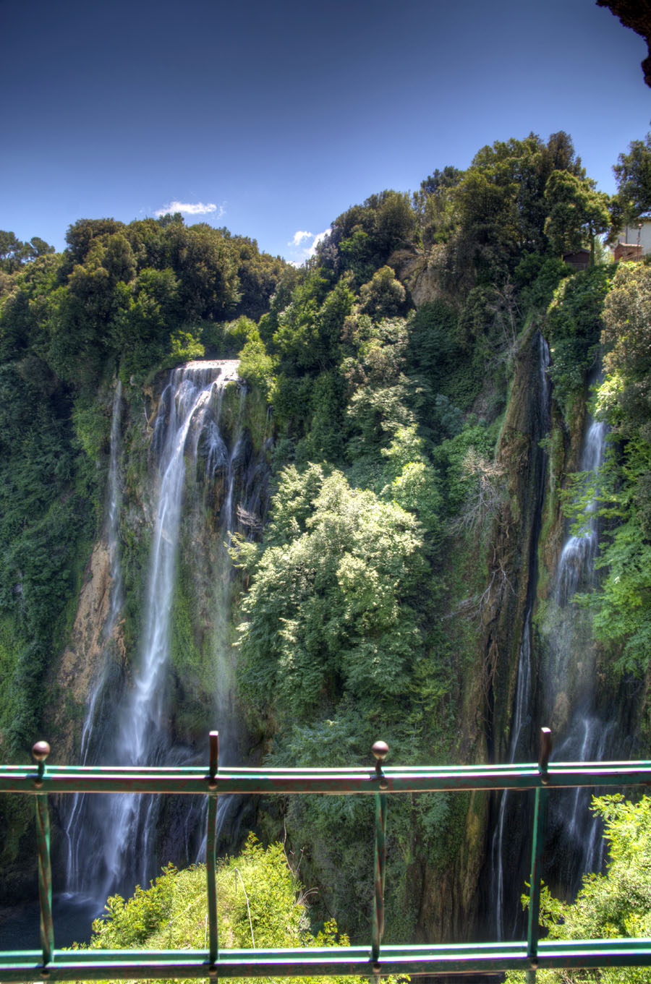
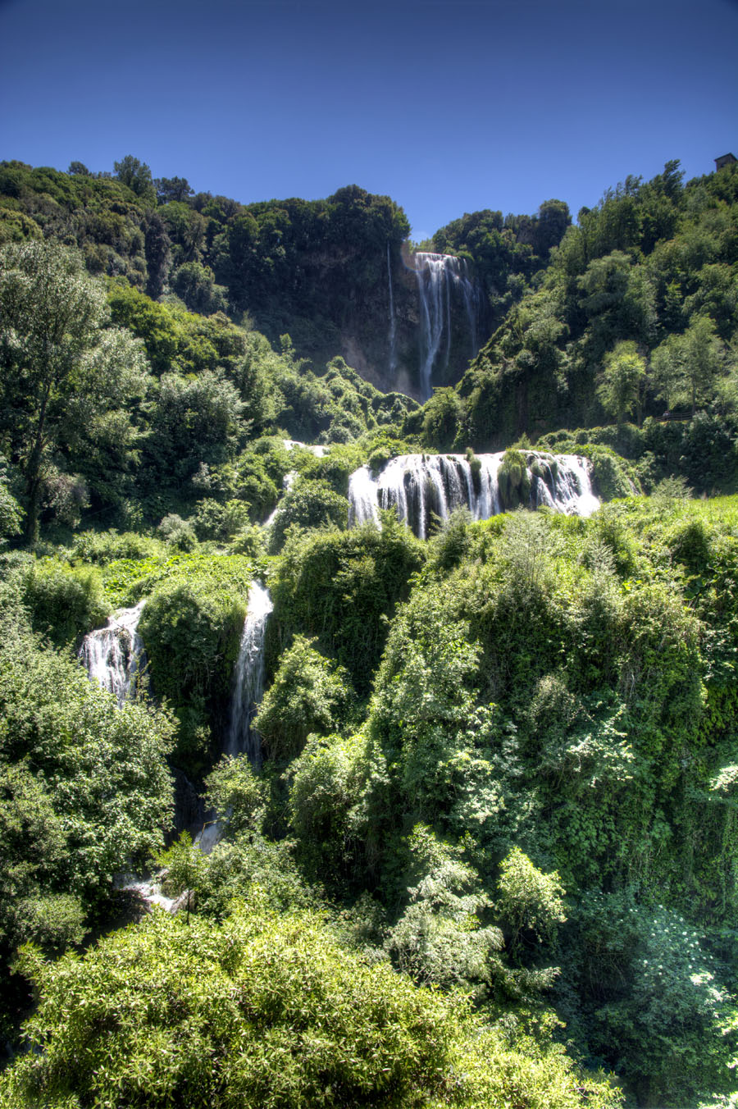
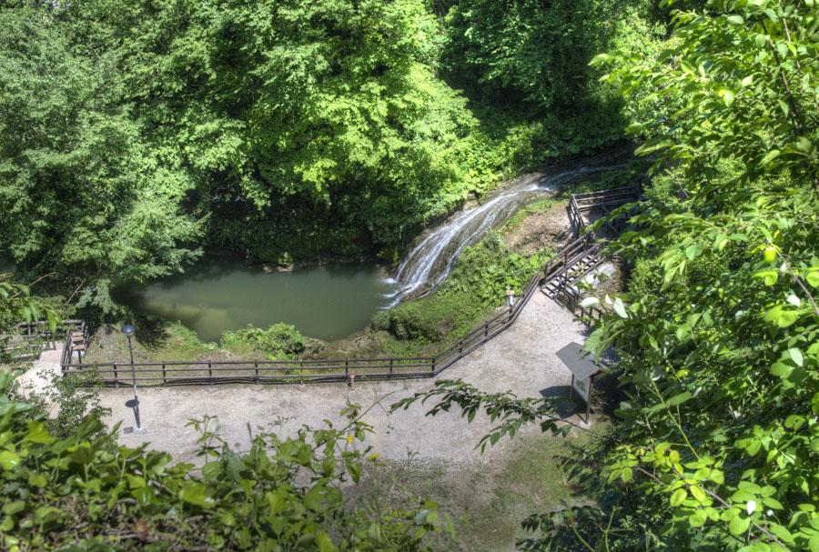
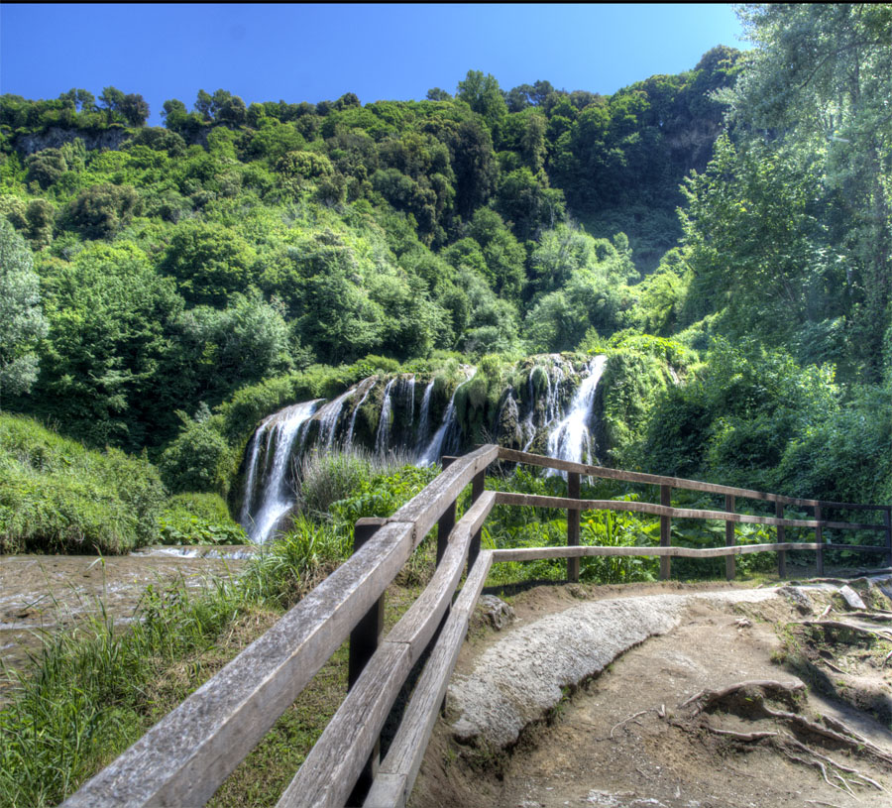
Why the floodgate / switch?
Because this ROR power plant is shut down two hours every day (at noon and 5pm),
restoring flow over the 165 meter Cascata delle Marmore,
so that it can be photographed by tourists
On!
On this note set's Resources webpage:
My movie of the full cascade turning on to off
Off!
Photos: John C. Bean

Slide 17
The bottom lines for this ROR plant (and ROR's in general)?
Exploiting hydropower's uniquely quick + economic up/down throttling,
this picturesque ROR power plant (even with twice daily one-hour shutdowns),
makes excellent use of its large plateau-to-valley drop of 165 m (541 feet)
to produce up to 527 MW of electrical power
Which IS substantially less than the Columbia River's ROR powers of 1-7 GW,
but which still makes it a very respectable regional power plant,
and one with stunningly low environmental impact!
Yes, RORs are vulnerable to precipitation cycles due to their lower water storage
Raising the possibility of shutdowns in drought seasons or drought years
But given their sustainability + minimal environmental impact,
might these be considered for our (or Canada's) steep western mountains?

Slide 18
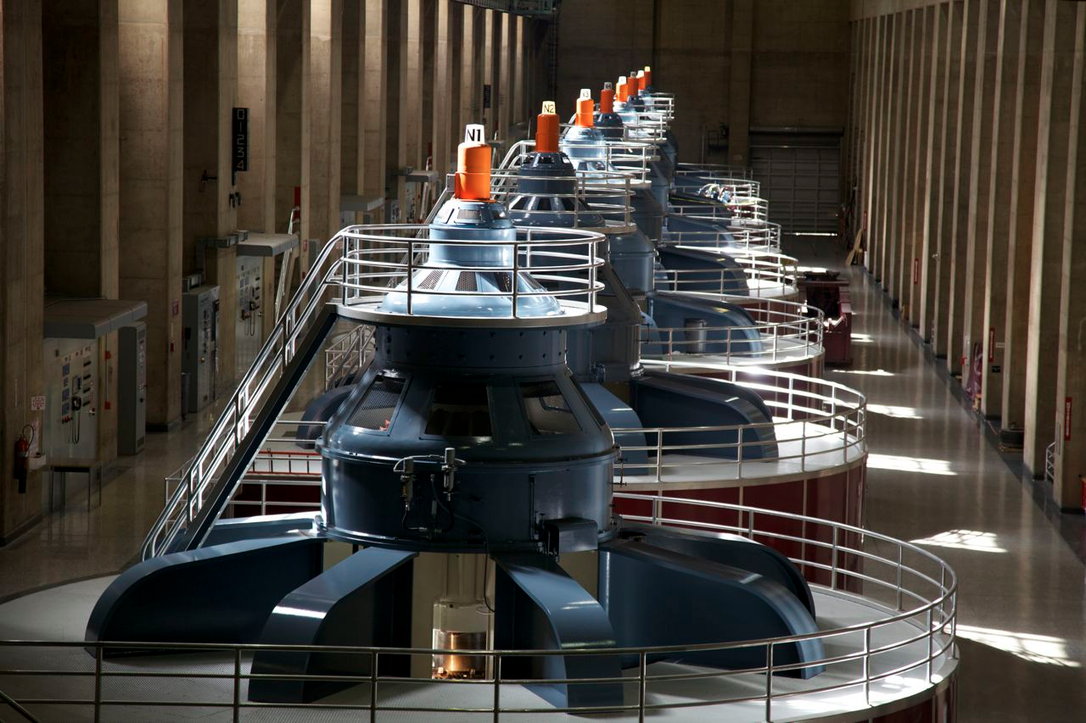
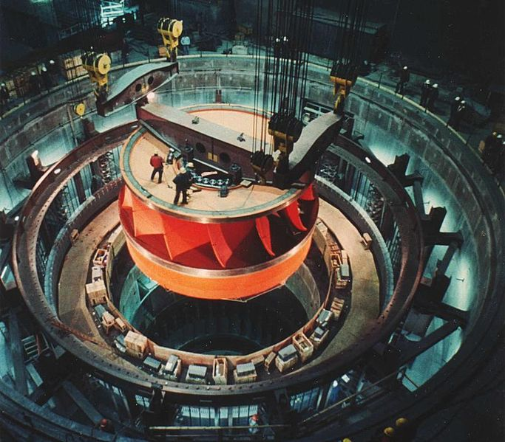
Common features of Conventional AND ROR dams:
Despite differences in dam size, both exploit water's gravitational potential energy
Water is driven by gravity downward into power houses at the base of the dam
Where it turns huge turbine generators
Such as these at the Hoover and Grand Coulee Dams
https://beautifulbrandnewday.wordpress.com/tag/colorado-river/
http://upload.wikimedia.org/wikipedia/commons/thumb/a/a7/Water_turbine_grandcoulee.jpg/683px-Water_turbine_grandcoulee.jpg

Slide 19
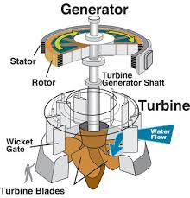
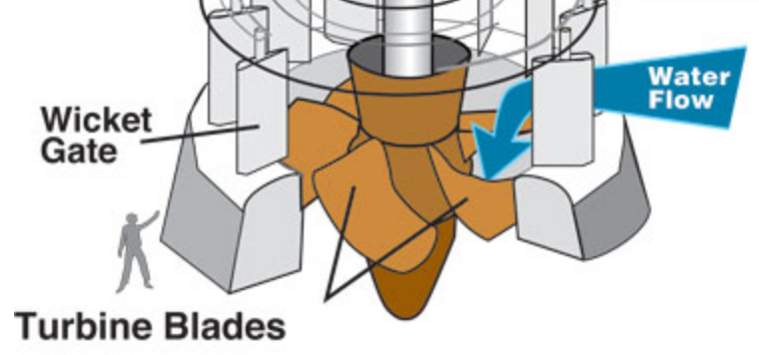
The layout of a hydroelectric turbine generator:
http://water.usgs.gov/edu/hyhowworks.html
With a conventional propeller, air or water flow parallel to the axis of the propeller
In a hydroelectric turbine water instead wraps around it (for ~ one turn)
It is thus more like pushing your way through a revolving door
But passing through a revolving door, you push much harder as you first enter
To maximize power extraction, we want water to push HARD all the way around
So in modern turbines the water passage narrows as it loops around
Which maintains the pressure and force on the turbine around the loop

Slide 20
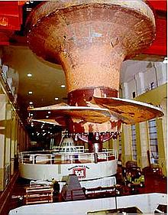
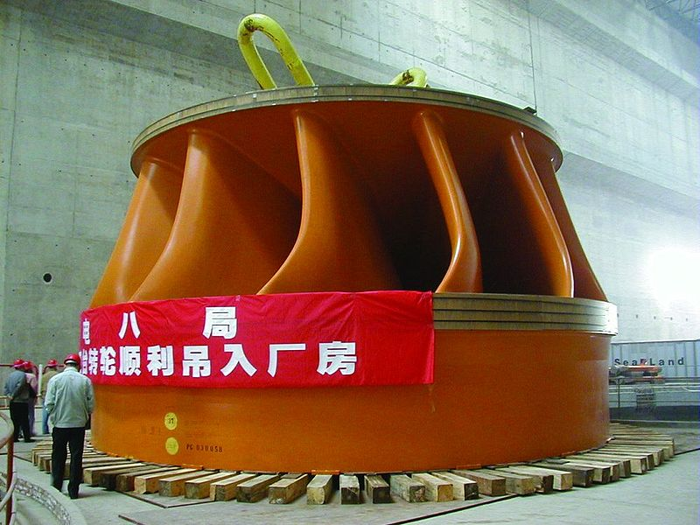
Turbines can take different forms
Specific types (older to newer):
Pelton wheel: Kaplan turbine: Francis Turbine:
Larger more modern hydroelectric plants tend to use huge Francis turbines
which can increase power conversion efficiencies from 90% up to 95% ¹
Three Gorges Dam
http://en.wikipedia.org/wiki/Francis_turbine
In a German Museum
http://en.wikipedia.org/wiki/Pelton_wheel
Bonneville Dam
http://en.wikipedia.org/wiki/Kaplan_turbine
1) http://www.mpoweruk.com/hydro_power.htm

Slide 21
But thinking back to my Magnetic Induction note set:
In these generators, BOTH the stator and rotor are electromagnets
With the rotor receiving DC current via two slip rings
So there MUST be DC INPUT power for the rotation to produce OUTPUT power!
Further, we want AC output at EXACTLY 60 Hz (within ~ 0.1%) and 110-120 Volts
But more water flow / pressure => Higher speed / frequency / power out
Suggesting that water flow & pressure must be very tightly regulated

Slide 22
Flow and pressure ARE critical, but it gets even trickier:
Higher flow / pressure will drive turbine generator to higher speed / output
On the other hand, higher load (use of its power) will slow a generator down
(Probably why its called a "load" in the first place)
So frequency control now involves flow + pressure + load = Ouch!
But now we get a strange break: Electrical generators also act as electric motors
And MANY generator/motors are working together to power the Grid
Imagine our generator just "came on line" and is struggling to get up to speed
If its speed is too low, it sucks power from the Grid
Yes! it will then instead act like a motor:
And be bootstrapped up to full speed BY THE GRID!

Slide 23
And if, at some point our generator then starts spinning too fast:
Which would lead it to try and put out higher frequency, voltage and power
IT would then end up POWERING all the other Grid generators
Which, now acting like motors, would present a huge load to our generator
Which would tend to slow our generator back down
The end result: A form of "consensus management" helping to synchronize the Grid
Which is both good news & bad news:
Because, via tight coupling, the Grid tends to work and crash as single unit ¹
Bottom line for hydroelectric generators?
90-95% of water's gravitational potential energy is converted to electrical power
far exceeding the efficiency of any other type of electrical power plant
1) An excellent textbook on the Grid: Electric Power Systems – A Conceptual Introduction, by Alexandra von Meier

Slide 24
The 3rd (less common) hydro technology = Pumped Storage Hydro (PSH)
Which I'll represent as:
Small dam and reservoir
Lake/River With a "Power House" that actually alternates between:
Using power to pump water up the hill
Generating power from water falling back down the hill
It's a whole different animal, built for the purpose of STORING ENERGY
Specifically, for storing energy (generated elsewhere) overnight
When our then mostly sleeping population uses less energy
And then releasing that energy the next day when our demand again rises

Slide 25
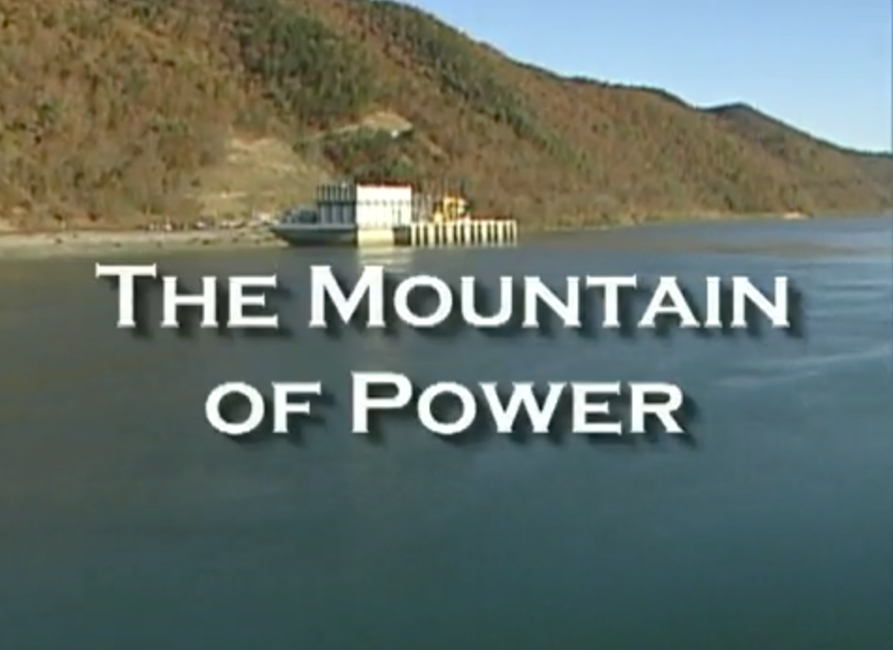
Dominion Power Corp's film about the Bath VA Pumped Storage Hydro Plant:
Cached copy of that film on this note set's Resources webpage (9 minutes): Link
Once found via: https://www.dom.com/about/stations/hydro/bath-county-pumped-storage-station.jsp
An Introduction to Sustainable Energy Systems: WeCanFigureThisOut.org/ENERGY/Energy_home.htm

Slide 26
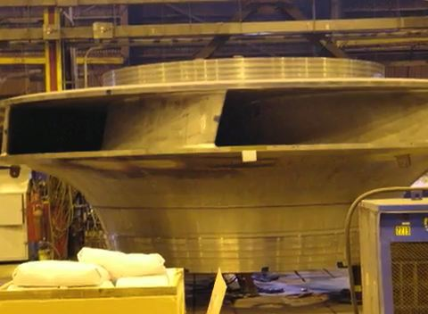
Energy storage efficiency (energy out / energy in) for a PSH plant?
Various sources cite efficiencies from 70% ¹ to 85% ²
I trust the U.S. National Renewable Energy Lab's number: 80% 3
Why is it so low? Because it's a round trip efficiency involving two conversions:
1) Electricity to potential energy conversion as water is pumped UP the hill
2) Potential energy to electricity conversion when it comes back DOWN the hill
If each conversion is 90% efficient, the "round trip" efficiency = (0.9)² ~ 80%
A PSH turbine moving (in parts) for assembly at the Bath VA PSH site: ⁴
1) The Economist: www.economist.com/node/21548495?frsc=dg|a)
2) European Commission: https://setis.ec.europa.eu/setis-reports/setis-magazine/power-storage/europe-experience-pumped-storage-boom
3) NREL: www.nrel.gov/docs/fy14osti/60806.pdf 4) https://www.dom.com/about/stations/hydro/bath-county-pumped-storage-station.jsp

Slide 27
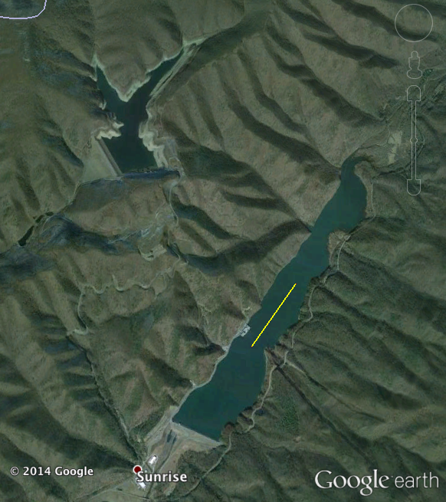
Key differences between PSH and all other types of hydroelectric power:
PSH's goal to STORE energy that was originally SOURCED elsewhere
Including, possibly, from a distant Conventional or ROR hydroelectric plant
A PSH can thus operate with a fixed, very limited amount of water
Which is just shuttled up and down repeatedly
between its two reservoirs
As seen here at the Bath VA PSH plant for which:
There are only two rather small reservoirs
There is no incoming / outgoing river
(OK, there's a small creek entering upper right)
Upper Reservoir
Lower Reservoir
1 km

Slide 28
But quantification of energy storage then runs into a recurring problem:
A failure to distinguish between Energy and Energy Flow (= Power)
We generally want to store as much ENERGY as possible
That energy capacity is measured in energy units such as a
Joule or its equivalent, a Watt-second, or as its multiple
of a kilo-Watt-hour (kW-h) = 1000 x W x 3600 s = 3.6x10⁶ Joules
PSH energy capacity is the gravitational potential energy of water transferred
= Mass_{water} x g x Δ height (g = earth's surface gravity = 9.8 m/s²)
We may also need to release that energy at a certain rate = POWER
Which has the unit of Watts, or its multiples of kW, MW or GW
PSH power depends the speed of water transfer between its two reservoirs
Which is limited by the size of its connecting piping (penstocks)
and the size of its turbine pump/generators

Slide 29
PSH energy storage capacity and discharge power are thus unrelated!
Reservoir size & separation => Energy storage capacity
Piping & turbine size => Energy discharge rate (= power)
But the press & power companies discuss ONLY discharge power!
To demonstrate why that missing energy capacity is important, consider this scenario:
I am offered a cheap personal mini PSH that can produce "1 MW of Power"
Fantastic! I'll put solar cells on my roof and cut my connection to the grid!
But is this enough? What if that 1 MW level can only be maintained for 1 second?
That would imply that this mini PSH has an energy storage capacity of:
1 MW-second = 10⁶ W-s = (10⁶ / 1000 x 3600) kW-h = 0.28 kW-h
Say I extract its energy more slowly to cook dinner in my 1500 W toaster oven
It could then cook for (0.27 kW-h) / (1.5 kW) = 0.19 h = 11 minutes
A quick dinner (alone) would thus wipe out my overnight energy!

Slide 30
A more serious analysis of Bath Virginia's "largest PSH in the world"
A claim that Wikipedia bases on only its "3000 MW capacity" ¹
= The same number cited by its co-owner, Dominion Power ²
But HOW MUCH ENERGY DOES IT STORE?
Neither Wikipedia nor Dominion bother to tell us (a rather significant oversight!)
We are instead left to mine various documents for additional information
The Dominion Bath County Pumped Storage Station information sheet says: ²
The upper Reservoir has 265 surface acres & its level fluctuates 105 feet
An earlier (now missing) Dominion web post once told me that: ³
The upper reservoir is "1262 feet higher" than the lower reservoir
From which WeCanFigureItOut:
1) https://en.wikipedia.org/wiki/Pumped-storage_hydroelectricity
2) https://www.dominionenergy.com/about-us/making-energy/renewables/water/bath-county-pumped-storage-station
3) https://www.dom.com/about/stations/hydro/bath-county-pumped-storage-station.jsp

Slide 31
Calculation of Bath Pumped Storage Hydro energy storage capacity:
Gravitational potential energy = M g Δh
M = mass of water moved between reservoirs
= 265 acres x 105 feet x density of water
= (1.07x10⁶ m²) x (32.0 m) x (1 Mg/m³) = 34.3 x10⁹ kg
With: g = 9.8 m/s² And: Δh = 1262 feet = 384.6 m
M g Δh = 34.3 x10⁹ kg x 9.8 m/s² x 384.6 m = 35.9 GW-h
When that water flows down, recreating electricity at ~ 90% conversion efficiency
Electrical energy output = 32.3 GW-h
The Bath PSH's discharge power of "3000 MW" (3 GW) could thus be sustained for:
(32.3 GW-h) / (3.0 GW) = 11 hours ~ twice as long as the evening demand peak
Suggesting that twice as many customers might be served
if discharge power were doubled by adding turbines & penstock piping!
Upper Reservoir
Lower Reservoir
1 km

Slide 32
The 4th (much less common) hydro technology: Tidal Barrage Along with its politically-driven (?) reincarnations as Tidal Lagoon or Offshore Lagoon
Ocean:
Dammed inlet or manmade basin:
Power as tide comes in
Power as tide goes out
Tidal Barrages (& lagoons) also extract energy from the gravity-driven flow of water
But the water is no longer the freshwater of falling rivers
It is instead the saltwater of rising and falling ocean tides
But the water flow will no longer be constant (or near constant)
And the water's height will cycle with the tides
Calling for a rather different computation of gravitational potential energy:
An Introduction to Sustainable Energy Systems: WeCanFigureThisOut.org/ENERGY/Energy_home.htm

Slide 33
Computing the power that might be extracted from a tidal cycle:
The Barrage is powered by water flowing through its turbines
But the ultimate source of that power is the gravitational potential energy
added to the water lifted into the Barrage by the incoming tide
That lifted water is upper right in this figure - which depicts a tide of height H:
The added water has mass: M = ρseawater x Area x H (ρseawater ⁼ 1029 kg / m³) ¹
Lifting increased that added volume's potential energy as: M g Δh
But while water at its surface rose by H
Water at its base rose by 0
Making for an average lift of Δh = H/2
The total potential energy added within the Barrage was thus:
Added Tidal Energy = M g Δh = (ρseawater x Area x H) g (H/2)
Rearranging: Added Tidal Energy = ρseawater g Area H² / 2
Area
H
H/2
0
1) https://en.wikipedia.org/wiki/Seawater

Slide 34
That much energy would be capturable over each tidal cycle
The average available tidal-driven power would thus be:
Power tidal = (Tidal Energy) / (Tidal Cycle Time)
For a typical tidal cycle time of ~ 12 hours = 43,200 seconds:
Power tidal = [ρseawater g Area H² / 2] / [Tidal Cycle Time]
= [(1029 kg / m³) (9.8 m / s²) Area H² / 2] / [43,200 s]
= 0.12 (kg / m² - s³) Area H²
Using the definition of a Watt: W = J / s = (kg m² / s²) / s = kg m² / s³ we then get:
Power tidal = 0.12 Watts / m⁴ x (Area x H²)
For a 1 km² Tidal Barrage with a worldwide average coastal tide ¹ of 2.5m:
Power tidal = 0.12 Watts / m⁴ x (10⁶ m² x 6.25 m²) = 0.75 MW
1) https://www.infoplease.com/encyclopedia/earth/geology-oceanography/info/tide/the-magnitude-and-effects-of-tidal-ranges

Slide 35
But there is also the "pumping trick"
As described in "Sustainable Energy without the Hot Air" by David J.C. MacKay:
Make your dam a bit TALLER than the high tide level, and add some pumps
At HIGH tide, pump extra water UP into reservoir (expending energy!)
At LOW tide that SAME water will fall a LARGER DISTANCE => More energy back!
Tide provided PART of the energy to get extra water up into reservoir
But YOU then get ALL the energy back
An Introduction to Sustainable Energy Systems: WeCanFigureThisOut.org/ENERGY/Energy_home.htm

Slide 36
With the new "pump trick" numbers work out as follows:
Say at (about) high tide, you pump water UP a further height b:
With pump efficiency = ε_{pump} and generator efficiency= ε_{generator}
That requires you to expend an energy:
E_{expended} = (1/ε_{pump}) M g height =(1/ε_{pump}) (ρ A b) g b = ρ g A b²/ε_{pump}
But then, at low tide, that water falls back not b but b + 2L:
E_{recovered} = ε_{generator} M g height = ε_{generator} (ρ A b) g (b + 2L)
Giving ratio of added power out to added power invested
Ratio out / in = (ε_{generator}ε_{pump}) (b + 2L)/b call ε_{generator}ε_{pump} = ε_{total}
If efficiencies were 1, ratio would always be better than 1 => net gain
For real efficiencies less than 1, ratio => 1 when b = 2L (ε_{total})/(1- ε_{total})

Slide 37
But you can also pump water OUT near low tide:
Putting this ALL together, "Sustainable Energy without the Hot Air" shows:
The net gain for "pump trick" is a "boost factor" of (ε_{total})/(1- ε_{total})
For ε_{total} ~ 0.76 (corresponding to pump and generator efficiencies of ~ 87%)
MacKay's book then generates this table (averaged over a full tidal cycle):
Tidal Half Optimum Power Power
Amplitude (L) Boost Height (b) with "pump trick" without "pump trick"
1 meter 6.5 meter 3.5 W/m² 0.8 W/m²
2 meter 13 meter 14 W/m² 3.3 W/m²
3 meter 20 meter 31 W/m² 7.4 W/m²
4 meter 26 meter 56 W/m² 13 W/m²
Col. 3 vs. Col. 4 = A rather substantial power enhancement
An Introduction to Sustainable Energy Systems: WeCanFigureThisOut.org/ENERGY/Energy_home.htm

Slide 38
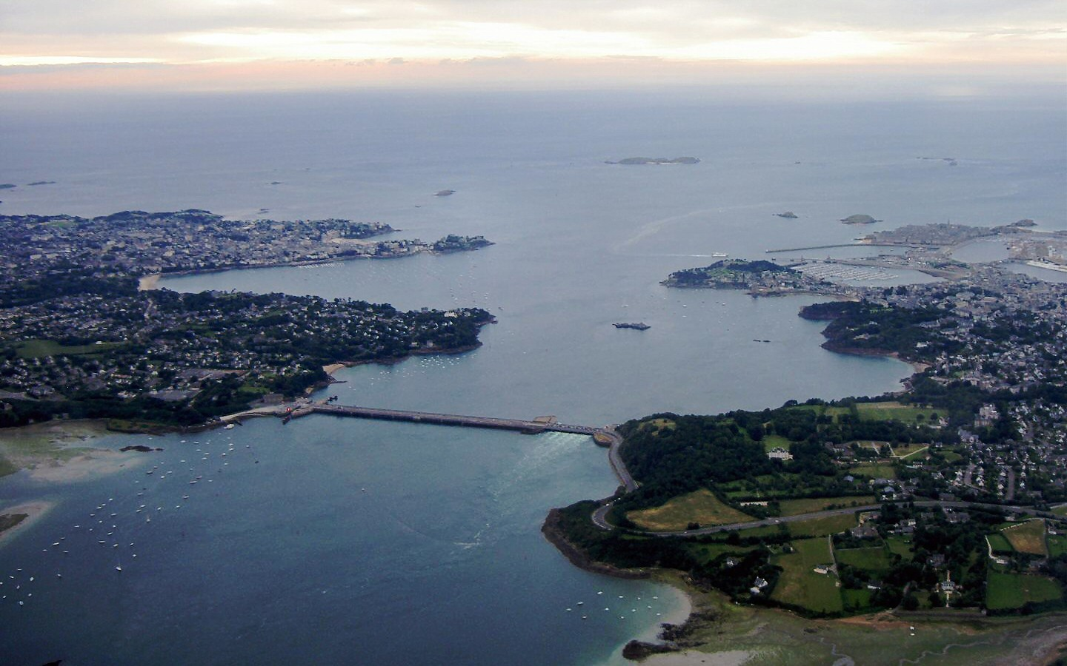
Real world Tidal Barrages?
We must BUILD those coastal reservoirs by damming up bays or estuaries
We thereby modify the ecological value of those coasts
E.G. the water-purification and animal-rearing value of coastal marshes
Barrages also impact coasts' visual, residential and leisure activity value
As they also impact their possible use as harbors or industrial sites
"Worlds First" tidal power station (1966)
La Rance River estuary, Brittany France:
Proponents cite its PEAK power: 240 MW
But its tide-cycle-averaged power is 57 MW
Meaning that La Rance Barrage power
= ~ 1/10th of an average U.S. power plant
http://en.wikipedia.org/wiki/Rance_Tidal_Power_Station

Slide 39
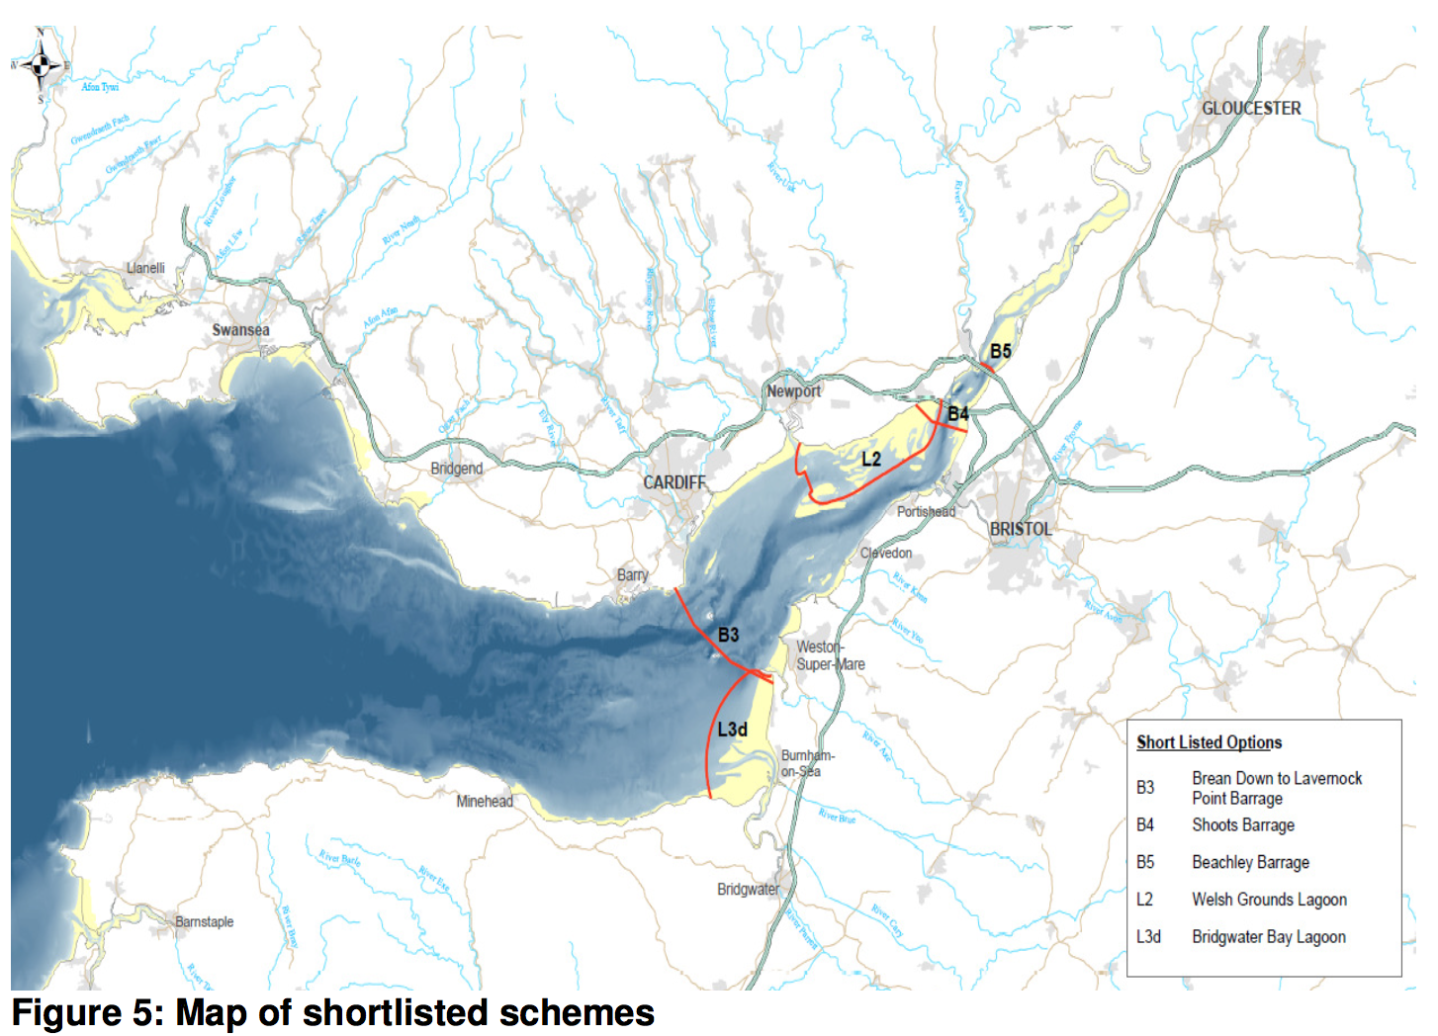
La Rance's low power production numbers have meant that:
Not only was it the largest Tidal Barrage when it was built in 1966
It is still the largest, almost sixty years later
Subsequent proposals have met fierce environmental & political criticism
as exemplified by Barrage proposals for the mouth of the U.K.'s Severn River:
Possible barrier dams ("barrages") indicated in red
From the U.K. Government's 2010:
Severn Tidal Power
Feasibility Study Conclusions and Summary Report
https://www.gov.uk/government/uploads/system/uploads/attachment_data/file/50064/1._Feasibility_Study_Conclusions_and_Summary_Report_-_15_Oct.pdf
(red annotations added)

Slide 40
The Severn controversy has raged for ~ twenty years
With government authorization & funding seemingly reversed ~ every 2 years
I have followed that debate via a long series of Guardian & BBC news articles
Some of which I include in this note set's Resources webpage
Plans to completely span the Severn River (3 of 5 plans on the preceding slide)
are now so TOXIC that supporters use a new name for non-spanning alternatives:
Tidal Lagoons (as differentiated in this figure from a recent review): ¹
Moving dams partially or totally offshore will mitigate river & estuary impact
But increased dam length & height will certainly mean sharply increased costs!
"Tidal Barrage"
"Tidal Lagoon"
"Offshore Lagoon"
1) http://www.mdpi.com/2411-5134/2/3/14

Slide 41
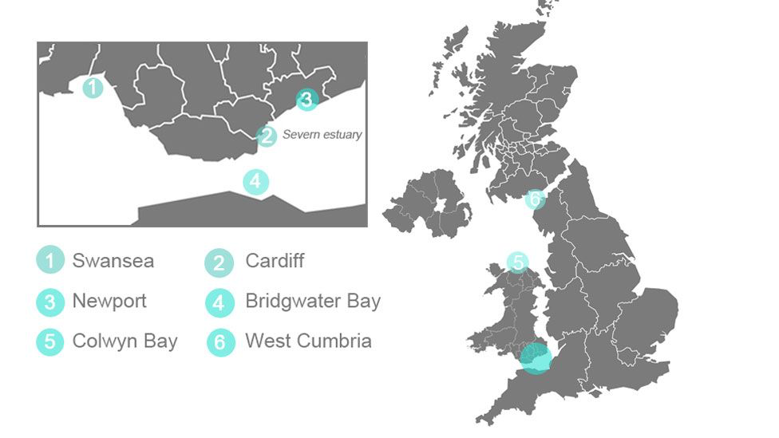
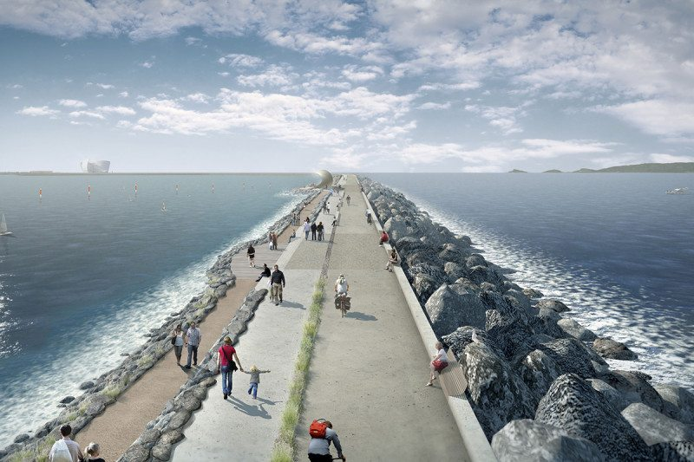
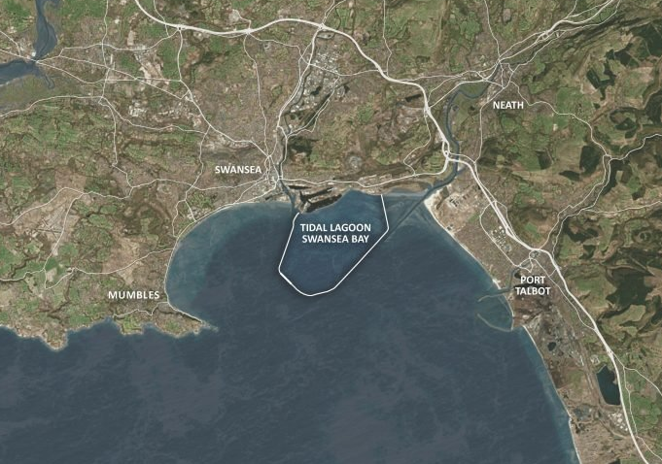
These "Tidal Lagoons" are now proposed for U.K shores:
http://www.bbc.com/news/uk-wales-38585627
The tidal lagoon vision/plan for Swansea:
Left: https://www.newscientist.com/article/2117792-uk-urged-to-push-ahead-with-world-first-tidal-lagoon-power-plant/
Right: http://www.tidallagoonpower.com/projects/swansea-bay/

Slide 42
Conclusions about tidal basin power – from private studies:
2004: "A Severn Barrage or Tidal Lagoons?" Friends of the Earth (page 2): ¹
"There are a large range of potential environmental and economic benefits and disbenefits associated with siting lagoons or the proposed Severn Barrage in the Estuary. However, initial comparisons strongly suggest that lagoons could be significantly less extensive and environmentally damaging and more cost effective and powerful than the Barrage. Lagoons would not directly impound the ecologically highly valuable inter-tidal areas of the Estuary. Indeed, lagoons may offer potentially significant wildlife habitat. Yet, lagoons would generate twice as much power per square mile impounded than the Barrage and could extract about 25 - 40% more energy from two thirds of the impounded area.
developments."
2017: "Review of Tidal Lagoon Technology and Opportunities . . . " (page 6): ²
"La Rance Tidal Power Station was commissioned in 1967 after three years of construction, and it took almost 20 years to recover the initial capital cost . . . (For the South Korean Sihwa Lake plant commissioned in 2011) "Construction time was 8 years (in spite of using an existing dam) and the energy production cost is currently 0.6 p/kWh . . . this figure is quite close to the value reported for La Rance, indicating that the efficiency of the two plants is similar, in spite of the time lapse between the two developments."
0.6 £ / kW-h = 84 ¢ / kW-h ~ 7X prevailing U.S. power costs
(But other sources cite Swansea & Cardiff power costs of 0.17 £ / kW-h or less) ³
1) https://friendsoftheearth.uk/sites/default/files/downloads/severn_barrage_lagoons.pdf
2) http://www.mdpi.com/2411-5134/2/3/14 3) http://www.bbc.com/news/science-environment-31682529

Slide 43
Conclusions about tidal basin power - from a government study:
2010: "Severn Tidal Power - Feasibility Study Conclusions and Summary"
UK Government (pages 2-5): ³
"A tidal power scheme in the Severn estuary could cost as much as £34 billion, and is high cost and high risk in comparison to other ways of generating low-carbon electricity"
"A scheme is unlikely to attract the necessary private investment in current circumstances, and would require the public sector to own much of the cost and risk"
"Over their 120 year lifetime, Severn tidal power schemes could in some circumstances play a cost-effective role in meeting our long term energy targets. But in most cases other renewables (e.g. wind) and nuclear power represent better value"
"The scale and impact of a scheme would be unprecedented in an environmentally designated area"
"A scheme would produce clearer, calmer waters but the extreme tidal nature of the Severn estuary would be fundamentally altered. This means that some habitats including saltmarsh and mudflat would be reduced in area, potentially reducing bird populations of up to 30 species"
"Fish are likely to be severely affected with local extinctions and population collapses predicted for designated fish, including Atlantic salmon and twaite shad"
3) https://www.gov.uk/government/uploads/system/uploads/attachment_data/file/50064/1._Feasibility_Study_Conclusions_and_Summary_Report_-_15_Oct.pdf

Slide 44
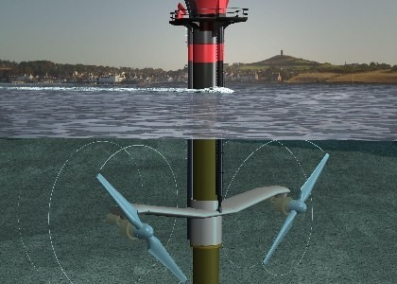
The 5th form of hydropower technology: Tidal Stream?
Photo/figure: http://subseaworldnews.com/2012/01/17/uk-seagen-tidal-turbine-gets-all-clear-from-environmental-studies/
Yes, Tidal Stream does also extract power from the gravity-driven flow of water
But instead of the earth's gravity, it's the moon's gravity at work
Further, the science of Tidal Stream mimics that of Wind Power, where energy
comes from the fluid's kinetic energy and not its gravitational potential energy
I will thus postpone its discussion until after my notes on Wind Power (pptx / pdf / key)
covering Tidal Flow in my Exotic Power Technologies (pptx / pdf / key) notes

Slide 45
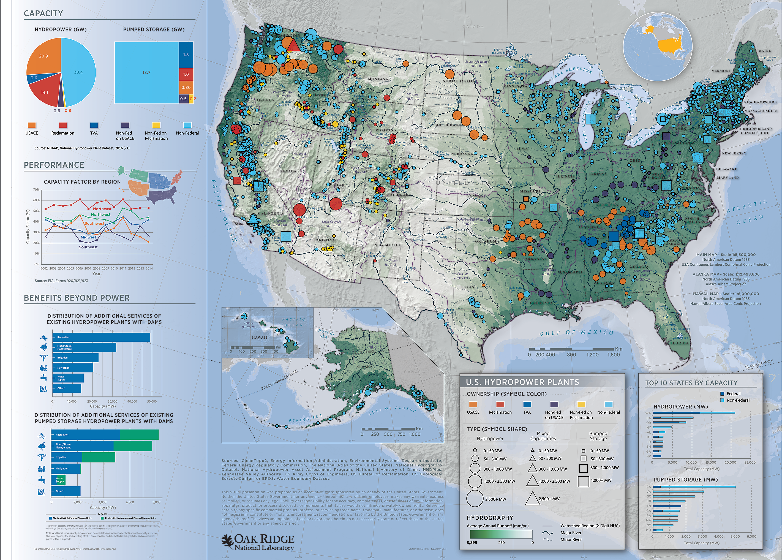
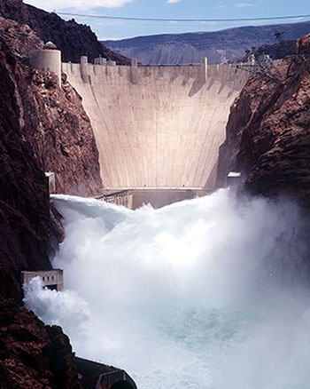
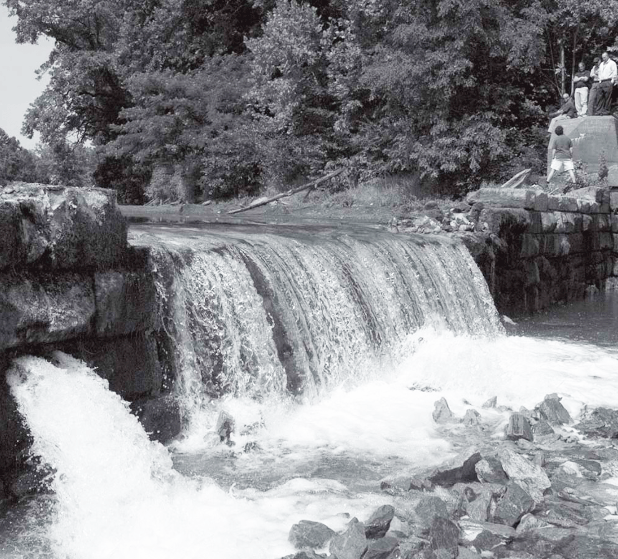
U.S. Hydroelectric Power Today:
https://nhaap.ornl.gov/2016-national-hydropower-map
http://www.usbr.gov/lc/hooverdam/
http://vacanals.org/images/Tiller_pdf/Tiller_Winter_2007_op_ro.pdf

Slide 46
Is this what comes to mind? It's also about dams like this:
http://www.usbr.gov/lc/hooverdam/
http://vacanals.org/images/Tiller_pdf/Tiller_Winter_2007_op_ro.pdf
Until recently, the tiny dam at the right was Charlottesville's own Woolen Mills Dam
Erected in 1757 across the Rivanna River by Thomas Jefferson's family ¹
It was one of series of dams and locks built to increase the river's depth
Allowing barges to haul tobacco, and for paddle-driven mills to saw and grind
But which was eventually converted to generate (a little) hydroelectric power
1) http://www2.iath.virginia.edu/schwartz/vhill/rivanna.html

Slide 47
Just how many dams - of all sizes - does the U.S have?
According to AmericanRivers.Org, in the U.S. there are ~ 66,000 river dams ¹
And all dams, including our tiny Woolen Mills Dam, have the potential of:
Obstructing fish breeding migrations, disrupting sediment flow
and generally (even grossly) altering the natural environment
But given the broader and older use of dams, what is hydropower's net impact?
Of the 66,000 U.S. dams, 2540 produce hydroelectric power (3.8%) ¹
But hydroelectric dams are not all equal: Of the ~ 6% of U.S. power they produce,
almost half (44%) is produced in the Columbia River basin alone ²
The main branch Columbia River has 11 U.S. dams (plus 3 upriver in Canada)
But over its entire basin, 400 dams generate hydroelectric power ³
1) https://www.americanrivers.org/conservation-resources/river-restoration/removing-dams-faqs/
2) https://en.wikipedia.org/wiki/Hydroelectric_power_in_the_United_States
3) https://en.wikipedia.org/wiki/Columbia_River

Slide 48
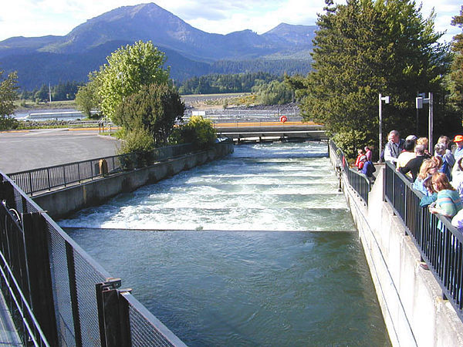
The Columbia River as a would-be environmental case study:
Many childhood vacations took me over the Columbia River
Where we visited multiple dams, which proudly described their fishery programs
For instance, here is a "fish ladder" we toured at the Columbia's Bonneville Dam: ¹
These ladders are built to the side of the dams
allowing fish to leap up their mini-waterfall steps
Of the 11 U.S. dams on the main branch Columbia River:
Only one – Chief Joseph Dam - lacks fish ladders ²
But what fraction of the Columbia basin power is produced at those laddered dams?
Which would, presumably, be at least quasi-fish-friendly hydroelectric power
1) https://en.wikipedia.org/wiki/Fish_ladder
2) https://en.wikipedia.org/wiki/List_of_dams_in_the_Columbia_River_watershed

Slide 49
From Wikipedia's listing of main-branch Columbia River dams: ¹
Excluding power production from the U.S. Chief Joseph and the Canadian dams:
For the U.S. fish-laddered main-branch Columbia River dams
I came up with a total hydropower capacity of 18.5 GW
From my U.S. Energy Production & Consumption (pptx / pdf / key) note set:
Our time-averaged consumption is ~ ½ Tera-Watt (i.e., 500 GW)
Of which 6.3% is produced by hydroelectric => 31.5 GW
Of which 44% is produced in the total Columbia basin => 13.9 GW
Which indicates that the laddered dams account for
the overwhelming majority of Columbia River hydropower:
10 large and fish-laddered U.S. Columbia River dams: 13.9 GW
vs.
~ 390 variously-sized non-fish-laddered Columbia River Dams: 4.6 GW (18.5 – 13.9)
1) https://en.wikipedia.org/wiki/List_of_dams_in_the_Columbia_River_watershed

Slide 50
The preceding suggests an eco-friendly U.S. hydropower plan:
1) Retain/build a small number of large hydroelectric dams
In that they seem to produce the overwhelming majority of hydropower
2) Insofar as geographically feasible, prioritize the use of ROR dams
ROR's where major elevation changes allow for minimal dam & reservoir size
As seen in the Cascata delle Marmore example
Or ROR's without major elevation changes but which are built on high-flow rivers
Allowing them to be low enough that fish ladders can be accommodated
As seen in the Columbia River examples
3) Get rid of the very large numbers of small/tiny hydroelectric dams
Which individually generate chump-change power => Minor overall power

Slide 51
(Relevant news articles I've not yet fully researched and/or verified)
"More than a viral sensation, the Salmon Cannon could bring the species back to the Upper Columbia after 90 years"
Seattle Times - 16 August 2019 ¹
"The principle is simple: The tube, which is a proprietary plastic mix and very smooth on the inside, molds to the body of each fish that swims into it. Misters, placed on the outside of the tube, further lubricate the interior with water and allow the fish to breathe. Then, an air blower pressurizes the space from below, pushing the salmon up at speeds that can reach 20 mph, much like a pneumatic bank tube.
'From the fish’s perspective, it’s swim in, slide and glide,' said Vincent Bryan III, CEO of Bellevue-based Whooshh Innovations, which makes the device.
The system doesn’t hurt the fish, according to multiple studies. In fact, some research indicates that the system saves the salmon so much energy that they are more likely to survive the long swim back to their spawning grounds."
1) https://www.seattletimes.com/seattle-news/more-than-a-viral-sensation-the-salmon-cannon-could-bring-the-species-back-to-the-upper-columbia-after-90-years/
See Also:
https://www.theguardian.com/environment/2019/aug/15/salmon-cannon-fish-dam?CMP=Share_iOSApp_Other
https://flylordsmag.com/what-is-the-whooshh-salmon-cannon/

Slide 52
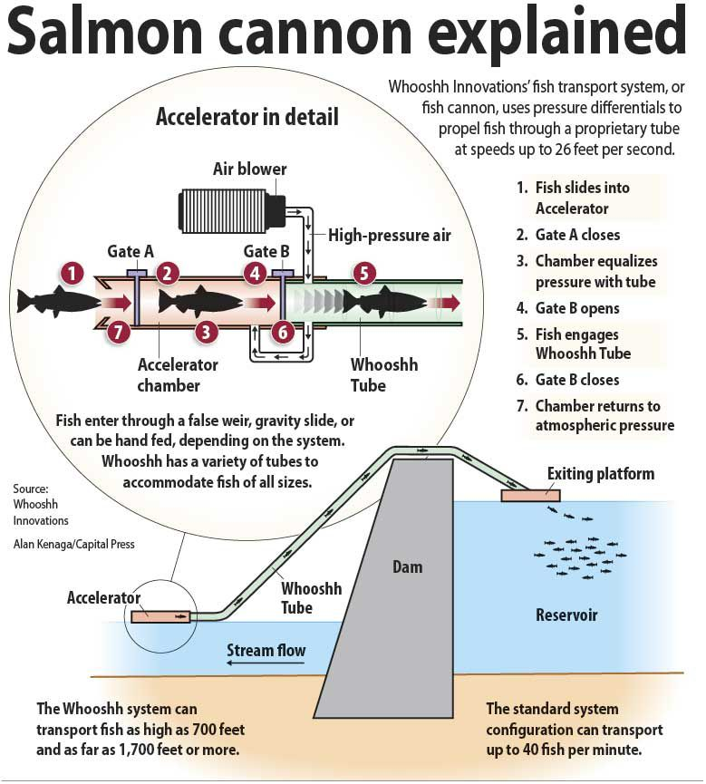
"Salmon Cannon Explained"
https://www.capitalpress.com/opinion/editorials/editorial-look-for-new-solutions-to-fish-problems/article_dd56c328-fc2f-11e9-bda1-0bb4dd9a25ea.html

Slide 53
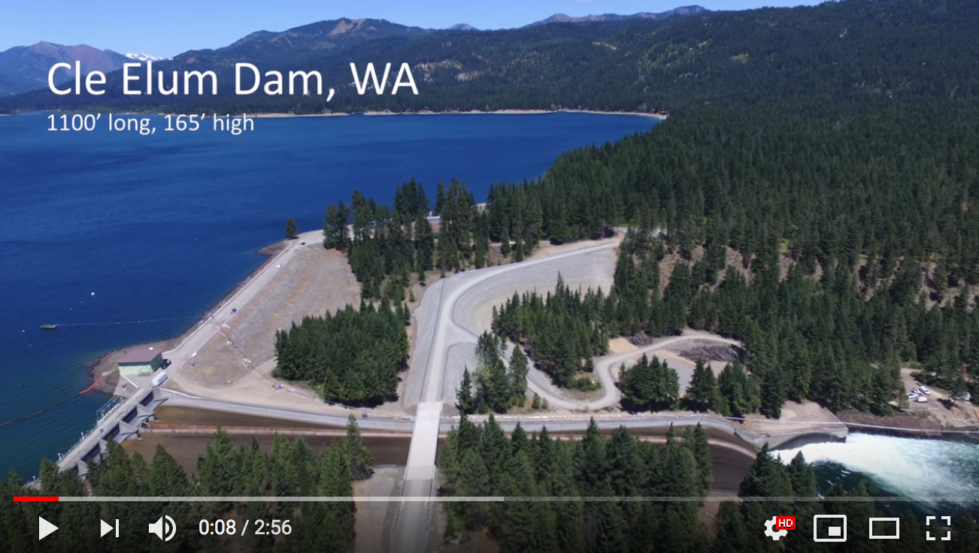
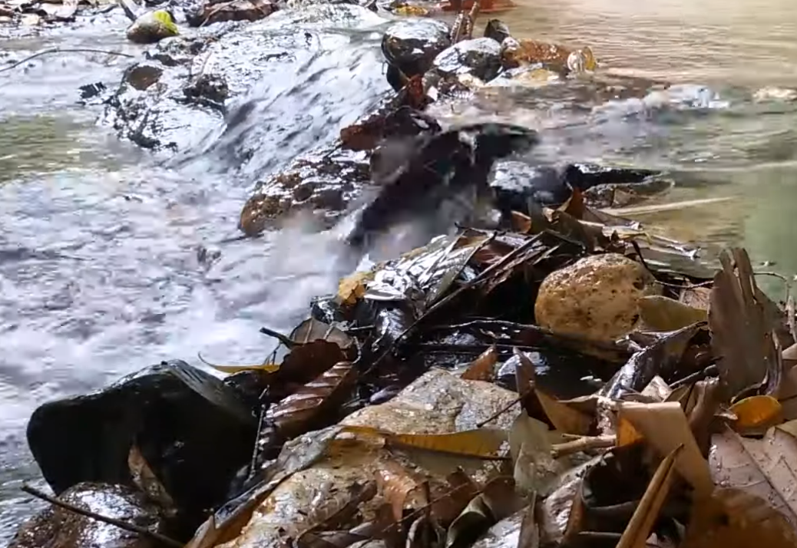
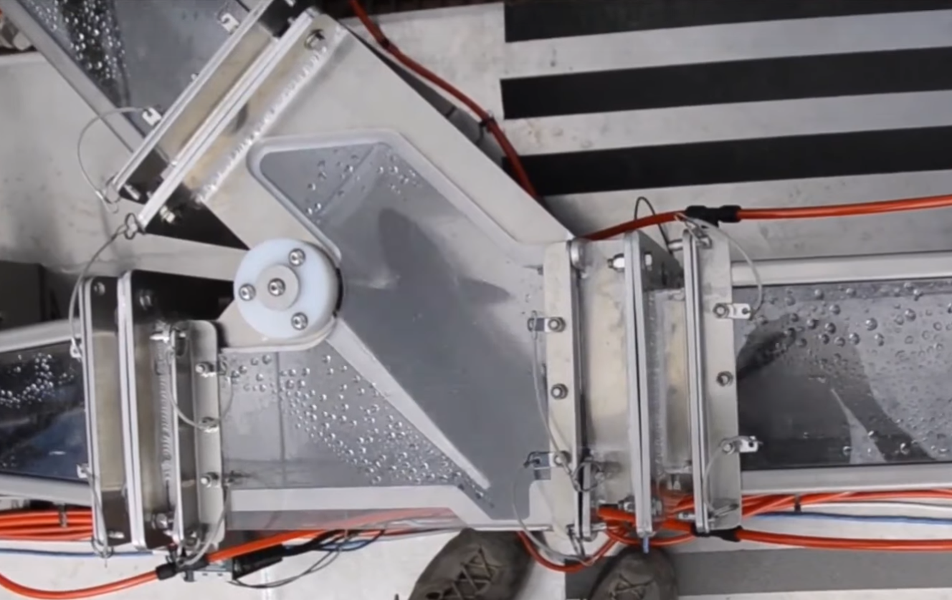
Video of salmon transport over 1700' wide / 165' tall Cle Elum dam: ¹
1) https://www.youtube.com/watch?v=yoYwaHffh58
Followed by successful test over the 236' tall Chief Joseph dam in Fall 2019 ²
Video explaining the technology (inspired by nature / derived from apple harvesting): ³
2) https://www.spokesman.com/stories/2019/sep/11/we-believe-in-the-salmon-company-demonstrates-salm/
3) Whooshh homepage video: https://www.whooshh.com

Slide 54
Limits of Hydropower / Objections to Hydropower:
Opening this note set I described my textbooks' strange avoidance of hydropower
But we've now discussed a lot of reasons for using hydropower
What is the source of this disconnect?
Some of the most commonly cited limits & objections to hydropower:
Drought & climate change impact upon hydropower output
Negation of hydropower's greeness due to concrete's carbon footprint
Environmental impacts of dams & reservoirs including:
Possible disruption of fishes spawning migrations
Impact upon rain forests & tropical river deltas
The possible liberation of soil mercury into newly filled reservoirs
Considering those limitations & objections in that order:
An Introduction to Sustainable Energy Systems: WeCanFigureThisOut.org/ENERGY/Energy_home.htm

Slide 55
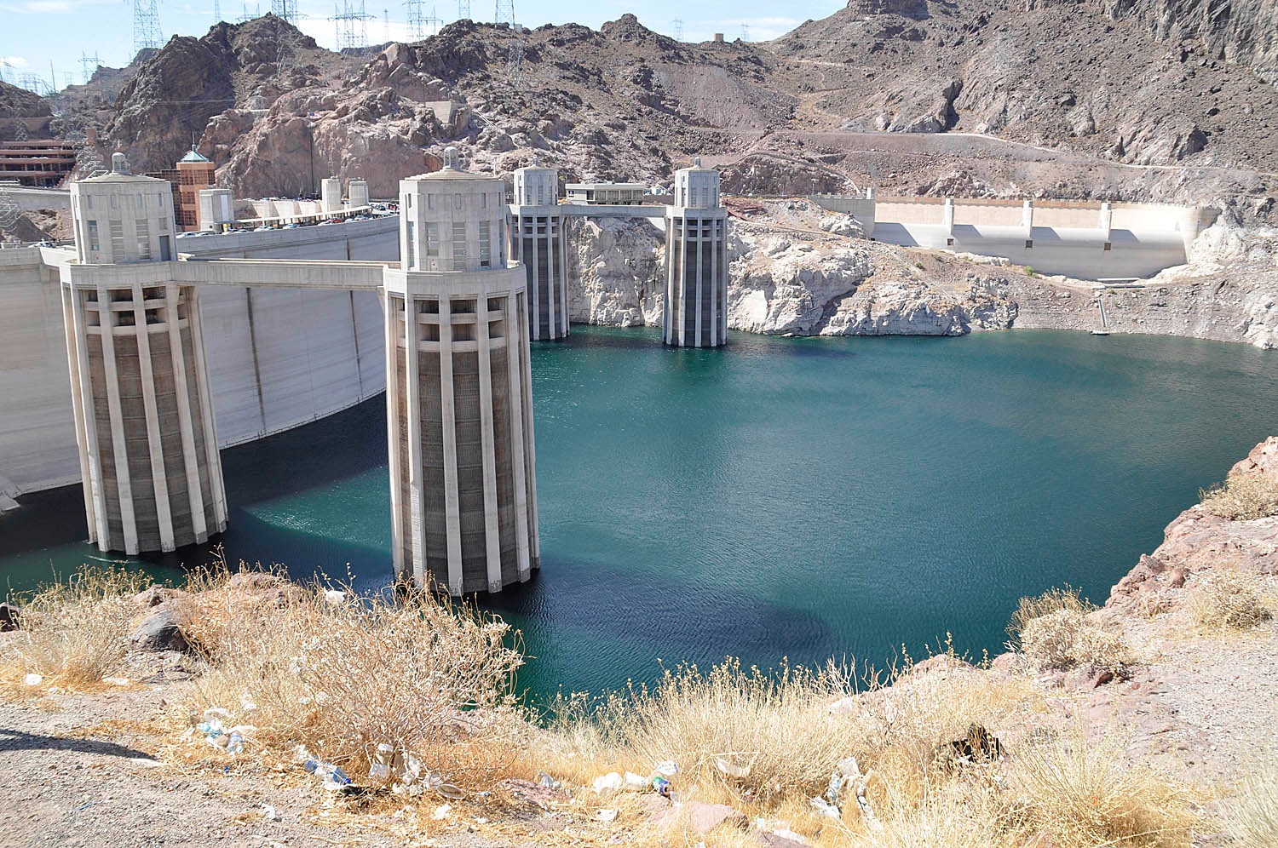
Impact of drought & climate change upon hydropower output?
The poster child for this concern is Hoover Dam and its Lake Mead reservoir
Compare these upriver photos of that dam and its penstock's water input towers:
For the filled reservoir: In 2013 w/ reservoir at 47% capacity:
With more recent years flirting with this possibility:
www.dailymail.co.uk/news/article-2549619/Shocking-pictures-reveal-Lake-Mead-shrinking-dangerously-low-levels-threatening-Las-Vegas-water-supply.html
https://groksurf.com/2013/08/05/san-diego-regional-water-news-roundup-jul-29-aug-4-2013/

Slide 56
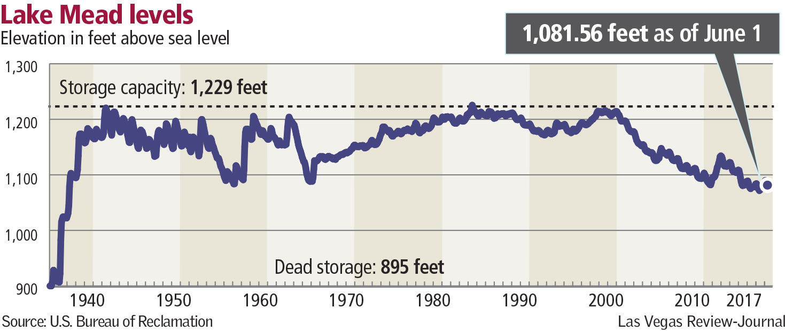
Evolution of that situation:
From the AP's 2014 article: "Southwest braces as Lake Mead water levels drop" ¹
Date:
1983
2013
2014
?
??
Lake Mead's surface
1,225 feet above sea level
1,080 feet
1,000 feet
900 feet
Percent of Capacity:
100%
47% ²
39%
Impact:
Las Vegas loses drinking water ³
Las Vegas loses power
A June 2017 update from the Las Vegas Review Journal: ⁴
1) http://www.sandiegouniontribune.com/sdut-southwest-braces-as-lake-mead-water-levels-drop-2014aug12-story.html
2) https://groksurf.com/2013/08/05/san-diego-regional-water-news-roundup-jul-29-aug-4-2013/
3) The Las Vegas water authority IS (frantically?) constructing a new lower water tunnel entrance!
4) https://www.reviewjournal.com/local/local-las-vegas/latest-forecast-shifts-lake-mead-from-big-gain-to-small-loss/

Slide 57
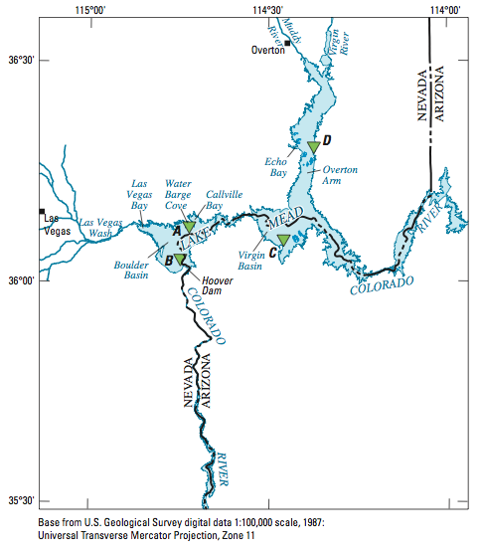
Lack of Colorado River water is compounded by Lake Mead evaporation:
Western mega-reservoirs are built in the HOT/DRY deserts of Arizona and Nevada
Where they present HUGE surface areas
According to USGS report on water consumption:
To produce hydroelectric power Hoover Dam
uses 10.1 million acre-ft of water/year
But Lake Mead's surface simultaneously
evaporates 1.1 million acre-ft of water/year
Making the price of an extravagant desert reservoir:
10% water loss to evaporation per year
Source: "Evaporation from Lake Mead, Nevada and Arizona, 1997-99
Link: http://pubs.usgs.gov/sir/2006/5252/pdf/sir20065252.pdf

Slide 58
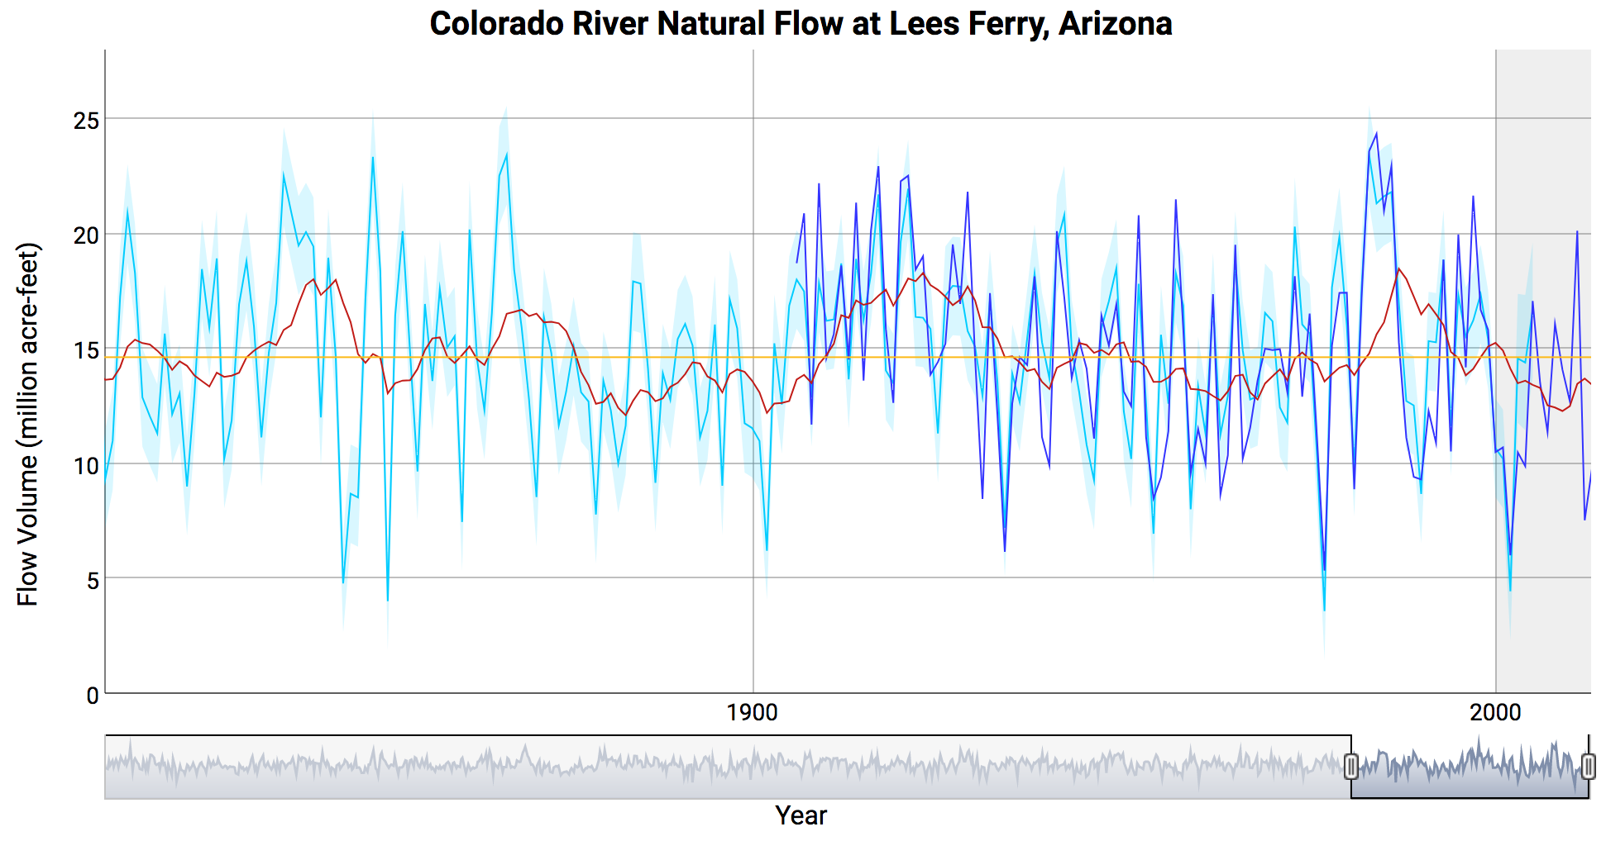
Adding to this is natural river flow variation:
In 1922 the Colorado River Compact set water allotments for surrounding states ¹
These were based on water flow data then going back a couple of decades
But tree ring studies now allow extrapolation of water flow back a full century
With the historical Colorado River water flow now appearing to be:
Since 1922, in what appears to be random variation, flows have dropped 20-25%
1) https://www.doi.gov/water/owdi.cr.drought/en/

Slide 59
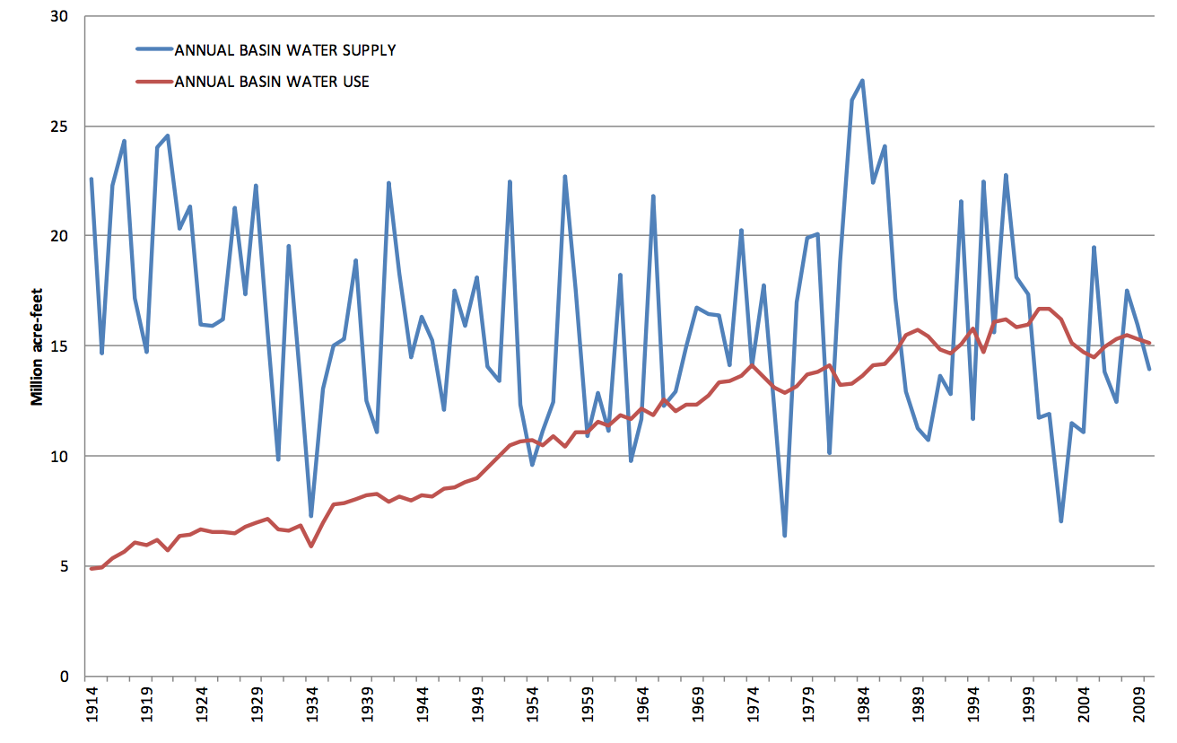
But does "random variation" alone explain current Western water problems?
The U.S. Department of the Interior's study:
"Colorado River Basin Water Supply and Demand" ¹
Suggests NO: if one wants to seize upon a single simple explanation
the threefold increase in water demand would be much more plausible!
Supply
Demand
- 2009
- 1922
1) My captions added to figure at:
https://www.usbr.gov/lc/region/programs/crbstudy/finalreport/Study%20Report/CRBS_Study_Report_FINAL.pdf

Slide 60
But now add non-random global warming to the picture:
A possibility discussed at length in my later notes sets:
Climatology & Climate Change (pptx / pdf / key)
Greenhouse Effect / Carbon Footprint (pptx / pdf / key)
Based on such warming, how might U.S. river flows now be expected to change?
A 2007 National Academies report concluded that: ¹
"Over the next 10-40 years, there is a tendency in the results of climate model superensembles to forecast slightly increased annual precipitation in the northwestern United States by about 10 percent above current values,
and to forecast slightly decreased annual precipitation in the southwestern
United States by less than 10 percent below current values,
with relatively little change in annual precipitation amounts forecast for the
headwaters regions of the Colorado River"
1) Pages 15-16: https://www.nap.edu/read/11857/chapter/5

Slide 61
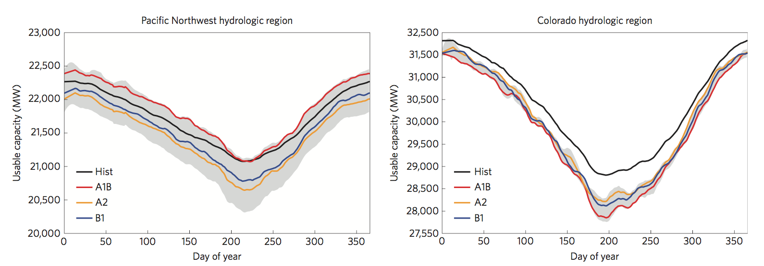
More recent studies directly model U.S. hydropower output:
"Impacts of climate change on electric power supply in the Western United States" ¹
includes this figure on seasonal hydropower in the Northwest and the Colorado Basin:
The black lines are hydroelectric power vs. day of the year for 1949 - 2010
The colored lines are models for the years for 2040-60
For the Northwest: Modeled 2040-60 power falls on both sides of historical data
For the Colorado Basin: Modeled 2040-60 power is on average 1-3% lower,
but over expected drier periods it would be 7-9% lower
1) https://www.nature.com/articles/nclimate2648

Slide 62
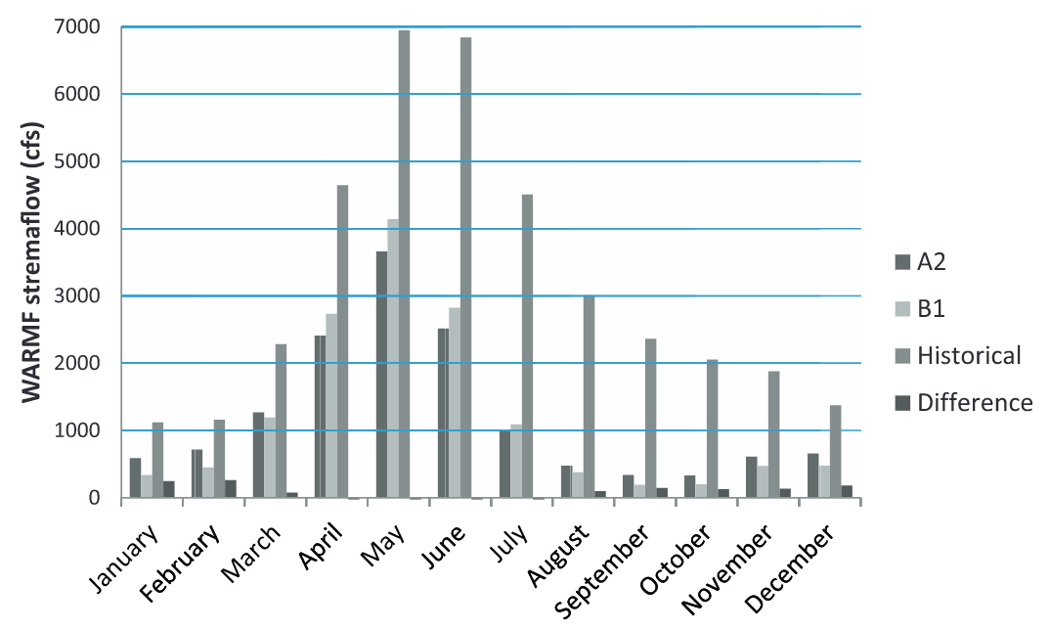
Newer Colorado flow modeling is more pessimistic:
"Climate-change impacts on water resources and hydropower potential
in the Upper Colorado River Basin:" ¹
This paper uses a range of models to compute water flow vs. month of the year
In this plot, the first two bars in each group are for 2046-65 water flow models
The third bar is for historical data
(the fourth bar is the discrepancy between the two models)
The paper's worst case models predict an "up to 50%" decrease in Colorado flow
1) https://www.sciencedirect.com/science/article/pii/S221458181500018X

Slide 63
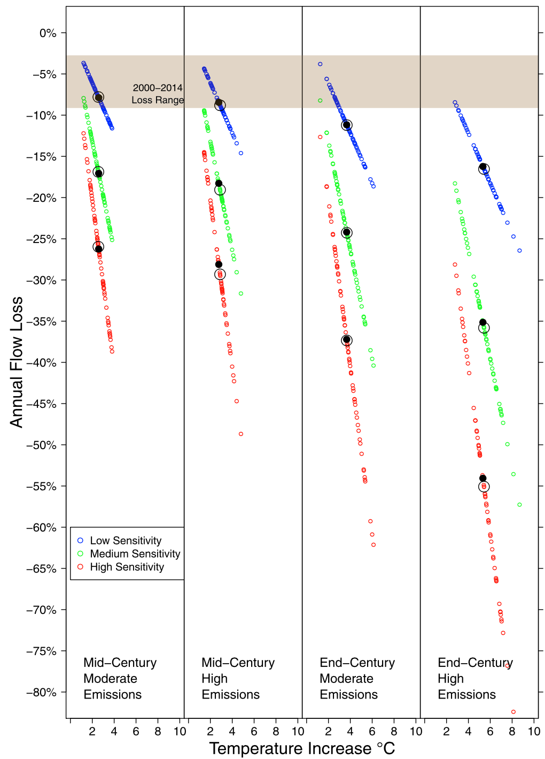
That more severe conclusion is echoed in another study:
"Twenty‐first Century Colorado River Hot Drought & Implications for the Future" ¹
Which modeled flow decreases in likely future drought years
That paper's water flow loss vs. model results
were presented via this decidedly obtuse figure:
Which were summarized in "plain language" as:
"losses may exceed 20% at
mid-century and 35% at end-century"
This agrees well with the preceding flow paper
But both flow papers then seem to predict
more severe Colorado River impact
than the earlier hydroelectricity paper
(if power is still proportional to flow!)
Middle of Century
Low vs. High Emissions
End of Century
Low vs. High Emissions
Anticipated Annual Loss of Water Flow
1) https://agupubs.onlinelibrary.wiley.com/doi/pdf/10.1002/2016WR019638

Slide 64
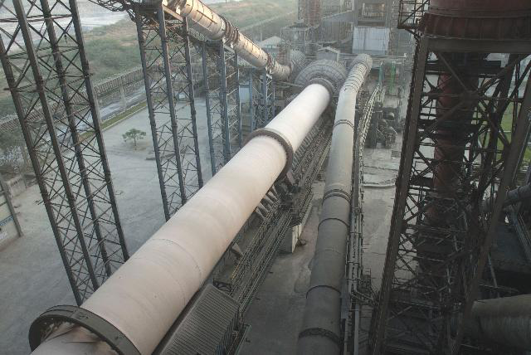
Negation of hydro's greeness due to concrete's carbon footprint?
What makes up the concrete that hydroelectric dams use in such large quantities?
Concrete consists of gravel ("aggregate") glued together with a cement
Portland cement is the most commonly used modern glue
It contains calcium silicates (e.g., Ca₃SiO₅ and Ca₂SiO₄) which,
when exposed to water, form hydrates that bind the gravel together ¹
The source of that Ca is naturally occurring limestone (CaCO₃)
Ca is liberated by heating the limestone at 1400-1600°C in HUGE rotating kilns: ²
1) Portland cement science:
http://matse1.matse.illinois.edu/concrete/prin.html
2) Photo: https://www.cemnet.com/Articles/story/39950/acc-s-mega-kiln-line-project.html

Slide 65
Concrete's Carbon Footprint:
The above process has a huge carbon footprint due to:
- Burning of carbon fossil fuels to produce the 1400-1600°C kiln temperatures
- The need to constantly heat those massive kilns, even when not in production
- The release of CO₂ that occurs as Ca is liberated from the limestone (CaCO₃)
The now censored EPA Inventory of US Greenhouse Gas Emissions & Sinks reported ¹
that 2012 U.S. Portland cement production produced a carbon footprint of:
35 million metric tonnes CO₂ equivalent = 38.5 million tons CO₂ equivalent
Annual U.S. Portland cement production is ~ 86 million tons ² and thus:
1 ton of Portland cement => 0.45 tons of CO₂ equivalent released
Concrete (aggregate + Portland cement) is ~ 11% Portland cement by weight ³ =>
1 ton of Concrete => 0.05 tons of CO₂ equivalent released
1) Deleted from the EPA website in April of 2017 "under the leadership of President Trump and Administrator Pruitt."
(but my copy can still be viewed/downloaded at THIS LINK)
2) www.cement.org 3) www.cement.org/cement-concrete-basics/concrete-materials

Slide 66
Hydroelectric power's contribution to concrete's carbon footprint:
There really isn't a "typical" dam – designs vary too much by location
But we can use data from two large U.S. hydroelectric dams:
Hoover Dam: 3.25 million yd³ concrete / 2.8 GW power capacity
(3.25x10⁶ yd³ Concrete)(1.9 tons/yd³)(11%) => 679,000 tons Portland cement
=> 0.24 tons Portland cement / kW
Bonneville Dam: 750,000 yd³ concrete / 1.189 GW power capacity
(7.5x10⁵ yd³ Concrete)(1.9 tons/yd³)(11%) => 157,000 tons Portland cement
=> 0.13 tons Portland cement / kW
An Introduction to Sustainable Energy Systems: WeCanFigureThisOut.org/ENERGY/Energy_home.htm

Slide 67
Using those ratios to calculate hydro's carbon footprint due to concrete:
Average for those two dams was 0.185 tons Portland cement / kW
And given hydroelectric dam lifetimes of ~ 100 years, this translates into:
= 0.0013 tons Portland cement / kW-yr for a hydroelectric plant
From my note set on U.S. Power Production & Consumption (pptx / pdf / key):
Average total U.S. power is ~ ½ Tera-Watt
In 2016 hydroelectric dams produced 6.3% of that power => 3.1 x 10⁷ kW
with 0.0013 tons Portland cement / kW-yr for a hydroelectric plant
that translates into 40,300 tons Portland cement / yr, and thus:
Total U.S. hydro footprint = 18,135 tons of CO₂ equivalent
An Introduction to Sustainable Energy Systems: WeCanFigureThisOut.org/ENERGY/Energy_home.htm

Slide 68
Comparing that to Fossil Fuel power plant footprints:
In Where Do We Go from Here? (pptx / pdf / key) analysis of carbon tax impact, I found:
Conventional Coal => 0.001 metric tonne CO₂ eq. / kW-hr => 9.6 ton / kW-yr
OCGT Natural Gas => 0.0007 metric tonne CO₂ eq. / kW-hr => 6.7 ton / kW-yr
CCGT Natural Gas => 0.00045 metric tonne CO₂ eq. / kW-hr => 4.3 ton / kW-yr
In 2016 coal provided 30.4% of U.S. power => 1.52 x 10⁸ kW
Carbon footprint = (1.52 x10⁸ kW)(9.6 ton/kW-yr) = 1.5 x 10⁹ tons CO₂ / yr
= 82,700 times Hydro's current carbon footprint
In 2016 natural gas provided 33.8% of U.S. power => 1.69 x 10⁸ kW
Which, if it were produced using half OCGT and half CCGT, would represent
Carbon footprint = (1.69 x10⁸ kW)(5.5 ton/kW-yr) = 9.3 x 10⁸ tons CO₂ / yr
= 51,300 times Hydro's current carbon footprint
Hydro's CO₂ footprint is MINISCULE compared to our fossil fuel plants!

Slide 69
Comparing carbon footprint for each kW-hour of power you consume:
From top of preceding page, converting kW-yr to kW-h, and ton to kg:
Conventional Coal Power: 9.6 ton CO₂ eq. / kW-yr=> 0.99 kg CO₂ eq. / kW-hr
OCGT Natural Gas Power: 6.7 ton CO₂ eq. / kW-yr => 0.69 kg CO₂ eq. / kW-hr
CCGT Natural Gas Power: 4.3 ton CO₂ eq. / kW-yr => 0.44 kg CO₂ eq. / kW-hr
From two pages ago, converting GW-yr to kW-h, and ton to kg:
Hydro Power: 18,135 ton CO₂ eq. / 31 GW-yr => 0.000061 kg CO₂ eq. / kW-hr
Hydro's carbon footprint / kW-hr is ~ 10,000 lower than for fossil fuels
An Introduction to Sustainable Energy Systems: WeCanFigureThisOut.org/ENERGY/Energy_home.htm

Slide 70
Disruption of fishes spawning migrations?
In my earlier would-be environmental plan for U.S. hydroelectricity
I tentatively assumed that fish ladders are effective. Are they?
I dug up studies from sources as diverse as public interest watchdogs, ¹
to the Federal Energy Regulatory Commission, ²
to the National Marine Fisheries Service of NOAA ³
The consensus seemed to be that:
For dams ≤ 100 meters in height, practical fish ladder designs do exist
Permitting 35-50% of the fish to swim upstream past a dam
Which may not sound great - especially when there is a whole series of dams
But on the steep & swiftly flowing Columbia River,
30-50% might be ~ the same as passage through the pre-dam rapids
1) http://www.nwcouncil.org/history/fishpassage
2) https://www.ferc.gov/EventCalendar/Files/20041018094218-fish-pass-final-report.pdf
3) http://www.nwfsc.noaa.gov/assets/26/8380_05132015_110147_Spring-Survival-2014.pdf

Slide 71
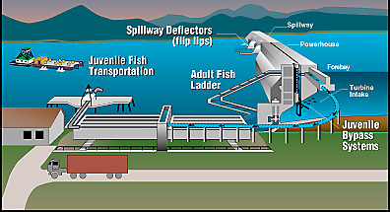
But there was a big problem with juvenile fish swimming downstream:
Which they had thought could just pass through the turbines
But experience showed they were instead being killed in the turbines,
or stunned long enough to allow mobs of birds to catch them at the outlets
This was then corrected by adding simple diversion grilles at the turbine inlets
And then, in many cases, collecting and trucking the juveniles down river:
Yielding a full modern (nominally effective) fish management scheme:
https://www.teachengineering.org/view_lesson.php?url=collection/cub_/lessons/cub_dams/cub_dams_lesson06.xml
(attributed to the U.S. Army Corp of Engineers)

Slide 72
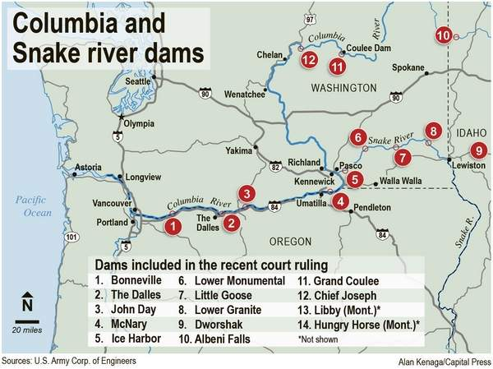
The Columbia River valley may well mitigate larger fish impact:
Because this rapidly flowing river is largely confined to long narrow canyons
which, plus high flows, facilitate the use of low Run of the River dams
around which fish ladders are practical (as at the Bonneville Dam, left map):
But it takes just one non-conforming dam to block fish mitigation
As now occurs at the non-fish-ladder equipped Chief Joseph Dam which
blocks all migratory fish from spawning upstream of it (#12, right map) ¹
1) http://www.capitalpress.com/Water/20170224/lawsuit-seeks-to-keep-columbia-snake-rivers-cool-for-salmon

Slide 73
Inundation of huge tropical rain forests and river deltas?
Much of the "developing world" consists of low-lying tropical landscape
Lacking a developed "grid" infrastructure, governments in such countries
are often drawn to the possibility of a single huge central power source
The abundance of tropical rainfall makes hydro a natural candidate
That attraction is reinforced by hydro's uniquely high power-production potential
Many countries thus pin their hopes upon a single mega hydro project
But in flat and low-lying landscapes, reservoir extent and impact are hugely larger
Instead of the compact/confined Columbia River reservoirs discussed above . . .

Slide 74
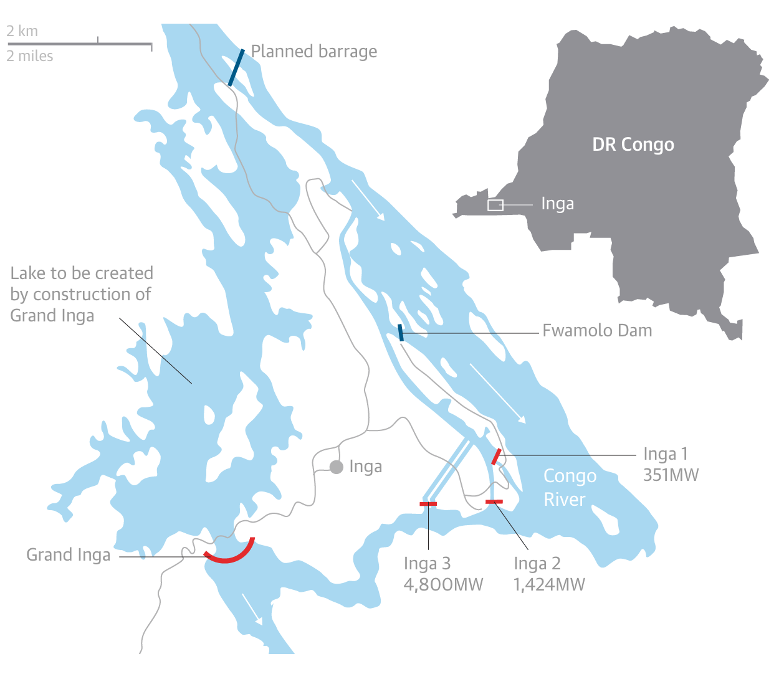
Reservoirs can inundate tropical forest
Tropical forests which now harbor most of the world's biodiversity
And, when regularly-flooding river mouth delta's are involved (as they often are),
this land may be a country's richest existing or potential agricultural resource
Exemplifying the mega project (but not in a delta) is the Congo River Inga Project:
"The world’s largest proposed hydropower scheme" ¹
"It is expected to have an electricity-generating
capacity of nearly 40,000MW – nearly twice as
much as the Three Gorges dam in China
or 20 large nuclear power stations"
"backers claim it could provide about
40% of Africa’s electricity"
"But 35,000 people may have to be relocated"
(+ 25,00 later) without any environmental
or social impact surveys"
1) https://www.theguardian.com/environment/2016/may/28/construction-of-worlds-largest-dam-in-dr-congo-could-begin-within-months?CMP=Share_iOSApp_Other

Slide 75
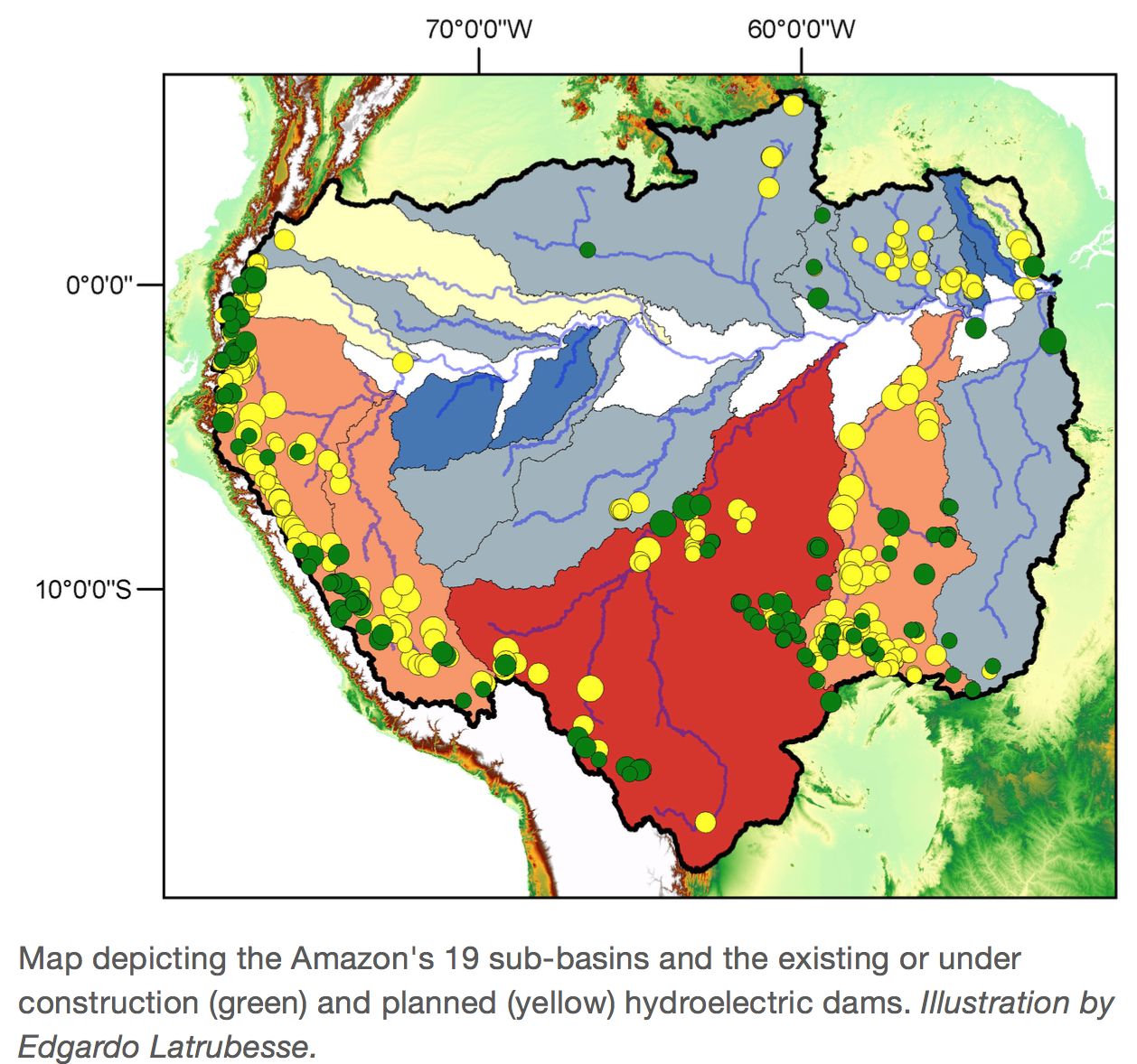
In other cases, the issue can be the shear number of planned dams:
As seen in this Amazon Basin map from the University of Texas's report entitled:
"Hydroelectric Dams May Jeopardize the Amazon’s Future" ¹
1) https://news.utexas.edu/2017/06/14/hydroelectric-dams-may-jeopardize-the-amazon-s-future

Slide 76
Or the issue may be competing uncoordinated hydroelectric projects:
As along Southeast Asia's Mekong river where many different countries
are now - largely independently - planning their own large dam (or dams)
But where cross-border impact and/or cumulative impact is often being ignored
https://www.nature.com/news/2011/111019/full/478305a.html?s=news_rss

Slide 77
Studies of these projects have generated observations such as:
Concerning the Amazon:
"Feasibility studies of hydropower plants typically ignore the effect of future deforestation . . . (When included, the) simulated power generation declined to only 25% of maximum plant output and 60% of the industry's own projections." ¹
"Proposed dams could result in significant losses in river connectivity in river mainstems of five of eight major systems . . . Because Andean rivers contribute most of the sediment in the mainstem Amazon, losses in river connectivity translate to drastic alteration of river channel and floodplain geomorphology and associated ecosystem" ²
"Should Brazil’s unfettered dam construction continue at the current pace, the
country will essentially take all of the major free-flowing Amazon tributaries east of the Madeira River - in effect, half of the Amazon basin - and turn them into
continuous chains of reservoirs. This would mean expelling all of the traditional
residents from two-thirds of Brazilian Amazonia." ³
1) http://www.pnas.org/content/110/23/9601
2) http://advances.sciencemag.org/content/4/1/eaao1642/tab-pdf
3) https://e360.yale.edu/features/how-a-dam-building-boom-is-transforming-the-brazilian-amazon

Slide 78
(continuing):
Concerning the Mekong:
"(Regarding Lao's proposed Xayaburi dam) "some scientists say the environmental impact assessment conducted for the builder is seriously flawed because it does not consider the wider effects of the dam . . . (that assessment considers effects) only for a downstream area about 10 kilometres from the barrage site . . . a remarkably small stretch of the river" ¹
"Cambodia and Vietnam, which researchers say will receive a disproportionate share of the harm from the dam, have both objected to it . . . a regulatory body made up of government representatives from Thailand, Laos, Cambodia and Vietnam - last year recommended a 10-year delay on damming the river so that researchers could gather the needed data. But the Laotian government, which will receive up to 30% of the revenue, says that it will push ahead." ¹
"The proposed dams will also exacerbate the Mekong Delta's ongoing battles
with the sea. The delta, home to 17 million people in Vietnam and 2.4 million
in Cambodia, seems to be losing coastal land" ¹
"The Mekong River Basin, site of the biggest inland fishery in the world, is undergoing massive hydropower development . . . We find that the completion of 78 dams on tributaries, which have not previously been subject to strategic analysis, would have catastrophic impacts on fish productivity and biodiversity." ²
1) https://www.nature.com/news/2011/111019/full/478305a.html?s=news_rss
2) http://www.pnas.org/content/109/15/5609

Slide 79
Or concerning all three river basins, in a paper entitled:
Balancing hydropower & biodiversity in the Amazon, Congo, and Mekong
Basin-scale planning is needed to minimize impacts in mega-diverse rivers ¹
No less than 39 American, Brazilian and European co-authors concluded that:
"The world’s most biodiverse river basins - the Amazon, Congo, and Mekong - are experiencing an unprecedented boom in construction of hydropower dams. These projects address important energy needs, but advocates often overestimate economic benefits and underestimate far-reaching effects on biodiversity and critically important fisheries."
"Current site-specific assessment protocols largely ignore cumulative impacts on hydrology and ecosystem services as ever more dams are constructed within a watershed."
"To achieve true sustainability, assessments of new projects must go beyond local impacts by accounting for synergies with existing dams, as well as land cover changes and likely climatic shifts."
"Long-term ripple effects on ecosystem services and biodiversity are rarely weighed appropriately during dam planning in the tropics. We are skeptical that rural communities in the Amazon, Congo, and Mekong basins will experience benefits of energy supply and job creation that exceed costs of lost fisheries, agriculture, and property."
1) http://science.sciencemag.org/content/351/6269/128

Slide 80
Liberation of soil mercury into newly filled reservoirs?
Most of us have heard about mercury's toxic effects (e.g., the "Mad Hatter") ¹
And that its toxicity is enhanced by its ability to readily vaporize and migrate
Mercury, from both natural minerals and manmade pollution (e.g., coal combustion)
is thus being continuously released into the earth's atmosphere
But I was surprised to learn that Arctic soil is particularly rich in mercury
Do low low temperatures cause mercury vapor to preferentially condense there?
No, it's more complicated: Plants pull minute amounts of mercury out of the air
But when a plant dies and decays, its mercury then returns to the atmosphere
Except in the Arctic: Where plant + mercury are incorporated into the permafrost ²
So climate-change-thawed permafrost could liberate both methane and mercury!
1) https://www.ncbi.nlm.nih.gov/pmc/articles/PMC1257552/
2) https://www.washingtonpost.com/news/energy-environment/wp/2018/02/05/the-arctic-is-full-of-toxic-mercury-and-climate-change-is-going-to-release-it/?utm_term=.f33976d94dfb

Slide 81
Fortunately, the immediate hazard is mitigated by the fact that:
Common simple mercury has limited toxicity
But mercury becomes much more toxic when it links up with organic compounds
With a particularly toxic combination being water-soluble methyl-mercury
How and when does methyl-mercury naturally form?
When water-borne bacteria digest mercury-containing dead plant matter
Thereby liberating and dispersing methyl-mercury into that water
Which happens when a new hydro reservoir floods Arctic permafrost
This is not news to the Canadian hydroelectric industry ¹
Nor is it news to a scientific community researching its mitigation ²
And, indeed, after ~ 5-10 years the mercury is effectively rinsed away
But during those years, local fish may be heavily contaminated
1) http://www.hydroquebec.com/sustainable-development/documentation-center/mercury-reservoirs.html
2) https://www.sciencedirect.com/science/article/pii/S0048969705006637

Slide 82
Hydroelectric expansion in Quebec now confronts this issue
Which is particularly sensitive because of the surrounding indigenous population
which has long been marginalized and/or disenfranchised,
and which is often strongly dependent on local fish for sustenance
Hence recent articles such as the New York Times'
"Canada’s Big Dams Produce Clean Energy, and High Levels of Mercury" ¹
And research publications such as:
"Future Impacts of Hydroelectric Power Development
on Methylmercury Exposures of Canadian Indigenous Communities" ²
Solutions? To date they've been mostly discouraging fishing & fish consumption
But to sustain that for ~ ten years requires substitutes & subsidies,
and still entails major disruption of native culture & tradition
1) https://www.nytimes.com/2016/11/11/world/canada/clean-energy-dirty-water-canadas-hydroelectric-dams-have-a-mercury-problem.html
2) https://pubs.acs.org/doi/abs/10.1021/acs.est.6b04447

Slide 83
Better solutions might eventually be found in research such as:
"Strategies to Lower Methyl Mercury Concentrations in Hydroelectric Reservoirs & Lakes" ¹
That review discusses removal or neutralization of organic matter prior to flooding,
ways of suppressing bacterial digestion of plant matter after flooding,
and ways of lowering methyl-mercury accumulation in fish populations
Its long list of specific techniques under study included:
Burning organic matter before flooding, and/or removing standing trees
Capping and dredging bottom sediment
Aerating anoxic bottom sediment and waters (discouraging bacterial growth)
Demethylating methyl-mercury by means of ultraviolet light exposure
Adding selenium or lime (which suppress methyl-mercury accumulation in fish)
1) htthttps://www.sciencedirect.com/science/article/pii/S0048969705006637

Slide 84
Alternate visions of tomorrow's hydropower:

Slide 85
The U.S. Department of Energy's: "Hydropower VISION: A New Chapter for America’s 1st Renewable Electricity Source"
This study, spanning almost 600 pages, was released in July of 2016
It states that our existing 101 GW of hydropower could grow 50% by 2050: ¹
"from a combination of 13 GW of new hydropower generation capacity (upgrades to existing plants, adding power at existing dams and canals, and limited development of new stream-reaches), and 36 GW of new pumped storage capacity"
I have an immediate problem with that Executive Summary statement:
The 13 GW would be a true 13% growth in power available to the U.S.
But 36 GW of PSH capacity would NOT represent a further 36% growth
because PSH only temporarily stores power that must be produced elsewhere
New sustainable but intermittent energy sources WILL require such storage
But the implication that PSH is an electricity source is misleading & disingenuous
1) Page iii: https://www.energy.gov/eere/water/articles/hydropower-vision-new-chapter-america-s-1st-renewable-electricity-source

Slide 86
Breaking down what I would consider the true 13 GW increase:
Also from that Executive Summary (adding line breaks for clarity & emphasis):
"Near-term growth of hydropower generation (through 2030), estimated as 9.4 GW under this scenario, is driven primarily from:
- Upgrades of existing hydropower facilities (5.6 GW)
- Powering non-powered dams (3.6 GW)
Long-term growth of 3.4 GW between 2030 and 2050 includes
- 1.7 GW of NSD (New Stream-reach Development)"
In other words, the real growth in hydropower by 2050 would break down as:
Improving existing hydroelectric plants: 5.6 GW
Adding hydroelectric generation to currently non-powered dams: 3.6 GW
Building entirely new hydroelectric dams: 1.7 GW
Those numbers are comparable to SINGLE existing Columbia ROR dams:
Grand Coulee (6.8 GW), Chief Joseph (2.6 GW), and The Dalles (2 GW) dams

Slide 87
The DOE would upgrade existing hydroelectric plants at these locations: ¹
The map's color coding gives the number of upgraded plants per state
With upgraded plant numbers near or exceeding 1000 in some states
1) P. 248: https://www.energy.gov/eere/water/articles/hydropower-vision-new-chapter-america-s-1st-renewable-electricity-source

Slide 88
While entirely new plants would be built at these stream locations: ¹
The map's color coding gives the number of new plants per state
With new plant numbers often running in the many 1000's per state
1) P. 250: https://www.energy.gov/eere/water/articles/hydropower-vision-new-chapter-america-s-1st-renewable-electricity-source

Slide 89
With those numbers, the DOE is clearly not betting on large dams: ¹
Quite the opposite: they propose huge numbers of new very small dams exploiting
cheap, compact, factory mass-produced modular turbine/generators:
Which could be installed on small streams to create still fish-friendly scenes like this:
1) Page 20: https://www.energy.gov/eere/water/articles/hydropower-vision-new-chapter-america-s-1st-renewable-electricity-source

Slide 90
How do such plans account for possible drought / climate change?
To quote: ¹
"The Hydropower Vision analysis examines two alternative water availability futures, one in which the United States on average becomes dryer (that is, less runoff) through 2050, and one in which it becomes wetter."
1) P. 255: https://www.energy.gov/eere/water/articles/hydropower-vision-new-chapter-america-s-1st-renewable-electricity-source

Slide 91
From which "nine scenarios" were constructed yielding conclusions: ¹
Upgrades of existing hydroelectric dams:
"Most upgrades are economically attractive even with reduced water availability, which leads to less than a 5% change in deployment under Business-as-Usual conditions."
Conversion of existing non-hydroelectric dams to hydroelectric production:
"are also similarly unaffected by changing water availability . . . which support construction of a large fraction of the NPD resource even when water availability is reduced"
Construction of new hydroelectric dams:
"In contrast, the range of NSD deployment variation across Wet and Dry conditions is
42–74% of the reference NSD deployment for scenarios in which NSD is economically feasible."
How can at least two of these three options be so apparently drought resistant?
I suspect the answer lies in the first two maps shown a few slides ago:
Plans avoid the Colorado River basin, focusing on the east/west coastal areas
NPD = "New Power Development " NSD = "New Stream-reach Development"
1) Page 240: https://www.energy.gov/eere/water/articles/hydropower-vision-new-chapter-america-s-1st-renewable-electricity-source

Slide 92
The impact of new/enlarged reservoirs on greenhouse gas emissions?
The DOE Vision briefly discusses reservoir and dam GHG issues using this figure:
But it avoids any conclusions:
"The Hydropower Vision acknowledges that there are important scientific questions surrounding the potential for GHG emissions from bacterial processes in waters and soils (hereafter “biogenic GHG emissions”) of any freshwater systems, including impoundment systems such as hydropower reservoirs. However, given the state of scientific understanding and discourse, the Hydropower Vision does not attempt to address hydropower-related biogenic GHG emissions"
Page 298-300: https://www.energy.gov/eere/water/articles/hydropower-vision-new-chapter-america-s-1st-renewable-electricity-source

Slide 93
Versus The Nature Conservancy's vision for hydroelectric power:
As reported in their study entitled:
"The Power of Rivers
Finding Balance between Energy and Conservation in Hydropower Development" ¹
The report opens with these observations:
"Hydropower development is contributing to one of the largest expansions of dams seen in history. According to some forecasts, as many hydropower dams will be built in the next three decades as were built in the last century, essentially doubling global hydropower capacity. Emerging economies, in particular, are under extraordinary pressure to harness the power offered by their natural resources.
Finding balance between river conservation and energy production is no easy task. Many people question whether it is even possible. Some environmentalists doubt the feasibility of protecting critical ecosystems in the face of any basin-wide development. Some government leaders fear environmental concerns will jeopardize the development of desperately needed energy sources and storage capacity."
1) https://www.nature.org/media/freshwater/power-of-rivers-report.pdf

Slide 94
It then provides details and statistics about hydro's ongoing expansion:
Hydro now:
Hydro in 2050:
Existing / Under Construction / Planned
That growth, it argues, is being driven primarily by:
- Hydro's low carbon footprint
- Hydro's flexibility, including its ability to store and buffer wind & solar energy
- Hydro's low cost & proven technology (=> ease of construction & management)

Slide 95
It then discusses the challenges & problems accompanying such expansion
Raising many of the very same issues (and possible ways of addressing them)
that I have detailed in the many earlier sections of this long note set
From which you might expect an environmental advocacy group
to reach a judgment opposing further large scale hydroelectric development
Instead, after considering the alternatives, the report concludes:
"While conservation and hydropower development will not always be able to find common ground, our research shows that in many cases, it is possible to achieve significant levels of hydropower development while still protecting important ecological values. While more-balanced outcomes may come with additional costs, they are often relatively low, and the benefits of doing so – many of which are directly monetizable – may compensate for the costs.
Ultimately, we believe the long-term protection of rivers represents a good deal for nations and their economies. By working with governments, communities, the hydropower industry and other partners, we can keep intact thousands of kilometers of free-flowing rivers while providing clean energy to people around the world. This is not an either/or decision – it is a necessary step in building a sustainable world."

Slide 96
Credits / Acknowledgements
Some materials used in this class were developed under a National Science Foundation "Research Initiation Grant in Engineering Education" (RIGEE).
Other materials, including the WeCanFigureThisOut.org "Virtual Lab" science education website, were developed under even earlier NSF "Course, Curriculum and Laboratory Improvement" (CCLI) and "Nanoscience Undergraduate Education" (NUE) awards.
This set of notes was authored by John C. Bean who also created all figures not explicitly credited above.
Copyright John C. Bean
(However, permission is granted for use by individual instructors in non-profit academic institutions)
An Introduction to Sustainable Energy Systems: WeCanFigureThisOut.org/ENERGY/Energy_home.htm

