Slide 1
Other Gen IV Reactor Designs
My main lecture on Next Gen Nuclear Energy focused on:
Short term safety via improved reactor operation
Which led to a discussion of the major U.S. Gen III/III+ designs
Long term safety via diminished nuclear waste
Which led to a general discussion of nuclear decay schemes
And how breeding can accelerate & alter nuclear waste reactions
Prompting a lengthy description of thorium molten salt reactors
Which left me no time to discuss other Gen IV reactors designs
An omission I'll rectify in this mini-lecture

Slide 2
Other Gen IV reactor concepts getting particular attention:
Grouped by what they seem to most want to eliminate:
Reactor Type: Eliminating:
Gas Cooled Reactors
including Pebble Bed reactors Water
Fast Reactors Slowed ("moderated") neutrons:
Fast Breeder Reactors Large quantities of ²³⁵U
Traveling Wave Reactors Onsite refueling & fuel rod storage:
Liquid Fluorine Thorium Reactors Long-lived nuclear waste
Small Modular Reactors Onsite assembly by instead using
factory-made pre-tested modules

Slide 3
To provide context, a brief review of the Gen II/III status quo:
Present day Gen II/III reactors are overwhelmingly based on the use of:
Solid Uranium fuel + liquid light-water cooling
Uranium ore is: ²³⁸ U: 99.27% Half-life: 4.6 billion years
²³⁵ U: 0.72% Half-life: 703.8 million years
Those half-lives are so long that the rate of energy release is miniscule
So for power production, that rate must be sped up by inducing a chain reaction
Where fission of one U atom releases things inducing another U to fission
Those "things" are neutrons of different energies:
high-energy "fast" neutrons AND low-energy "slow" / "thermal" neutrons
Neutron energy is important because it's not just about being hit by a neutron
In atoms and nuclei, its all about probabilities and resonances
And certain nuclei "resonate" better with certain energy neutrons

Slide 4
Including different resonances for different types of uranium:
The dominant ²³⁸U specie fissions best when it is hit by hot/fast neutrons:
²³⁸U + ¹n (hot/fast) => ²³⁹U => ²³⁹Np + β => ²³⁹Pu + β
But its fission creates no new neutrons to propagate the chain reaction!
The much rarer ²³⁵U specie fissions best when it is hit by slow/thermal neutrons:
²³⁵U + ¹n (slow/thermal) => ²³⁶U => ³⁶Kr + ⁵⁶Ba + 2.4 ¹n + 200 MeV
This reaction DOES yield neutrons, but they are hot/fast ones
So to propagate the ²³⁵ U fission chain reaction, hot neutrons must be slowed down
Which is done by bouncing them off light atoms of a moderator material
Most commonly: Hydrogen (with only 1 proton in its nucleus) OR
Carbon in the form of graphite

Slide 5
In BWRs, PWRs, ES-BWRs and AP-1000, the moderator is:
Light Water = Water with hydrogen having only one proton in its nucleus
Vs. costly/rare heavy water where hydrogen nuclei = proton + neutron
Which thus absorbs fewer neutrons, accelerating fission
Water is also used to transport away the heat of nuclear fission
Boiling a fluid to turn a turbine is called the Rankine Cycle
The efficiency of thermodynamic cycles increases with temperature differences
Above, the change is cool liquid water => superheated water or steam
Producing perhaps a net 300°C temperature difference
Why not just go hotter? Because extremely hot water or steam produce:
Extraordinarily high pressures and enhanced corrosion
Making the plumbing very difficult, expensive and dangerous

Slide 6
Bringing us to our first new class of reactors: Gas Cooled Reactors
In their fissioning reactor core, gases are heated to 500-1000°C
Expanding gas to turn a turbine is called the Brayton Cycle
Comparison of Rankine (water cooled) vs. Brayton (gas cooled) reactors: ¹
Water-cooled PWR (w/ water to 325°C) = 34% heat transfer efficiency
Gas cooled reactor (w/ gas to 640°C) = 41% heat transfer efficiency
That is, gas cooled reactors could be ~20% more efficient
However: Fuel cost IS a minor contributor to nuclear energy's cost
So a bigger advantage might be that, without water piping:
It's possible to change fuel rods while the reactor is on
Eliminating need for reactor shutdowns & dual reactor power plants
= A potentially MUCH BIGGER COST SAVINGS

Slide 7
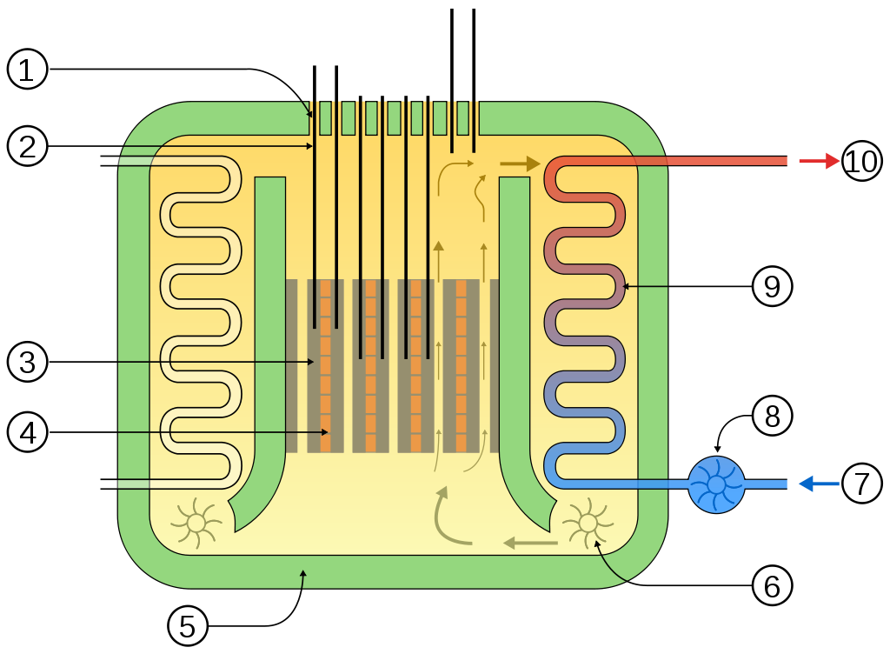
Leading to the UK's Advanced Gas-Cooled Reactor (AGR)
Central core contains: Fuel Rods (1), Control Rods (2), Graphite Moderator (3)
- Through which fans (6) drive a cooling gas
- Outside of which pipes carry water (7-10)
- Which is boiled by the gas
- Producing steam, sent out to generators
A "design feature" of this reactor: Its Output matches that of a coal-fired boiler
I.E., it produces similar combinations of steam temperature and pressure
And it is thus retrofitable to coal plants (retaining original turbines & generators)
Which, in the heavily coal-dependent UK, is apparently a big plus
http://en.wikipedia.org/wiki/Advanced_gas-cooled_reactor

Slide 8
However, there are problems with the AGR:
1) Within the containment structure there is a lot of complexity
2) By ultimately boiling water, it is partially lower efficiency Rankine Cycle
3) And its gas-cooled core had: Fuel Rods + Control Rods + Graphite Moderator
Change wording to "partially-gas-cooled core" and this describes another reactor:
Chernobyl RBMK: Where overheating + graphite fire => Disaster
WHY then does the AGR use graphite (with its flammability hazard)?
Because to use conventional mildly enriched ~4% ²³⁵U in ²³⁸U fuels,
You MUST have a moderator to sustain the chain reaction
With most of the water omitted from the AGR,
required neutron moderation must instead be supplied by graphite

Slide 9
Other issues with advanced gas-cooled reactors:
Moderated / gas-cooled reactors have a very poor operating history:
E.G., UK "Magnox" AGR reactors ^{1,2} & U.S. Fort St. Vrain CO reactor ²
The latter setting the record for worst U.S. commercial reactor downtime ³
Elimination of water removes an intrinsic stabilizing mechanism:
H₂O expansion => Less neutron moderation => Weaker chain reaction
Giving water-cooled reactors a stabilizing "negative void coefficient" ⁴
Some claim gas-cooling might have a similar stabilizing mechanism
But I found no mention of this in a nuclear reactor engineering textbook ⁵
Nor in two research papers modeling the stability of gas-cooled reactors ^{6, 7}
(references given on next page)

Slide 10
Advanced gas cooled reactor references:
1) http://en.wikipedia.org/wiki/Advanced_gas-cooled_reactor
2) "Sustainable Energy – Choosing Among Options," Tester et al., MIT Press (page 474)
3) http://ieer.org/wp/wp-content/uploads/2010/09/small-modular-reactors2010.pdf
4) See my earlier nuclear lecture for detail on stabilization mechanisms and "void coefficients"
5) High Temperature Gas Cooled Reactors in Nuclear Energy Materials and Reactors, Vol. II
R.A. Chaplin (http://www.eolss.net/Sample-Chapters/C08/E3-06-02-07.pdf)
6) Simulation of a gas-cooled fluidized bed nuclear reactor – Part II: Stability of a fluidized bed reactor with mixed oxide fuels, B.E. Miles et al., Annals of Nuclear Energy 37, p. 1014 (2010)
7) Stability margin analysis of gas-cooled reactor design models, A.I. Oludare et al., Mathematical Theory and Modeling 3(8), p. 133 (2013)

Slide 11
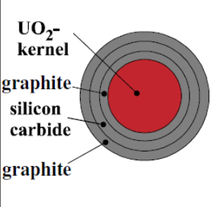
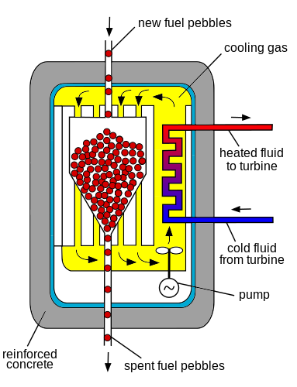
Related Gas Cooled Pebble Bed Reactors
Here fuel is embedded in spheres of graphite / silicon carbide ¹
Carbon of both materials provides the neutron moderation
At center of sphere is the 5% ²³⁵ U / ²³⁸ U fuel
Spheres are continuously fed into top of the reactor
Replenishing the nuclear fuel
And eventually released at the bottom of the reactor
Making room for fresh fuel at top
This eliminates refueling downtime of PWRs / BWRs
AND need for twin reactors to cover that downtime
Further, coolant can be a low pressure gas
Eliminating complexity & hazard of pressurized piping
1) https://www.iaea.org/NuclearPower/Downloadable/Meetings/2012/2012-10-22-10-26-WS-NPTD/Day-2/8.Reitsma.pdf

Slide 12
It's claimed that PBR's would be inherently safe
Firstly, because of a strange, but plausible, intrinsic stability mechanism:
Overheating would increase the energy spread of neutrons
Which would lead to their stronger absorption by the ²³⁸ U
Leaving fewer to sustain the vital, central, ²³⁵ U chain reaction ¹
Secondly, because of the aforementioned elimination of high-pressure plumbing
Thirdly, because it is believed that PBR's could shut themselves down passively:
Because, at their very high operating temperatures,
convection alone might sustain emergency cooling
Safety, operational & cost claims have generated a lot of enthusiasm
In both the popular press and within the U.S. Department of Energy

Slide 13
But many experts have strong reservations about PBR's: ^{1, 2}
Pebble Bed Reactors, like AGR's, have gas-filled graphite-laden cores:
If that core were ever breached, super hot inert gas would quickly vent
To be replaced by surrounding oxygen-containing air =>
Ignition of graphite coated pebbles¹ => Chernobyl Redux?
Overall volume of radioactive waste is substantially increased
Because Uranium is covered in large volume of graphite & silicon carbide
Moving pebble bed makes it difficult to monitor conditions within the reactor
Making it harder to safely control conditions within the reactor
And pebble feed mechanism jammed within the prototype reactor during fission
Contributing to Germany's decision to shut down pebble bed development

Slide 14
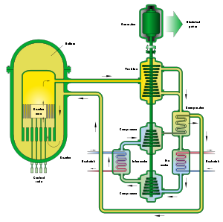
An alternative: Gas-Cooled Fast Reactors (GFR's):
Which eliminate flammable graphite moderator
And, indeed, almost all moderation
Relying on fast neutrons to sustain the chain reaction
Making GFR's a type of FAST REACTOR
Downside: In a fast reactor ²³⁵U must be enriched to ~20%
Because with few slow neutrons, conventional ~4% ²³⁵ U fuel won't work
But 20% enrichment is a big step closer to bomb-ready 80% enrichment
So accommodating fast reactors can ALSO facilitate bomb making
figure: http://en.wikipedia.org/wiki/Gas-cooled_fast_reactor

Slide 15
However, fast reactors MIGHT also do something very positive:
Turn radioactive waste into radioactive fuel
Fast Reactors retain the full range of possible neutron energies (thermal + fast)
Range of neutron energies stimulates a broad range of materials to fission
Opening the door to using nuclear waste as nuclear fuel
Simple waste may not be good enough, but it can be spiked with some ²³⁵ U
And as these new fuel + waste fuel mixtures fission:
- Some radioactive waste atoms transmute into final non-radioactive atoms
- Some transmute into radioactive atoms decaying in centuries not millennia
- And, with certain fuel mixtures, some transmute into ²³⁵U closing the cycle
This is then called a Fast Breeder Reactor

Slide 16
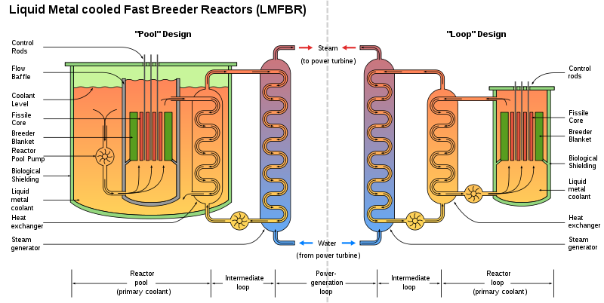
Fast Breeder Reactors
Some were gas-cooled (as above), others were liquid lead cooled
But today's large scale versions are cooled with liquid sodium metal
Making them Liquid Metal Fast Breeder Reactors (LMFBR's)
Which come in two different configurations:
With 1st heat exchanger inside the reactor tank (left) or outside (right)
Breeding material is cached to sides of the core in removable green "blankets"
http://en.wikipedia.org/wiki/Breeder_reactor

Slide 17
But Fast Breeders also come with some serious shortcomings:
- Lacking the negative feedback of a boiling or expanding water moderator
They may be more prone to rapid temperature excursions (and runaway)
- Sodium coolant used in LMFBR's spontaneously ignites in contact with air
=> Sodium accidents include the infamous: Santa Susana Meltdown
- Costs, expected to be competitive, have instead remained higher
- Estimates of remaining world uranium supply have sharply increased
Undercutting the original drive to exploit new fuels or fuel mixes
Bringing us to what many consider the Breeder's BIG PROBLEM:
Among the transmutation that can occur under hot neutron irradiation is
Transmutation of certain fuel components into bomb-ready plutonium
Indeed, the "nuclear club" members first developed Breeders for just this purpose

Slide 18
Which led to revival of Traveling Wave Reactor proposals:
Which have received attention including a Bill Gates TED talk (and his $$$)
The new TerraPower proposal amounts to a variation of the preceding:
Liquid Metal Fast Breeder Reactor (LMFBR)
But as this reactor burns, the new radioisotopes created (including plutonium)
Would themselves ~ all be burned, in a single step, inside the reactor core
Before they could be diverted for bomb use
Idea is from nuclear pioneers (including Edward Teller, inspiration for Dr. Strangelove):
Use a long bed of new fuel + waste radioactive fuel mixed such that
Once fission is initiated at one end, fission front propagates down length ^{1,2}
TerraPower: Propagation continues, without refueling, for sixty years

Slide 19
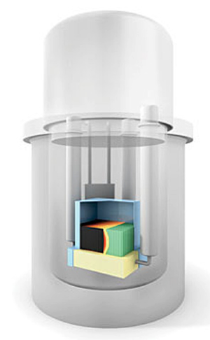
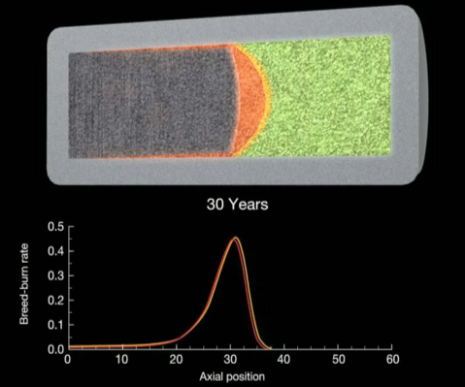
The TerraPower TWR burn is likened to a slowly burning cigarette:
"Highly enriched ²³⁵U or ²³⁹Pu fuel propagates a fission wave (red) preceded by a breeding wave (yellow) into unused depleted uranium (green) in hexagonal pillars sitting in a liquid metal sodium coolant, turning it into spent fuel (black). The fission gases accumulate in the space above the assembly. The heat generated is extracted by the sodium coolant using the cooling pumps" ¹
But one still confronts the many challenges generic to sodium cooled reactors
Leading both Gates and TerraPower to cool their enthusiasm of late

Slide 20
Alternate proliferation-resistant breeder: Molten Salt Reactor
Which instead uses fissionable fuel dissolved in a molten salt
Salt that, unlike sodium metal, does NOT burn in contact with air
Further, rather than proliferation-prone enriched ²³⁵ U
The MSR's fuel can be more abundant & less radioactive Thorium =>
Liquid Fluorine Thorium Reactor = LFTR
For which, it's claimed, nuclear proliferation would be exceedingly difficult
AND quantity of nuclear waste would be radically decreased
AND waste would have a much shorter in radioactive lifetime
Leading me detail LFTR's in companion Next Gen Nuclear Power lecture
An Introduction to Sustainable Energy Systems: WeCanFigureThisOut.org/ENERGY/Energy_home.htm

Slide 21
Finally bringing me to: Small Modular Reactors (SMR's)
Which are being proposed in incredible numbers:
Water Cooled SMR's:
ABV-6m (OKBM, Russia)
AHWR300-LEU (BARC, India)
ASCP-100 (CNNC, China)
CAREM-25 (CNEA, Argentina)
DMS (Hitachi-GE, Japan)
ELENA (Kurchatov Institute, Russia)
Flexible (DCNS, France)
IMR (Mitsubishi, Japan)
IRIS (IRIS, International Consortium)
KLT-40S (OKBM, Russia)
mPower (B&W/mPower, USA)
NuScale (NuScale, USA)
RITM-200 (OKBM, Russia)
RUTA-70 (RDIPE, Russia)
SHELF (RDIPE, Russia)
SMART (KAERI, Korea)
SMR-160 (Holtec, USA)
UNITHERM (RDIPE, Russia)
VBER-300 (OKBM, Russia)
VK-300 (RDIPE, Russia)
VVER-300 (OKB, Russia)
Westinghouse SMR (Westinghouse, USA)
High Temperature Gas Cooled SMR's:
GT-HTR300 (JAEA, Japan)
GT-MHR (OKBM, Russia)
HTMR-100 (STL, South Africa)
HTR-PM (Tsinghua U, China)
MHR-T (OKBM, Russia)
MHR-100 (OKBM, Russia)
PBMR-400 (PBMR Ltd, South Africa)
SC-HTGR (AREVA, USA)
Xe-100 (X-energy, USA)

Slide 22
But SMR is not so much a type of reactor, as a design philosophy
Indeed, SMR's include virtually all reactor types I've described above (+ more)
Design philosophy extols the virtues of "small is beautiful" plus
Cost benefit of factory-based "mass production" and testing
Formal definition: SMR is a reactor with a power output ≤ 300 Mega Watts
Versus conventional fission reactors of 1000 MW or more
Some are indeed proposed down to ~ 35 MW size
For remote construction sites, barge-mounted desalinization plants . . .
And many are in fact derived from existing ship-borne reactors
Such those from Russia's large nuclear ice-breaker fleet
Partially explaining the huge number of Russian SMR proposals!

Slide 23
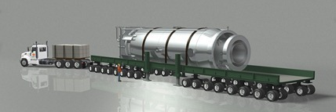
But for grid power, designs rise toward 300 MW high end:
Which can then weigh 700 tons, but could still be factory made & pre-tested
Then transported whole via railcar or large truck
And more easily installed onsite as single units
Potentially reducing construction cost and times
But shrinkage has another (entirely natural) consequence:
Reactor core's surface area to volume ratio increases sharply
Enhancing the heat transfer required during normal steam generation
AND simplifying/expediting emergency shutdown
Both of which might be done passively
An Introduction to Sustainable Energy Systems: WeCanFigureThisOut.org/ENERGY/Energy_home.htm

Slide 24
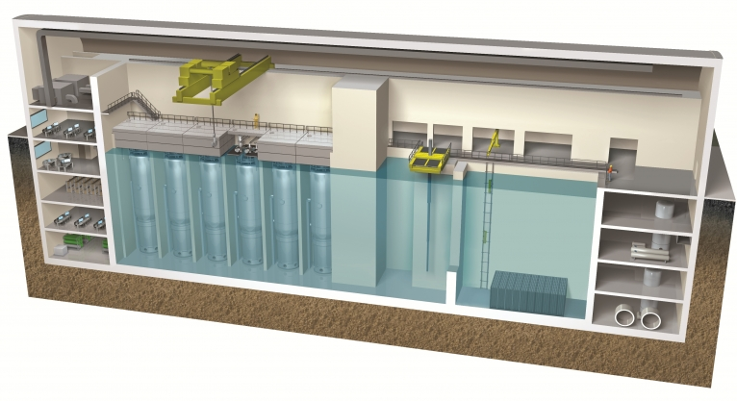
But then, perhaps, a harder reality sets in:
Extremely tough (airliner collision proof?) containment structures are still required
Which, to economize, are then often proposed for whole banks of SMRs:
Allowing for slow addition of modules (but at full initial containment cost)
And despite possible passive cooling, some wonder if simplification of each module
Would fully offset the cost of having to buy multiple modules
Or worry that an operator preoccupied with a problem/anomaly in one module
Might loose track of other modules, precipitating emergency
An Introduction to Sustainable Energy Systems: WeCanFigureThisOut.org/ENERGY/Energy_home.htm

Slide 25
Bottom lines on Small Modular Reactors (SMRs) ?
Science + smallness intrinsically enhance about only one thing: Heat Transfer
Reactors ARE heat engines, so this can be a really good thing
It is also a good thing for cool downs, a big reactor safety issue
But smallness does not guarantee:
Cost reduction, simplification, safety, reduced waste, non-proliferation . . .
And small version of a big reactor likely inherits all the big reactor's safety issues
As this began to sink in, the frenzy about SMR's has cooled a bit, as seen in:
"US Small Modular Reactor Deployment Fades Further into an Uncertain Future" ¹
"Small Modular Reactors: No Solution for Cost Safety and Waste . . ." ²
It is also evident in the many worldwide delays and suspensions of SMR projects
Thus, while the SMR idea survives, it is no longer viewed as a silver bullet

Slide 26
Other class lectures on nuclear energy:
The lecture introducing nuclear energy & its accidents:
Nuclear Energy – But they blow up! (link)
The predecessor/parent to this "Other Gen IV Nuclear Reactors" lecture:
Next Generation Nuclear Reactors (link)
A bonus mini-lecture describing something truly remarkable:
Prehistoric Natural Reactors? (link)

Slide 27
Credits / Acknowledgements
Some materials used in this class were developed under a National Science Foundation "Research Initiation Grant in Engineering Education" (RIGEE).
Other materials, including the "Virtual Lab" science education website, were developed under even earlier NSF "Course, Curriculum and Laboratory Improvement" (CCLI) and "Nanoscience Undergraduate Education" (NUE) awards.
This set of notes was authored by John C. Bean who also created all figures not explicitly credited above.
Copyright John C. Bean
(However, permission is granted for use by individual instructors in non-profit academic institutions)
An Introduction to Sustainable Energy Systems: WeCanFigureThisOut.org/ENERGY/Energy_home.htm

