Slide 1
Waves (generic)
In a class about Nanoscience and Nanotechnology, why talk about waves?
REASON #1:
ELECTRON WAVES are what make NanoSCIENCE different from MicroSCIENCE
Nanostructures are governed by properties of electron waves: The ability to trap electron
waves and/or ability of those waves to move between nanoparticles.
RAMIFICATIONS?
Nanostructure's properties may be more dependent on size, shape or separation
then on what atoms it is made of or exactly how those atoms are arranged.
At nanoscale "smallness" can become the most important feature
A Hands-on Introduction to Nanoscience: WeCanFigureThisOut.org/NANO/Nano_home.htm

Slide 2
REASON #2:
Limitations of light waves separate NanoTECHNOLOGY from MicroTECHNOLOGY
Light can’t be focused to less than its wavelength (which is > nano)
RAMIFICATIONS?
Light-based Microfabrication can’t get much smaller
Limits of Microfabrication mean must now consider broadest possible array of alternatives
That is why present day Nanoscience is so incredibly broad (physics, chem, bio . . .)
Understanding of light waves = Understanding of WHERE Nanotechnology must take over
Understanding of light waves = Understanding of WHAT Nanotechnology will be built upon
Because future nanodevices will almost certainly be built atop microstructures
A Hands-on Introduction to Nanoscience: WeCanFigureThisOut.org/NANO/Nano_home.htm

Slide 3
Waves 101
Waves (of various kinds) are usually taught by:
i) Determining physical laws that govern the situation (in form of equations)
ii) Combining these to form a key equation describing the phenomenon
Generally a “differential equation” of form similar to:
d²f(x,t) / dx² + A d²f(x,t) / dt² = 0
iii) Then try to find the “solutions” to equation (i.e. which functions f(x,t) work?):
End up being things like: B sin (kx – ωt) + C cos (kx-ωt)
Or weirder (but equivalent): De^{i(kx+ωt)} + Ee^{i(kx-ωt)} where i = √(-1)
Those mathematical solutions ARE waves:
k = 2 π / (wavelength of wave, λ) ω = 2 π (frequency of wave)
(other constants have to do with intensity of the wave)
A Hands-on Introduction to Nanoscience: WeCanFigureThisOut.org/NANO/Nano_home.htm

Slide 4
Problems with this mathematical approach:
- Must understand Calculus
- Even if do, math gives almost no sense of how waves behave
- Math LOOKS different for light, sound, electron waves . . . despite fact that:
WAVES = WAVES = WAVES
All waves behave in essentially the same manner!
You can actually take what you know about one type of wave and apply it to a completely different type of wave (with a very good chance of being right!)
(THIS is how physicists "figured out" electron waves - next lecture)
Rather than burrowing into math, try instead to understand similarities of waves:
A Hands-on Introduction to Nanoscience: WeCanFigureThisOut.org/NANO/Nano_home.htm

Slide 5
Similarity #1: Nature loves to oscillate
Oscillations occur when:
- There is a natural lowest energy position or state
- When thing leaves this position/state, nature applies force to drive it back
- Direction of force is to push back toward lowest energy point (always)
EXAMPLES Lowest energy position Force "restoring" position
Ball in valley:
Spring Pendulum:
A Hands-on Introduction to Nanoscience: WeCanFigureThisOut.org/NANO/Nano_home.htm

Slide 6
What is "wrong" with above picture?
Say we've agreed that you want stand at some "ideal" (lowest energy) point
I move you to one side
You move back to that "ideal" point. But more specifically:
You start by applying a force (through your feet) back toward ideal point
HOWEVER, as you approach the point you reverse force, slowing down
You "put on the brakes" BEFORE you reach "ideal" point so don't overshoot!
NATURE DOESN’T DO THAT: As it approaches desired point, force => zero (only!)
But reverse force NOT applied (to slow down) until crosses OVER point to other side
So nature always overshoots and ends up oscillating back and forth
(until/unless it somehow dissipates excess momentum)
A Hands-on Introduction to Nanoscience: WeCanFigureThisOut.org/NANO/Nano_home.htm

Slide 7
Similarity #2: Nature loves waves
Let's see how water waves move:
Consider a small water "sea" with a "mean sea level" (MSL)
Disturb by raising a single small central column of water:
Time = 0 Time increasing =>
Water in central column starts high, then tries to get back to MSL by pushing water downward and shoving it to the side (into neighboring columns, building them up)
But, because of water's downward momentum, it keeps moving to below MSL (no brakes!)
Then process reverses with our column refilling, with water pushed in from sides...
Overshoots again . . . with similar oscillations in neighboring columns => circular ripples
A Hands-on Introduction to Nanoscience: WeCanFigureThisOut.org/NANO/Nano_home.htm

Slide 8
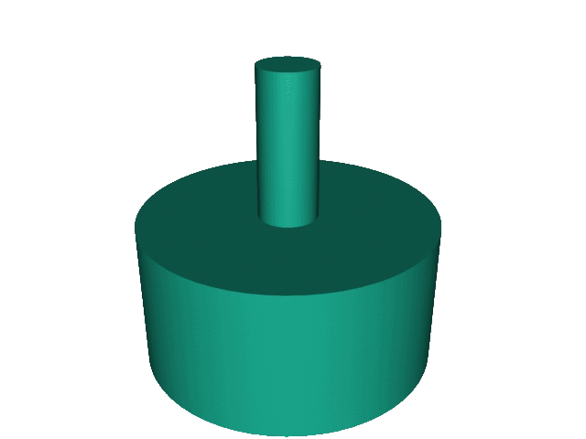
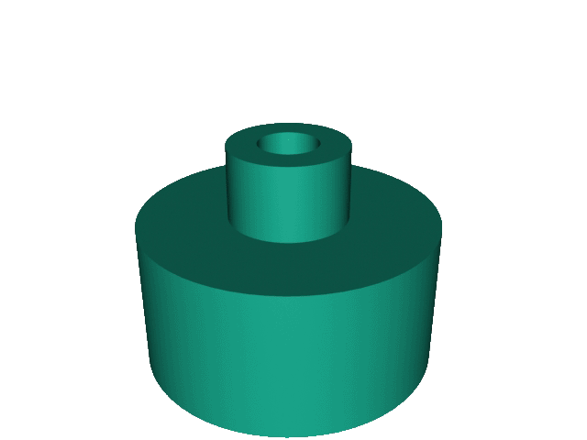
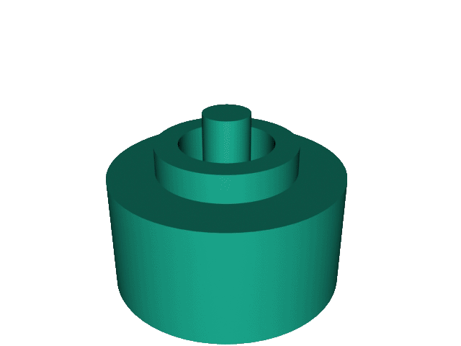
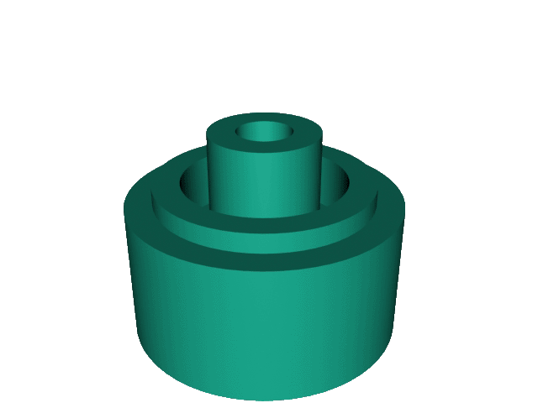
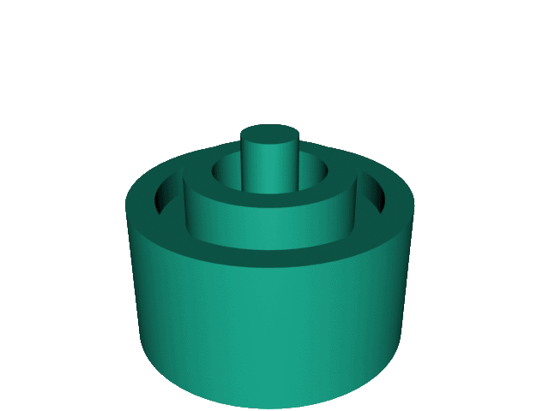
Lack of Brakes + Momentum => Oscillations => Waves
Moving to 3D, get:
But this is really a dynamic behavior, wouldn’t an animation be better?
A Hands-on Introduction to Nanoscience: WeCanFigureThisOut.org/NANO/Nano_home.htm

Slide 9
EDITORIAL DIGRESSION: Animations ≠ PowerPoint
Microsoft seems incapable of deciding on acceptable movie format:
Old Old Windows PowerPoint = MS AVI
Old Windows PowerPoint = Windows Media
Old Apple PowerPoint = QuickTime
Newer PowerPoints = multiple formats but embedded in PPTX file
(making it HUGE and sometimes IMPOSSIBLE to load)
So I have given up on Animations in PowerPoint
For this class I will embed all animations in companion webpages
With links like this: Waves: Generic Supporting Materials - Animation 1
A Hands-on Introduction to Nanoscience: WeCanFigureThisOut.org/NANO/Nano_home.htm

Slide 10
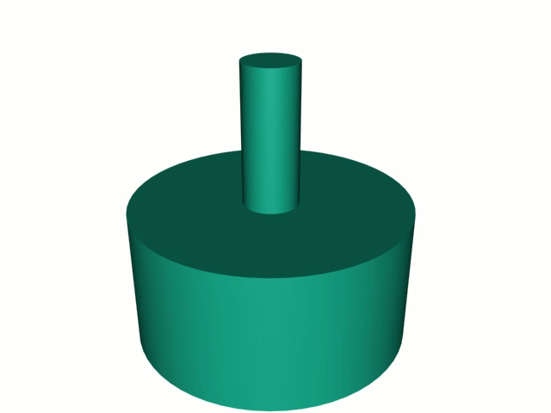
Link to animation: Waves: Generic Supporting Materials - Animation 1
A Hands-on Introduction to Nanoscience: WeCanFigureThisOut.org/NANO/Nano_home.htm

Slide 11
That Animation took a Bit of Work
But underlying point by point principles were not so difficult
For every individual column of water:
1) Pressure in column increases with height of column
2) Higher the pressure, higher the flow of water from the column
Or at least that would be the case
IFF were no neighboring columns trying to do the same thing!
How to deal with neighboring columns? The trick:
For EVERY column, apply rules #1 and #2
Add results column by column to get net effect
A Hands-on Introduction to Nanoscience: WeCanFigureThisOut.org/NANO/Nano_home.htm

Slide 12
= PRINCIPLE OF SUPERPOSITION
Amounts to treating every point (column) as the ultimate egotist:
Let it think it has no neighbors, calculate what it alone would do
But, behind its back, do the same for every other point
Then add it all together to get overall behavior
MUCH easier than figuring out how every point interacts with neighbors
And it WORKS!
Also called “Huygen’s Principle” Why?
Because Physicists like to name things after Physicists
Side benefit: No one else knows what they are talking about
A Hands-on Introduction to Nanoscience: WeCanFigureThisOut.org/NANO/Nano_home.htm

Slide 13
Can Use “Principle of Superposition” to Figure out More Complicated Situations
For instance, in lab can start multiple circular waves
Net behavior? From Principle of Superposition = Sum of behaviors
So let’s start by mathematically representing ONE set of circular waves
(Will be a LOT easier than me trying to animate problem)
Mathematical representation of 1D moving wave: Cos (kx - ωt) where
k = “wave number” = 2 π / λ x = position
ω = “angular frequency” = 2 π frequency t = time
But we want a circular 3D wave
A Hands-on Introduction to Nanoscience: WeCanFigureThisOut.org/NANO/Nano_home.htm

Slide 14
Single Circular Wave:
Depends on R, distance from center of wave, not x
Diminishes in amplitude as moves outward
Energy once concentrated at center is spread over enlarging rings
So mathematical expression is going to be more like:
Cos (k R - ω t) / R where k = 2 π / λ and ω = 2 π frequency
Actually, to keep it from blowing up at the center of the wave (R = 0),
need to change denominator to (R + a) where a is a small constant
I have programmed this into a Mathcad automated worksheet (worksheet / pdf)
A Hands-on Introduction to Nanoscience: WeCanFigureThisOut.org/NANO/Nano_home.htm

Slide 15
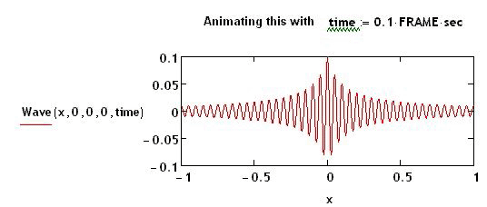
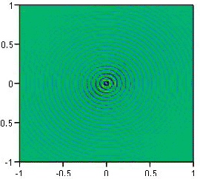
Simulated Circular Wave:
First, verify by taking animated cross-section of wave along x axis:
Then look at animation of full wave:
Link to animated simulations: Waves: Generic - Supporting Materials - Simulations 1-2

Slide 16
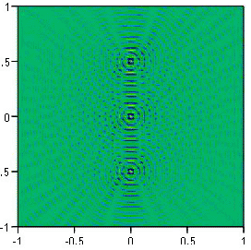
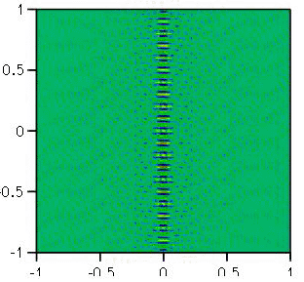
What Happens if Superimpose Multiple Circular Waves?
Put three sources in a vertical row: Then try 11 in a row:
Link to animated simulations: Waves Generic - Supporting Materials - Simulations 3-6
A Hands-on Introduction to Nanoscience: WeCanFigureThisOut.org/NANO/Nano_home.htm

Slide 17
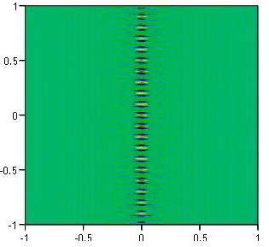
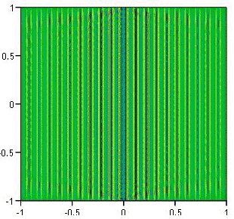
What Happens if Superimpose Multiple Circular Waves?
Then 41 in a row: Or finally 81 in a row:
Superposition of circular waves => straight (“plane”) wave!
Link to animated simulations: Waves Generic - Supporting Materials - Simulations 3-6
"A Hands-on Introduction to Nanoscience: WeCanFigureThisOut.org/NANO/Nano_home.htm

Slide 18
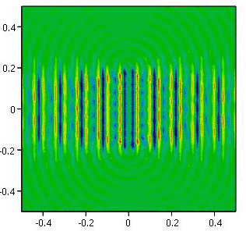
But What if Compact Sources into Shorter Line?
Start with 81 circular wave sources arranged along 50 cm long line
Then shrink line’s length to zero (moving all sources toward same point):
Beam of waves blows up as sources are confined to width ≤ λ !!
Link to animated simulations: Waves Generic - Supporting Materials - Simulation 7
A Hands-on Introduction to Nanoscience: WeCanFigureThisOut.org/NANO/Nano_home.htm

Slide 19
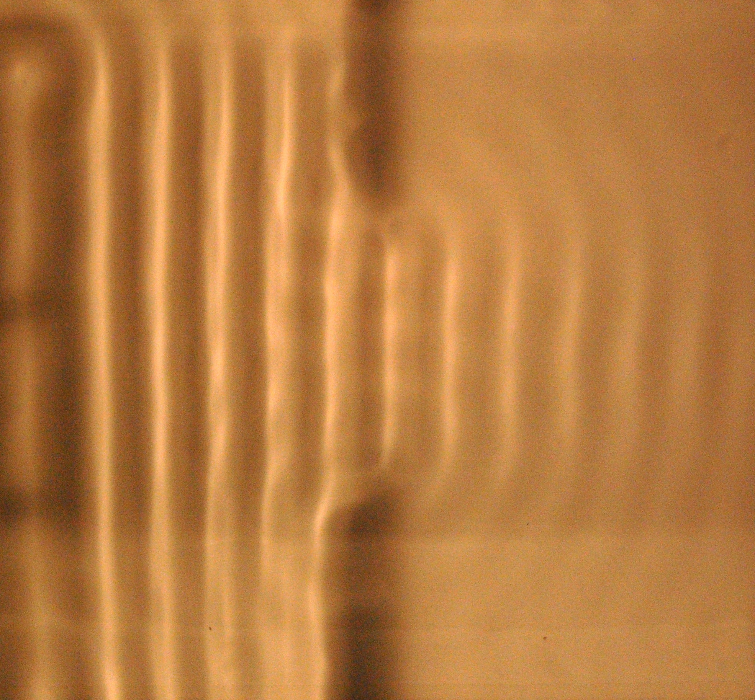
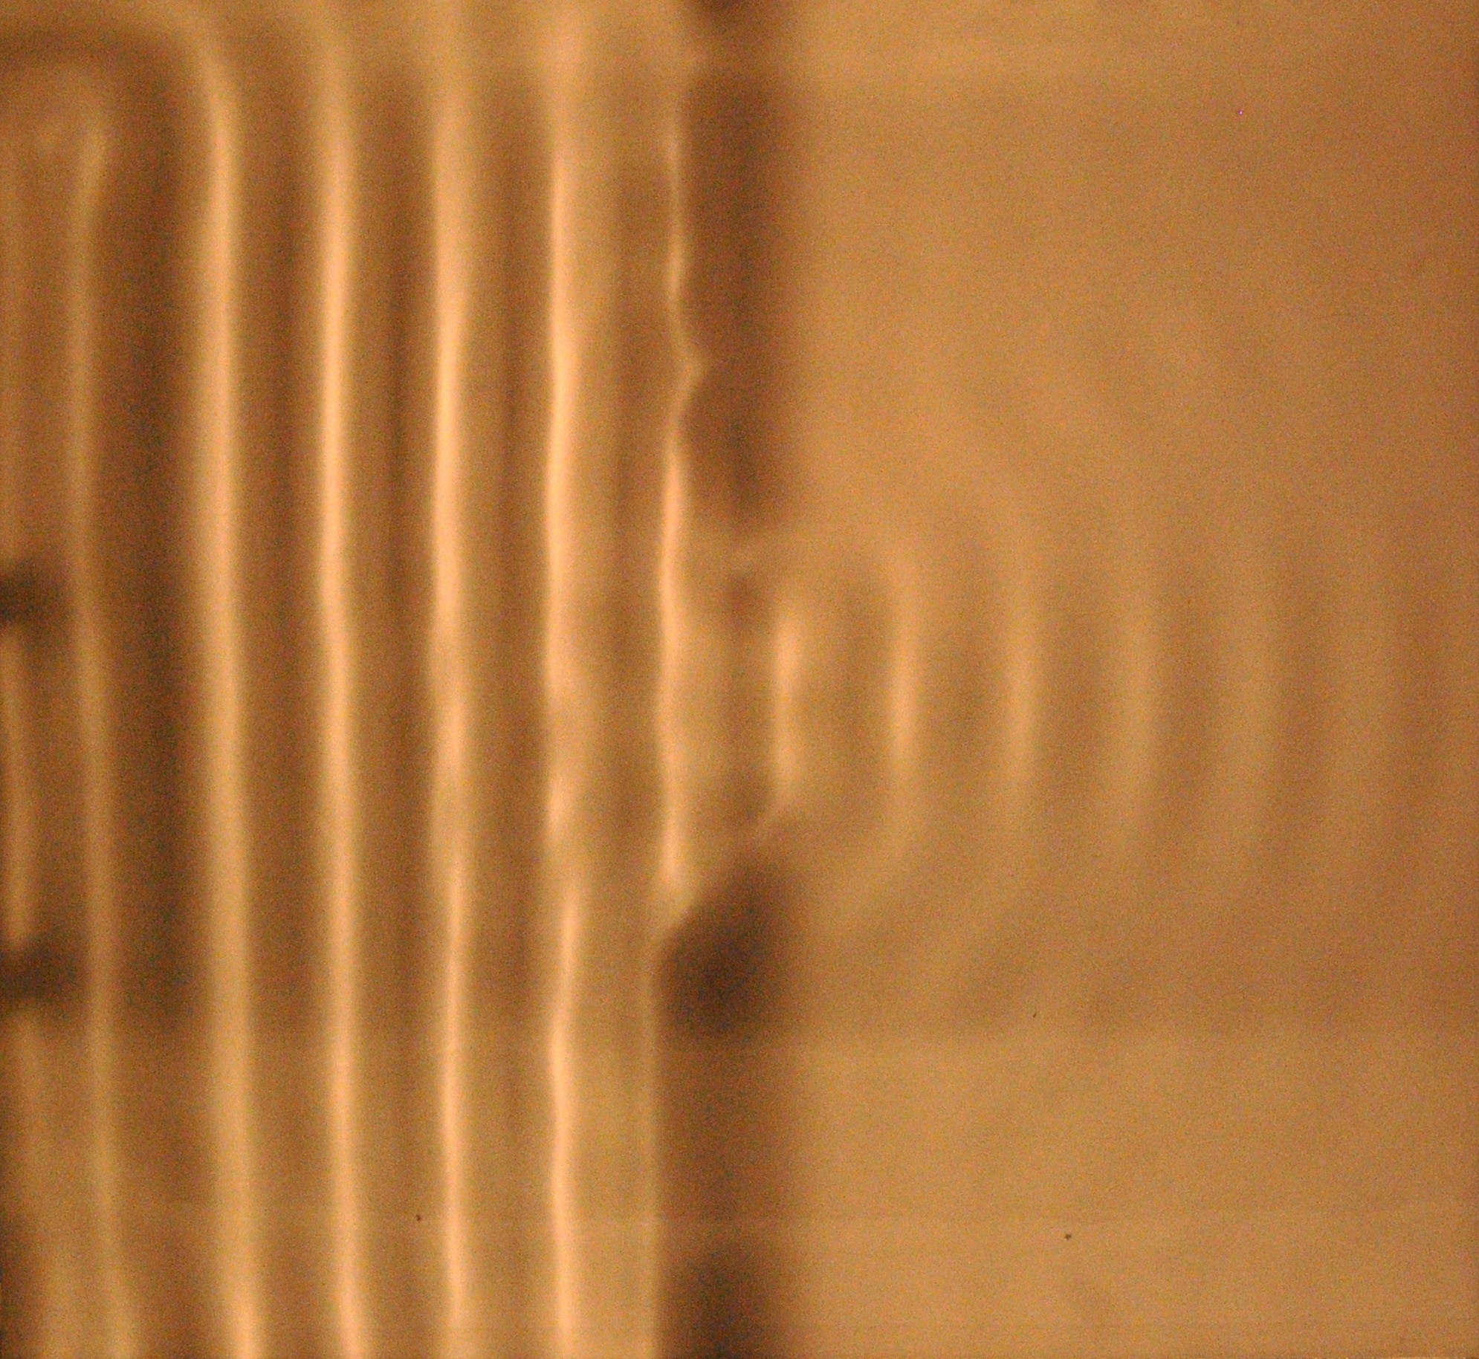
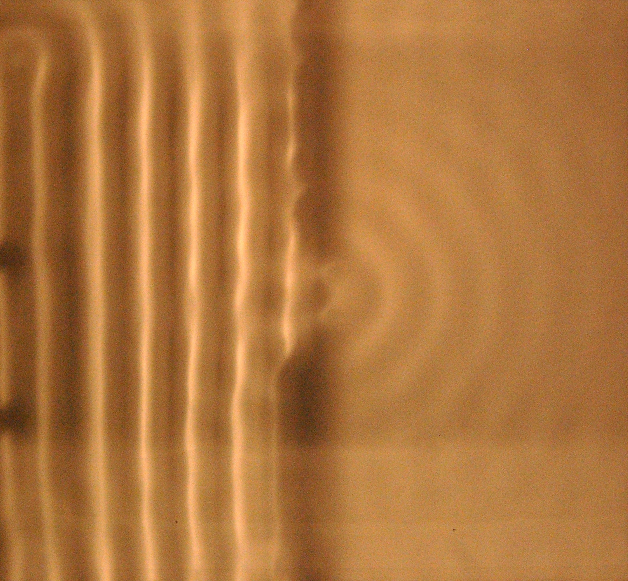
Actual Ripple Tank Images:
You are seeing the shadow image of light projected through square pan of water
Wave generator is bar along left edge moving up and down at regular frequency
Creates waves seen as bright / dark vertical lines in left half of image
About mid-tank, two barriers are inserted, one above the other, with gap between
In successive images, that gap is narrowed (actual gaps smaller than appear below)
Gap ~ 5 λ Gap ~ 2 λ Gap < 1 λ
A Hands-on Introduction to Nanoscience: WeCanFigureThisOut.org/NANO/Nano_home.htm

Slide 20
It’s Called “Diffraction Limited Focusing”
If you try to limit a wave to a width smaller than its wavelength . . .
By passing it through a hole or slit
Or by focusing it toward a point with a lens
It doesn’t work!!!!
In fact, it backfires: Beam blows up into circular wave moving out in all directions!
So, while you can START to reduce the size of a light image with a lens
You will not succeed in reducing features in that image to less than λ
THIS is why light image based processing techniques fail at the Nanoscale
A Hands-on Introduction to Nanoscience: WeCanFigureThisOut.org/NANO/Nano_home.htm

Slide 21
Also demonstrates useful way of deconstructing "plane" waves
Row of circular wave point sources But short row => ~ Circular wave
=> Plane wave, iff row is long enough
So can actually think of plane wave as being equal to a long row of point sources
> λ
< λ
"A Hands-on Introduction to Nanoscience: WeCanFigureThisOut.org/NANO/Nano_home.htm

Slide 22
Can use to analyze the effect of blocking objects
Plane wave passing by an object: Equivalent effect of blocking object:
Blocking object "removed" sources needed to produce center of wave
A Hands-on Introduction to Nanoscience: WeCanFigureThisOut.org/NANO/Nano_home.htm

Slide 23
But if object is smaller than a wavelength in size . . .
Surviving sources: Blocked/removed sources:
Blocked sources not wide enough to create plane wave!
So now missing center part of PLANE wave MUST have been created by BOTH now blocked center sources PLUS sources to sides (above and below)
But sources to the side are still there. And they are still doing their part to create continuing wave in the blocked gap!
"A Hands-on Introduction to Nanoscience: WeCanFigureThisOut.org/NANO/Nano_home.htm

Slide 24
So affect of blockage smaller than wavelength is:
Surviving sources:
Wave sort of "heals itself"
Because for blockage narrower than a wavelength
the loss was not critical:
Surviving sources above and below are still
close enough to fill in the missing wave
Plane wave continues almost as if object were not there!
A Hands-on Introduction to Nanoscience: WeCanFigureThisOut.org/NANO/Nano_home.htm

Slide 25
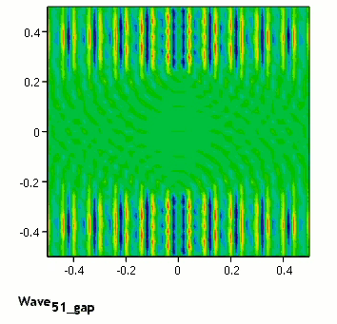
Mathcad Simulation Demonstrating Thus:
Link to animated simulations: Waves Generic - Supporting Materials - Simulation 8

Slide 26
Which then predicts how particles SCATTER light
If particle is larger than the wavelength of the light
It will block the light, casting a shadow
And if it is non-absorbing, blocked light will be "scattered" backward
If, on other hand, particle is SMALLER than λ . . .
Object will cast ~ zero shadow
Meaning that ~ all of light's energy continues forward
Implying (correctly) that ~ zero light is scattered backward
Almost as if that small particle is invisible to that light!
Why Nanoparticles, smaller than light’s wavelength, are being used in SUNBLOCK!
What? Explain!
A Hands-on Introduction to Nanoscience: WeCanFigureThisOut.org/NANO/Nano_home.htm

Slide 27
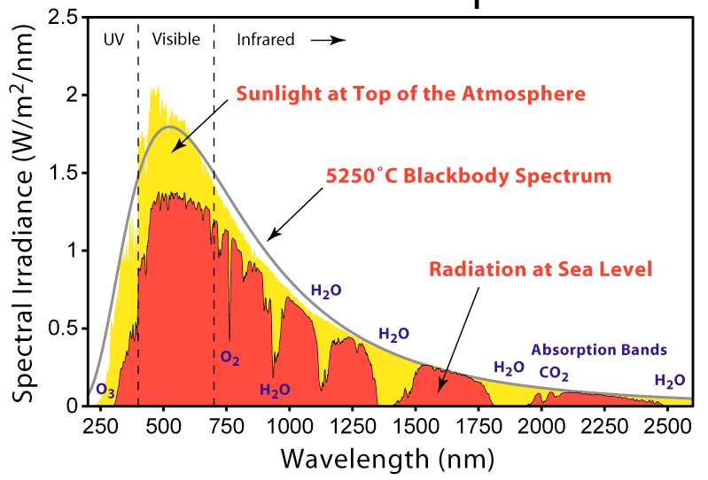
What ARE the Wavelengths of Light?
Infrared > 0.75 microns = 750 nanometers
Red ~ 0.65 microns = 650 nanometers
Blue ~ 0.45 microns = 450 nanometers
UV < 0.40 microns = 400 nanometers
Or getting a bit more precise, sun’s intensity versus wavelength (Wikipedia):
A Hands-on Introduction to Nanoscience: WeCanFigureThisOut.org/NANO/Nano_home.htm

Slide 28
So how does this relate to nanoparticles in sunblock?
Infrared > 0.75 microns = 750 nanometers
Red ~ 0.65 microns = 650 nanometers
Blue ~ 0.45 microns = 450 nanometers
UV < 0.40 microns = 400 nanometers
Damaging UV light includes "UVA" = 400 - 320 nm and "UVB" = 320 - 290 nm
Sunblocks can BLOCK in one of two ways: By absorbing UV or scattering UV
From preceding, to strongly scatter UV, particle must be at least the size of UV wavelength
Implying that size of strongly UV scattering particle ≥ 400 nm
But if particle's bigger than VISIBLE light, it ALSO scatter that light => sunblock looks white
So instead ONLY use particle size of ~ 400 nm => ONLY get UV scattering
A Hands-on Introduction to Nanoscience: WeCanFigureThisOut.org/NANO/Nano_home.htm

Slide 29
Wavelength of light also affected history of light-based microfabrication
In 1960's they started out by using blue light images
From 1970's to the present they moved farther and farther into UV
Problem along the way: Glass (SiO₂) absorbs light with wavelength < 200 nm
So below 200 nm had to switch to lenses made from exotic ($) new materials
They now use UV light with wavelength of about 100 nm (= minimum IC feature)
With really heroic (hundred mega $) lens systems, may reach ~ 50 nm
But lenses (of any material) stop focusing much beyond that
Must go to (giga $) curved mirror focusing systems,
or even weirder schemes, which many doubt will ever be practical
Lenses stop focusing at extreme short wavelengths, why? Must explain refraction:
"A Hands-on Introduction to Nanoscience: WeCanFigureThisOut.org/NANO/Nano_home.htm

Slide 30
Refraction of Waves
All lenses work on the basis of refraction
Has to do with fact that speed of waves is different in different materials
For instance, light moves at speed: c ( = 299,792 km/s) in vacuum
c / 1.000277 in STP air
~ c / 1.5 in typical glasses
~ c / (3-5) in semiconductors
Denominator has a name: "Index of refraction" or "n"
As water starts to shallow out, its waves slow (n increases)
(Remember explanations of the "Boxing Day" Asian Tsunami?)
So set up a simple thought (German = "Gedanken") experiment:
A Hands-on Introduction to Nanoscience: WeCanFigureThisOut.org/NANO/Nano_home.htm

Slide 31
Deep water (fast wave) entering from left,
moving to region of shallow water (slow wave) at right
Progressive times:
Or shrinking down steps at interface into continuous curve:
It’s a "refractive" lens! Just have to shape region of slower wave appropriately
A Hands-on Introduction to Nanoscience: WeCanFigureThisOut.org/NANO/Nano_home.htm

Slide 32
So why would lenses stop working at extreme short wavelengths?
What do we mean by "extreme" wavelength:? X-rays and shorter wavelengths
Refraction requires slowing of wave in one material
Slowing of light waves requires interaction of waves with that material:
Electric & magnetic (EM) fields of wave set charges of material into motion
Charge motion sets up secondary "induced" EM waves
SUPERPOSITION of all waves => slowed net wave
But we know that X-rays go right through most materials
Because EM fields oscillate so fast that material's charges can't follow
Result: No induced EM fields => No slowing => No refraction => No lenses

Slide 33
Reflection of waves
When a wave bumps into something, it bounces back
ALSO occurs when wave moves between regions of different speed (e.g. above)
MATH-FREE explanation:
Waves carry something: Energy
Materials that do not absorb wave energy = "transparent"
So, in transparent materials wave energy must be conserved!
How do waves "work this out?"
Another (even simpler) "Gedanken" thought experiment:
A Hands-on Introduction to Nanoscience: WeCanFigureThisOut.org/NANO/Nano_home.htm

Slide 34
Fast waves entering from left, moving into region where they move more slowly:
Say wave at left moves as 2 m/s, and continuing wave at right at 1 m/s
Energy moves at same velocity as wave: In 2 m/s from left, out 1 m/s to right
Energy is entering faster than leaving => building up => water boils . . .
Not with "transparent" non-energy absorbing materials!! SOLUTION?
Some of the wave from left reflects back to left removing the extra energy
Energy α amplitude², so just force sum of amplitudes to match at boundary:
Wave _{in} + Wave _{reflected} = Wave _{transmitted} (at the boundary)
A Hands-on Introduction to Nanoscience: WeCanFigureThisOut.org/NANO/Nano_home.htm

Slide 35
Plus a little math, for waves moving perpendicular to boundary get:
Reflected wave energy = [(n₁- n₂) / (n₁+ n₂)] ² x incident wave energy
Consequences?
Shine laser pointer from air (n₁ = 1) through glass (n₂ = 1.5)
Reflected fraction = [(1-1.5)/(1+1.5)] ² = [0.5/2.5] ²= 4%
Explains why powders tend to be white. Can you figure out why?
Shine laser down a quartz fiber (where beam intersects walls at shallow angle)
Formula above then complicated by additional trigometric functions
Reflection is much stronger => 100% = Basis for fiber optic communications
Leading to the topic of trapped waves
(e.g. electrons trapped in nanoparticles)
with which I will start the next class

Slide 36
Credits / Acknowledgements
Funding for this class was obtained from the National Science Foundation (under their Nanoscience Undergraduate Education program).
This set of notes was authored by John C. Bean who also created all figures not explicitly credited above.
Copyright John C. Bean
(However, permission is granted for use by individual instructors in non-profit academic institutions)
A Hands-on Introduction to Nanoscience: WeCanFigureThisOut.org/NANO/Nano_home.htm

