Slide 1
The Bleeding Edge – Part III: Emerging Applications in Nanoelectronics
Today, completing set of three lectures: Use of nano for information technology
Including:
1) The REAL size of transistors and their shrinkage
2) Why they can't get much smaller (including the POWER PROBLEM)
3) Weird NEW switches that might circumvent power and scaling problems:
QCA, Single electron transistors / NDR . . .
= Routes toward a true successor nanoelectonic technology?
A Hands-on Introduction to Nanoscience: WeCanFigureThisOut.org/NANO/Nano_home.htm

Slide 2
Echoing the first lecture: What IS nanoelectronics?
Microelectronics HAS shrunk to near nanometer size
But does that imply "nanoelectronics" is just a new name for microelectronics?
In other words, that it qualifies as "nano" based only on a technicality
Or, following my first lecture definition, might it be fundamentally different?
Where smallness makes things act in unprecedented and unexpected ways
To answer, we need to look more closely at the shrinkage of microelectronics
Bringing us back to "Moore's Law:"
A Hands-on Introduction to Nanoscience: WeCanFigureThisOut.org/NANO/Nano_home.htm

Slide 3
Moore's Law revisited:
Which is not really a law, but an after dinner speech that went viral!
Intel's (self-inflicted) curse:
(Because Wall Street now
expects it to be followed)
(Source: www.intel.com/technology/mooreslaw/index.htm)
"Integrated circuit complexity (# of transistors) doubles ~ every 18-24 months"
A Hands-on Introduction to Nanoscience: WeCanFigureThisOut.org/NANO/Nano_home.htm

Slide 4
What has driven this increase in complexity?
Possibility #1: Circuits have gotten larger (more area => fit in more transistors)
No!: Original 1960's IC's were about 1 cm² in area
Modern microprocessors might reach 10 cm² (net growth of only 10X)
Possibility #2: Individual transistors have gotten MUCH smaller
Yes! = "Nodes" – numbers that sort of describe transistor's size:
Year 1971 1982 1989 1994 2004 2008 2012 2014
Node 10 um 1.5 um 800 nm 600 nm 90nm 45 nm 22 nm 14 nm
That seems like a strange sequence of numbers?
It originally denoted wavelength of UV light source used in making the circuit
=> smallest ("diffraction limited") circuit feature
A Hands-on Introduction to Nanoscience: WeCanFigureThisOut.org/NANO/Nano_home.htm

Slide 5
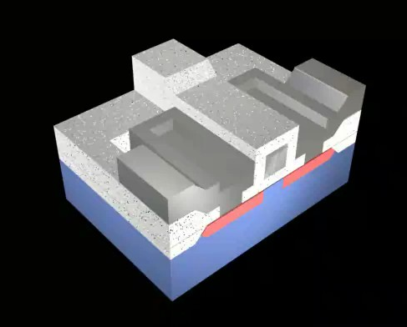
But that means, at least by one definition, IC's ARE nano!
Yes and no:
First, they were already embellishing things a bit:
Nodes = "smallest feature size"
E.g. the width of a metal line, or size of an oxide mesa
Transistors have many such features, hence they are 5-10 times larger
"Feature" (gate electrode)
vs. full transistor size:
https://WeCanFigureThisOut.org/VL/IC_process.htm
A Hands-on Introduction to Nanoscience: WeCanFigureThisOut.org/NANO/Nano_home.htm

Slide 6
And then it gets even fuzzier
"The End of the Shrink" - IEEE* Spectrum magazine (November 2013)
*IEEE = Institute of Electrical & Electronic Engineers (international, almost half million members)
"The relationship between node names and chip dimensions is far from straightforward.
Nowadays, a particular node name does not reflect the size of any particular chip feature"
The reporter asked:
"What do you mean by 14 nm?'"
She (a vice president for process development at IMEC):
"let out a wry, knowing laugh . . .'Ah ... what's in a name?
Actually not that much any more.'"
A Hands-on Introduction to Nanoscience: WeCanFigureThisOut.org/NANO/Nano_home.htm

Slide 7
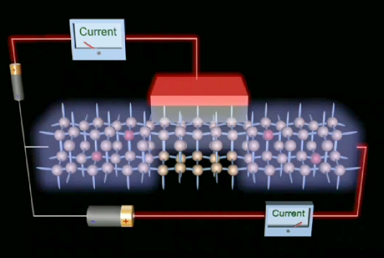
So no, even leading edge IC's are not truly "nanoelectronics"
They are instead being held back by several factors:
1) "Diffraction limited focusing" => Can't make beams narrower than wavelength
Well, just continue moving to even smaller wavelengths, right?
Go much smaller and UV light becomes X-ray "light"
Which doesn't slow down much in materials => Can't make lenses!!
2) "Electron tunneling" => Electrons tunnel THROUGH insulators < 1 nm thick
But MOSFET transistors DEPEND
on insulating layer BLOCKING
electron flow from "gate" into body
https://WeCanFigureThisOut.org/VL/MOS_kit.htm

Slide 8
Plus one more HOT problem: Power
Smaller transistors => You can fit in more per area of circuit (=> Moore's Law)
Smaller transistors => Smaller power required to operate each transistor
HOWEVER for MOSFET transistors (the workhorse of the IC industry):
As size shrinks, power consumption does not fall as rapidly
So an IC packed with smaller transistors consumes MORE power / area!
Big deal . . . Buy an extra/bigger battery!
No, there can be more significant ramifications:
Notice how “notebook” computers replaced “laptop” computers? Know why?
Computers got so HOT they can burn your lap - So lawyers said change name!

Slide 9
Evolution of power density in microprocessors
YES! Power density in modern microprocessor > that put out by rocket nozzle
And is heading (rapidly) for power/area of SUN’s SURFACE (!!@#!!)
Sun’s Surface
1
0
0
0
0
R
P
6
R
R
o
o
o
c
c
c
k
k
k
e
e
e
t
t
1
0
t
0
0
N
N
N
o
o
o
z
z
z
z
z
z
l
l
l
e
e
N
e
N
N
u
u
u
c
c
c
l
l
l
e
e
e
a
a
a
r
r
r
P
5
Power Density (W/cm2)
R
R
R
e
e
e
a
a
a
c
c
c
t
t
t
o
o
o
r
r
r
P
4
1
0
0
Figure courtesy of
Prof. Greg Snider,
U. Notre Dame
P
3
H
P
2
H
o
o
t
t
P
P
l
l
a
a
t
t
e
10
8
0
8
6
e
8
0
0
8
P
e
n
t
i
u
m
P
r
o
8
0
8
5
P
e
n
t
4
0
0
4
3
8
6
i
u
m
2
8
6
4
8
6
1
8
0
8
0
1
9
7
0
1
9
8
0
1
9
9
0
2
0
0
0
2
0
1
0
A Hands-on Introduction to Nanoscience: WeCanFigureThisOut.org/NANO/Nano_home.htm

Slide 10
So there is a big incentive to “get weird”
To develop devices very UNLIKE present day field effect transistors
Devices with far less charge movement => MUCH lower power per device
Maybe even devices that don’t move charge:
Based on nano magnetism (a.k.a. atomic “spin”)?
Based on photons? (but they are so darned big!)
Based on . . . (?)
Or devices that are NOT intrinsically analog (as today's transistors are)
You'd no longer need a surrounding circuit to force digital behavior
Intrinsically digital devices could instead stand alone: One device = 1 bit
Quantum Mechanics to the rescue (because you can’t get much weirder)!
A Hands-on Introduction to Nanoscience: WeCanFigureThisOut.org/NANO/Nano_home.htm

Slide 11
Getting weird with Quantum Mechanical Tunneling
Here we need to remember the full details of tunneling (from third lecture):
Tunneling occurs when an electron wave tries to penetrate an energy barrier
Energy barrier is formed in gaps between conducting materials:
THIS gap is higher energy because it lacks the positive nuclei that electrons like
A "Gap" would also be higher energy if it contained an excess of negative charge
E = V _{barrier}
E _{electron}
E = 0

Slide 12
Probability an electron can tunnel through such a barrier?
From the earlier lecture on electron waves, for a gap energy barrier like this:
We learned that, within the barrier, the electron wavefunctions die away as:
Ψ (x) ² = C e ^{- 2k x} where k = √ [2 m (V _{barrier} - E _{electron}) / h _{bar} ²]
Bigger k is, faster the wave dies away! Less left over to continue on other side!!
Key factor in k is V-E = how high barrier towers above electron (in energy)
E = V _{barrier}
E _{electron}
?
E = 0
"A Hands-on Introduction to Nanoscience: WeCanFigureThisOut.org/NANO/Nano_home.htm

Slide 13
Giving tunneling probabilities for various kinds of barriers:
Barrier: 0.1 nm 0.3 nm 1 nm 3 nm 10 nm
Similar material 0.63 0.25 0.01 1x10⁻⁶ < 10⁻¹⁵
(0.2 eV)
Insulator (2 eV) 0.36 0.046 3x10⁻⁵ 4x10⁻¹⁴ < 10⁻¹⁵
Air / Vacuum (4 eV) 0.13 2x10⁻³ 1x10⁻⁹ < 10⁻¹⁵ < 10⁻¹⁵
Through vacuum (ΔE ~ 4 eV) can only go fraction of nm:
Basis for STMs we use in lab
But through lower barriers, retain finite tunneling probabilities for 1-3 nanometers:
Basis for MANY nanodevices Examples?

Slide 14
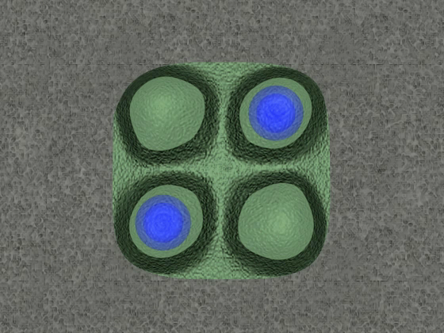
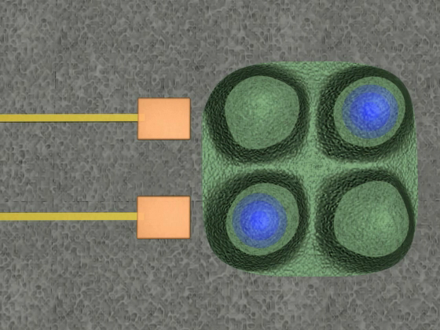
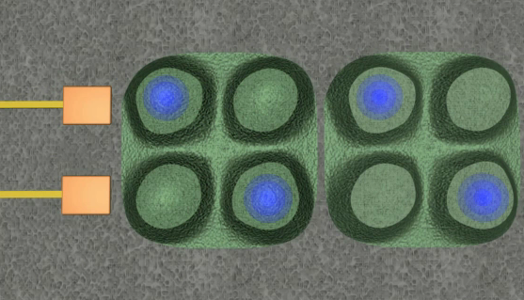
As applied to "Quantum Cellular Automata"
Introduced in lecture on self-assembly - But what is their necessary scale?
To switch between logic states, electrons must move between dots
Option 1: Jump through vacuum → ΔE ~ 4 eV Separation needed < tenths of nm
That's atomic spacing! QCA dots would have to be individual atoms!
Option 2: Jump through substrate → ΔE ~ 0.2 eV Separation needed < few nm
Dots ~ tens of nanometers (possible, remember self-assembled quantum fortresses?)
ALSO would be about right size if dot is to accommodate only one extra electron
"A Hands-on Introduction to Nanoscience: WeCanFigureThisOut.org/NANO/Nano_home.htm

Slide 15
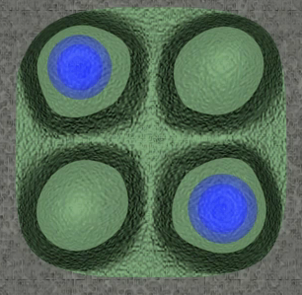
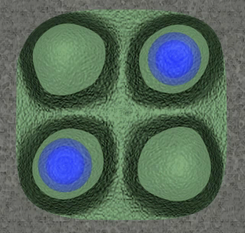
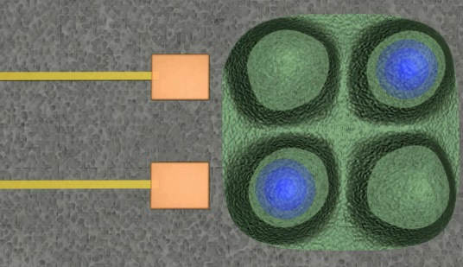
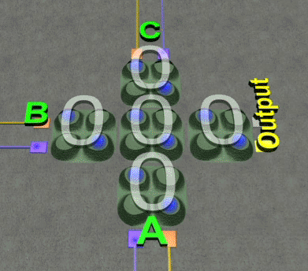
How to make QCA cells into powerful (yet simple) digital devices:
1) Define one electron arrangement as a digital “0” and the other as a digital “1”
= 0 = 1
2) Bring in plus and minus charged metal lines to program cell
_
+
3) Then arrange five cells like this
A Hands-on Introduction to Nanoscience: WeCanFigureThisOut.org/NANO/Nano_home.htm

Slide 16
This functions as a digital MAJORITY gate:
Three input votes (A, B, C) => Majority vote on output:
Supporting webpage with animated explanation of QCA MAJORITY gate function:
Bleeding Edge Nanoelectronics - Supporting Materials - QCA MAJORITY
"A Hands-on Introduction to Nanoscience: WeCanFigureThisOut.org/NANO/Nano_home.htm

Slide 17
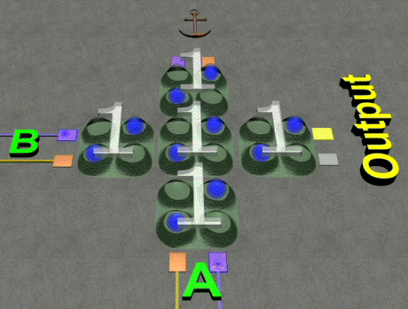
If instead hold one input at 1, functions as a digital OR gate:
Fix top input at 1 (anchor via fixed voltages on its input metal lines - not shown)
Then get 1 out if either A OR B input goes to 1 (guarantees majority of 1’s)
Supporting webpage with animated explanation of QCA OR gate function:
Bleeding Edge Nanoelectronics - Supporting Materials - QCA OR
A Hands-on Introduction to Nanoscience: WeCanFigureThisOut.org/NANO/Nano_home.htm

Slide 18
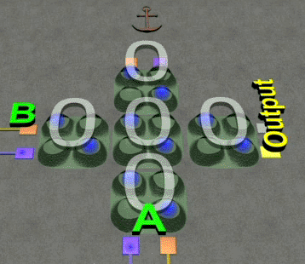
If hold one input at 0, functions as a digital AND gate:
Fix top input at 0 (anchor via fixed voltages on its input metal lines - not shown)
Then to get 1 out, both A AND B must be at 1 (to get majority of 1’s)
Supporting webpage with animated explanation of QCA AND gate function:
Bleeding Edge Nanoelectronics - Supporting Materials - QCA AND
A Hands-on Introduction to Nanoscience: WeCanFigureThisOut.org/NANO/Nano_home.htm

Slide 19
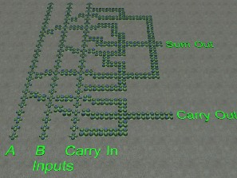
In addition to Boolean logic, QCA’s can do math:
Layout of QCA cells required to add digital inputs => digital sum and carry bit:
Adder circuit can then be easily modified to subtract => multiplication and division
Together, provide functionality necessary for a quantum dot computer
(DISCLAIMER: QCA still has problems with direction of information flow and clocking of data)
A Hands-on Introduction to Nanoscience: WeCanFigureThisOut.org/NANO/Nano_home.htm

Slide 20
Second “weird” idea: Devices using tunneling CURRENT
?
Your intuition probably says the current will increase as you increase the voltage
But don't see anything about voltages and electric fields on preceding pages
They enter through their effect on the barrier:
Voltage → Electric Field
→ Energy decrease to right
E _{electron}
E _{electron}

Slide 21
As electron tunnels through barrier, its height decreases
Analogous to series of very thin barriers of decreasing height:
=
"Barriers" less & less troublesome as move to right → less effective at diminishing current flow
So your intuition IS correct Further, more voltage → more tilt → much weaker net barrier
So expect tunneling current vs. applied voltage to go something like:
I
Voltage
A Hands-on Introduction to Nanoscience: WeCanFigureThisOut.org/NANO/Nano_home.htm

Slide 22
Tunneling current across 2 gaps in series?
Physical Structure:
Barrier diagram:
Can still tunnel. But twice as hard to tunnel across two gaps
So likely just get less current:
E _{electron}
I
Voltage

Slide 23
But this all changes when things get really small
Tunneling current starts flowing: But then runs into a problem:
Charge added to middle "quantum dot" repels charges trying to follow!
There is just not enough room on nano center dot for TWO negative charges to happily coexist
Result is that more charges jump from left ONLY when center charge jumps off to right
Blockage is caused by charge repulsion in confined space
Charge repulsion also called “coulomb repulsion" so phenomena is known as
COULOMB BLOCKADE
V_{ds}
V_{ds}
A Hands-on Introduction to Nanoscience: WeCanFigureThisOut.org/NANO/Nano_home.htm

Slide 24
So “Coulomb Blockading” will just further limit current?
Yes, but can counter by adding another electrode to side of center Q-dot
On center Q-dot, repulsion between two electrons had prevented two from jumping on
But now side “gate” counters this by adding nearby attractive positive charge
For the EE’s: The side gate electrode is forming a charging capacitor with the Q-dot
V_{g}
V_{ds}
V_{ds}
A Hands-on Introduction to Nanoscience: WeCanFigureThisOut.org/NANO/Nano_home.htm

Slide 25
And as you further increase attractive voltage on side gate:
V_{g} = 0
V_{g} = e/C
V_{ds}
V_{g} = 2e / C
V_{ds}
At higher side (“gate”) voltages,
expect 1, 2, 3 . . . charges on center Q-dot
V_{ds}
A Hands-on Introduction to Nanoscience: WeCanFigureThisOut.org/NANO/Nano_home.htm

Slide 26
Giving this electrical behavior:
With fixed end-to-end voltage (V_{ds}), as you ramp up side gate voltage (V_{g}) expect:
Or plotting the slope (known as the “conductance” = dI/dV_{g}):
(for explanation of magic voltages above, see appendix at the end of this lecture)
I = electron flow
V_{ds} = fixed
V_{g}
e/C
2e/C
3e/C
dI/dV_{g}
V_{ds} = fixed
V_{g}
e/C
2e/C
3e/C
A Hands-on Introduction to Nanoscience: WeCanFigureThisOut.org/NANO/Nano_home.htm

Slide 27
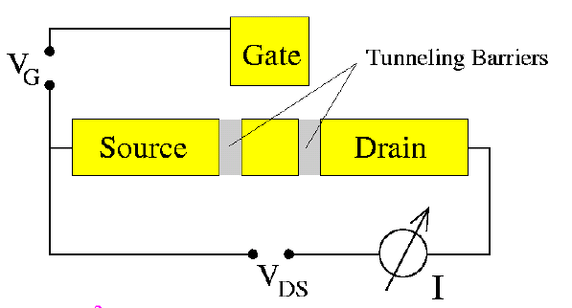
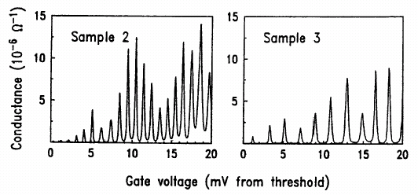
Which is indeed seen in “Single Electron Transistors” (SETs)
(from Kastner, Reviews of Modern Physics 64, 849 (1992))
A Hands-on Introduction to Nanoscience: WeCanFigureThisOut.org/NANO/Nano_home.htm

Slide 28
Third weird (but related) idea: Negative Differential Resistance (NDR)
"Resistance" = resistance to electron flow when push (from Voltage) is applied
If electron flow (current = "I")
increased in proportion to push (Voltage):
Steeper the slope, more current per push => less "resistance"
So "resistance" = reciprocal of slope = dV/dI (constant in plot above)
But for many things, including transistors, slope is NOT constant:
MOSFET "I-V characteristic:"
Slope falls, resistance increases as push harder
I
V
I
V
A Hands-on Introduction to Nanoscience: WeCanFigureThisOut.org/NANO/Nano_home.htm

Slide 29
What if slope actually went negative?
What would happen, and how might I exploit it?
One way to achieve: TWO closely spaced barriers:
BETWEEN the two barriers the electron is in a box => STANDING WAVES
Which can only have certain specific wavelengths and thus specific energies
Electron from left needs to briefly rest on allowed energy level between barriers
Or else it would have to tunnel complete distance in one hop (~ impossible)
So to cross, incoming energy must match up with one of the standing wave levels!
E _{electron}
E _{electron}
DE
A Hands-on Introduction to Nanoscience: WeCanFigureThisOut.org/NANO/Nano_home.htm

Slide 30
Or, can “tune” positions by applying an end to end voltage:
Assume (realistically) that left, center and right are conductors
Then ~ all of voltage drop occurs across the insulating spacer barriers
(Note: voltage = energy / charge, and electric field = voltage / distance)
Leading to energy vs. position diagram of:
Certain applied voltages will PULL center levels down to match incoming energy
At only(!) those voltages will we get strong current through the nano-device
E _{electron}
A Hands-on Introduction to Nanoscience: WeCanFigureThisOut.org/NANO/Nano_home.htm

Slide 31
Actual physical structure would look more like:
NO voltage applied => No match of levels => little or no electron flow
WITH medium voltage applied => MATCH! => current flow
With larger voltage applied => Match is lost => little or no electron flow
=
E _{electron}
DE
=
E _{electron}
=
E _{electron}

Slide 32
But eventually there'd be match with 2nd level, producing:
As voltage increases, get one (or more) peaks in current
Followed by valleys
"Negative Differential Resistance" - NDR
(because I vs. V slope is briefly negative)
Useful? What if external circuit only allowed one fixed current through NDR device?
I
V
I
NDR device MUST be at one of three voltages
Can be shown that it won't STAY at V₂
But still left with TWO stable voltages V₁ or V₃
Digital "0" and digital "1"
I_{o}
V
V₁
V₂
V₃
A Hands-on Introduction to Nanoscience: WeCanFigureThisOut.org/NANO/Nano_home.htm

Slide 33
Hold it!
Doesn't attached constant current circuit = added complexity elsewhere?
Negating the circuit simplification NDR's were supposed to offer? YES!
What if used paired NDR devices? And fixed the voltage across PAIR of NDR's:
What is going on with NDR ₁ ?
It's possible current flow vs. voltage:
V _{PS} = power supply
NDR ₂
I
V _{middle} = ?
NDR ₁
V = 0
V _{middle}
A Hands-on Introduction to Nanoscience: WeCanFigureThisOut.org/NANO/Nano_home.htm

Slide 34
Leaving remainder of voltage for NDR₂
I
NDR ₂ :
NDR₂ gets leftover part of power supply voltage, so flip over onto first plot:
V_{PS} - V _{middle}
Don't initially know acceptable value of current, I
But NDRs are in series so MUST have SAME current
V_{middle} MUST settle to value where curves intersect →
I
V _{middle}
V_{PS}

Slide 35
Center voltage of paired NDRs settles into one of two states
I
V _{PS} = power supply
NDR ₂
V _{middle} = V_{mid 1} or V_{mid 2}
NDR ₁
V = 0
V_{mid 1}
V_{mid 2}
V_{PS}
This strikingly simple but effective circuit = "Goto Pair" (after Japanese inventor)
Which combine into:
Design Approaches for Hybrid CMOS/Molecular Memory based on Experimental Device Data, G.S. Rose, A.C. Cabe, N. Gergel-Hackett, N. Majumdar, M.R. Stan, J.C. Bean, L.R. Harriott, Y. Yao, and J.M. Tour, Proc.16th ACM Great Lakes symposium on VLSI, pp. 2 - 7 (2006)

Slide 36
And there are LOTS of ways of creating required energy diagram!
One actually predates current nano craze:
Developed in 1980's when we already knew how to grow VERY THIN crystal layers
Used "Molecular Beam Epitaxy" (atomic spray painting – self-assembly lecture)
=
DE
Were called “Resonant Tunneling Diodes" (RTDs)
In that incoming electron wave had
to resonate with bound level in center layer
A Hands-on Introduction to Nanoscience: WeCanFigureThisOut.org/NANO/Nano_home.htm

Slide 37
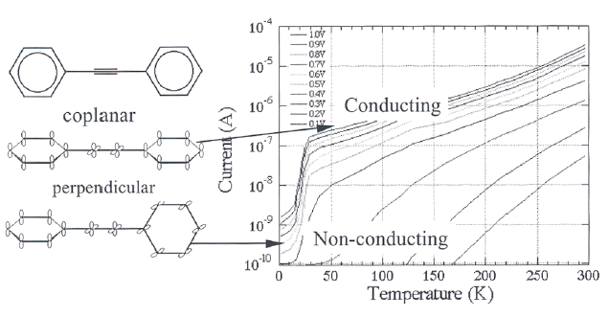
An entirely different way of making an NDR (or NDR like) device:
That molecule I described in second slide of first lecture:
Current changes as such molecules twist under an applied voltage
J. Chen and M.A. Reed, J. Chem. Phys 281, p127 (2002)

Slide 38
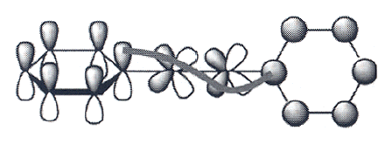
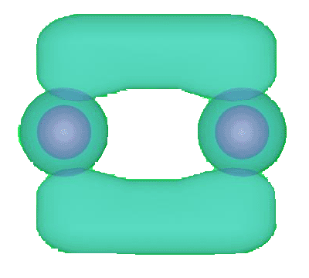
Still barriers & tunneling, but described in terms of Pi electron orbitals:
Pi electrons were the strange ones that stuck out perpendicular to main bonds
If have pi electrons on adjacent atoms, bridge together to form conductive pi bonds
But as molecule twisted by voltage, alignment is lost, pi bonds weaken → NDR
(or at least, that is ONE of the theories!)

Slide 39
Giving at least three very weird ways of getting digital devices:
QCA’s: SETs’: NDR's:
Which MIGHT emulate/surpass transistor digital circuits
But by making use of VERY WEIRD non-transistor devices
DISCLAIMER: None of these particular schemes has yet succeeded (and may never!)
But they are true nanoelectronic alternatives (along with many, many others)
And show that nanoelectronics will probably NOT be shrunken version of microelectronics!
A Hands-on Introduction to Nanoscience: WeCanFigureThisOut.org/NANO/Nano_home.htm

Slide 40
Credits / Acknowledgements
Funding for this class was obtained from the National Science Foundation (under their Nanoscience Undergraduate Education program).
This set of notes was authored by John C. Bean who also created all figures not explicitly credited above.
Copyright John C. Bean
(However, permission is granted for use by individual instructors in non-profit academic institutions)
NOTE:
Special appendix quantifying Coulomb Blockade nanoelectronic devices follows this slide
A Hands-on Introduction to Nanoscience: WeCanFigureThisOut.org/NANO/Nano_home.htm

Slide 41
Appendix Quantifying Coulomb Blockade behavior:
Need to expand understanding of “capacitors.” Use gas storage analogy:
Move a fixed amount of air into tanks of different size:
∆P₁ ?
∆P₁ ?
Will pressure changes be the same? Of course not:
MUCH more room for added air to spread out in bigger tank!
Pressure induced by addition of quantity of air is inversely proportional to volume:
That’s what the ideal gas law states: PV = nRT or . . .
P α Quantity / Vol or using Q for quantity: P(Q) α Q / Vol
A Hands-on Introduction to Nanoscience: WeCanFigureThisOut.org/NANO/Nano_home.htm

Slide 42
Work done to reach a given pressure?
NOT just proportional to amount of air added:
Because as air was added, had to fight increased pressure to add more!
So increment of work to add unit of air increases with pressure:
W (P) α P(Q) or from preceding page W (Q) α Q / Vol
= Work to add MORE air when have Q in tank increases as value of Q
So integrated energy expended in adding total quantity of air Q to tank is
∆ E_{stored} α Q² / 2 Vol
Recapping: P ~ Q / Vol and E ~ Q² / 2Vol
A Hands-on Introduction to Nanoscience: WeCanFigureThisOut.org/NANO/Nano_home.htm

Slide 43
Back to electrical world:
VOLTAGE corresponds PRESSURE CAPACITANCE corresponds to tank VOLUME
Capacitance is measure of a device structure’s ability to store charge
Integrated circuits use “planar” technology ~ single layer of more or less flat devices
In such flat devices, capacitance varies as their surface area: C = A (ε/d)
Putting this all together for modern planar electronic devices, expect:
P ~ Q_{gas} / Volume => Voltage = Q_{charge} / Capacitance
E ~ Q_{gas}² / 2 Volume => E = Q_{charge}² / 2 Capacitance
Using Q for quantity of air stored / quantity of charge stored
A Hands-on Introduction to Nanoscience: WeCanFigureThisOut.org/NANO/Nano_home.htm

Slide 44
Use in quantifying effect of “coulomb blockades” ?
General formulas for capacitors were:
Charge stored: Q = C V Voltage: V = Q/C Energy stored: E = Q ²/ 2 C
On nano capacitor (Q-dot + side gate) # of charges stored = n. Each with electron charge e:
Charge stored: Q = ne = CV Voltage: V = ne/C Energy stored: E = n ²e ²/ 2 C
Yielding this strange charge vs. voltage plot:
BIG capacitor: Steps so close together => continuous upward sloping line
NANO capacitor: Steps far apart and VERY significant => “Blockade”
Voltage jumps each time one electron added
OR
Must raise voltage e/C to add new electron
Q = n e
Side Gate Voltage
e/C
2e/C
3e/C
4e/C
5e/C
A Hands-on Introduction to Nanoscience: WeCanFigureThisOut.org/NANO/Nano_home.htm

Slide 45
Translating this into device “conductance” = dI_{ds} / dV_{g}:
Q vs. side gate voltage plot:
Translates into conductance plot of:
Q = n e
Side Gate Voltage (V_{g})
e/C
2e/C
3e/C
4e/C
5e/C
dI/dVg
V_{g}
e/C
2e/C
3e/C
4e/C
5e/C
A Hands-on Introduction to Nanoscience: WeCanFigureThisOut.org/NANO/Nano_home.htm

