Slide 1
Nuclear Energy – "But they blow up!"
John C. Bean
Outline
Nuclei: What they contain, how to keep track of this
Fission of abundant U238 vs. rare U235
Use of "moderators" to slow emitted neutrons => Sustained fission chain reactions
vs. neutron "poisons" vs. neutron "mirrors"
Chain reactions in bombs vs. chain reactions in nuclear reactors
Common "light water" moderated reactors:
Boiling Water Reactors (BWR) vs. Pressurized Water Reactors
As opposed to carbon moderated RBMK reactors
The Accidents:
Three Mile Island / Chernobyl / Fukushima Dai Ichi
The claim that massive use of concrete negates nuclear's ~ zero greenhouse emission
(Written / Revised: December 2017)

Slide 2
Nuclear Energy – “But the blow up!”
My sequence of topics has been a little strange:
I started with basic science
I then described almost all of the ways we traditionally produce electrical power
I followed this by descriptions of up and coming power technologies
Then, seemingly about to exhaust possibilities, described exotic long shots
And only now am I looping back to our biggest carbon-free technology:
Nuclear
I followed this path because I suspect many of you are uneasy with nuclear
So am I
An Introduction to Sustainable Energy Systems: WeCanFigureThisOut.org/ENERGY/Energy_home.htm

Slide 3
And I probably have more reason to be uneasy than you:
Early in my marriage, when my wife and I were hoping for a first child
A nuclear reactor called Three Mile Island blew up
125 miles directly upwind from our home
And we had to decide whether to evacuate my possibly pregnant wife
So yes, I am uneasy about nuclear, but following the path I've taken you along,
I've reluctantly concluded that greener technologies may not be ready
to have a big enough impact, in a short enough time
This has led me and many others (including major environmentalists)
To ask, not only if we might be able to live with nuclear,
but if it can improved to the point that we feel comfortable living with it

Slide 4
"But they blow up!"
Yes they (or at least three of them) have (sort of) blown up
So in this lecture we are going to learn how nuclear reactors blow up
AND, for comparison, how nuclear bombs blow up
Starting with a quick review of nuclear physics:
Nuclear physics is all about nuclei, which consist of protons plus neutrons
But protons and neutrons are capable of changing identities, for instance:
Neutron => proton + electron + ΔE or the reverse reaction
And that ΔE is HUGE, capable of boiling a lot of water, generating a lot of electricity
This all comes directly from Einstein's famous E = mc²
Which says that mass can actually be converted to immense energy
as occurs when protons & neutrons slightly shift their masses

Slide 5
Keeping track of atom's protons, electrons and neutrons:
Atoms start with equal numbers of protons and electrons, balancing charge
Their count is encoded in the atom's name, and in it's atomic number
Most carbon atoms have 6 protons (6 p) + 6 neutrons (6 n)
Giving carbon an atomic number of 6 (≠ its atomic mass of ~ 12)
The number of nucleons = number of protons + neutrons in atom's nucleus
But the number of neutrons in an atom varies => isotopes of an atom
In light atoms, numbers of protons and neutrons tend to be equal
In heavier atoms, neutrons tend to outnumber protons
Nucleon count is given by a leading superscript, as in ¹³C for carbon
From this, number of neutrons = [number of nucleons – number of protons]:
For ¹³C, neutron count = 13 – 6 = 7
For ¹²C (the more common isotope of carbon), neutron count = 12 – 6 = 6

Slide 6
Showing all of that schematically for ¹²C and ¹³C:
12C: 13C:
Protons = 6 = Electrons = Atomic Number Protons = 6 = Electrons = Atomic Number
Neutrons = 6 Neutrons = 7
But natural atomic abundances are 98.93% ¹²C, and only 1.07% ¹³C
So (averaged) atomic mass in nature works out to be 12.0107
Electrons
Electrons

Slide 7
In nuclear reactors (and bombs) a few atoms play major roles
Uranium (U), plutonium (Pu) and, perhaps in the future, thorium (Th)
Uranium, with an atomic mass of 238.02, is currently the major player
That mass suggests its main isotope is ²³⁸U, which is indeed the case:
²³⁸U: 99.27% Half-life: 4.6 billion years
²³⁵U: 0.72% Half-life: 703.8 million years
Plus other much less abundant isotopes (<0.01%)
Finite lifetimes => They ARE radioactive, eventually falling apart (releasing energy)
Extremely long lifetimes mean that very few decay in a given amount of time
So in reactors OR bombs something must vastly speed up the process of decay
An Introduction to Sustainable Energy Systems: WeCanFigureThisOut.org/ENERGY/Energy_home.htm

Slide 8
Decay is stimulated by capture of neutrons of particular energies:
The dominant ²³⁸U isotope captures high kinetic energy / "fast" neutrons
238U + 1n (hot/fast) => 239U => 239Np + β => 239Pu + β
where β ("beta") = a released high energy electron
Significantly: This decay sequence does NOT produce more neutrons
So while a neutron can CAUSE ²³⁸U to fission, that neutron is thereby consumed
And because it is not replaced, you cannot get a ²³⁸U chain reaction
Helping to explain ²³⁸U's surviving abundance
However, ²³⁸U's reaction DOES produce plutonium
Which works so well in bombs
Attracting would-be members of the "nuclear club"

Slide 9
Whereas:
235U prefers capture of low kinetic energy / "slow" / "thermal" neutrons
²³⁵U + ¹n (slow/thermal) => ²³⁶U => ⁸⁹Kr + ¹⁴⁴Ba + 2 ¹n + 200 MeV
With many other possible, but less likely, decay paths including: ¹
235U + 1n (slow/thermal) => 236U => 92Kr + 141Ba + 3 1n + 170 MeV
235U + 1n (slow/thermal) => 236U => 94Zr + 139Te + 3 1n + 197 MeV
The weighted average of these paths => ²³⁵U fission produces ~ 2.4 neutrons
Because these neutrons tend to have lots of kinetic energy = hot / fast
they don't strongly stimulate other ²³⁵U atoms to decay
But as hot / fast neutrons, they DO stimulate ²³⁸U atoms to decay
1) http://www.world-nuclear.org/information-library/nuclear-fuel-cycle/introduction/physics-of-nuclear-energy.aspx

Slide 10
The ways ²³⁸U and ²³⁵U typically interact with neutrons:
238U: Slow neutron incident Fast neutron incident
235U: Slow neutron incident Fast neutron incident
b
238
etc.
238
239
235
235

Slide 11
However, hot / fast neutrons can be slowed down:
The simplest way is by just bouncing them off light atoms
Those atoms are accelerated, capturing part of the neutron's kinetic energy
Light atoms => NEUTRON MODERATORS (absorbing energy)
Whereas a neutron can hardly budge a very heavy atom and thus
Heavy atoms => NEUTRON MIRRORS (neutrons ricocheting off)
And another important player: NEUTRON ABSORBERS / POISONS / SINKS
Which, because they absorb but do not emit more, eliminate neutrons
Xenon (Xe), Iodine (I), Boron (B) are examples of neutron poisons/sinks
To sustain nuclear fission there must be very few of these around!

Slide 12
Summary schematic of things affecting neutrons:
Before: After:
Neutron Moderator (light atom that absorbs some of neutron’s kinetic energy):
Result:
Neutron Mirror (heavy atom that absorbs ~ none of neutron’s kinetic energy):
Result:
Neutron Poison (an atom that absorbs a neutron into its own nucleus):
Result:

Slide 13
But some atoms act as both Moderator and Poison
Most notably, normal hydrogen with its nucleus containing a single lone proton
Because of the near match in proton and neutron masses
A neutron striking hydrogen transfers a lot of energy to it
Making normal hydrogen a great Neutron Moderator:
Producing:
But while unlikely, that nucleus can also absorb one (or even two) neutrons
Transmuting simple hydrogen into isotopes called deuterium or tritium
Making normal hydrogen at least a weak Neutron Poison:
Producing:

Slide 14
But for pure moderation one can instead use:
Carbon (in the form of graphite) as a moderator
Its heavier mass makes it a somewhat less effective as a moderator
But its nucleus is far less likely to absorb neutrons
And critically, when one uses almost purely-moderating carbon:
A fission chain reaction can be set up and sustained
in even naturally occurring uranium ore of 0.7% ²³⁵U + 99.3% ²³⁸U
Which has the huge advantage of eliminating the need to pre-process uranium ore
in order to enrich its ²³⁵U content, which is impossible via chemistry
because ²³⁵U and ²³⁸U have identical electron structures
However, as we shall see, Graphite has a deadly flaw: It is flammable
An Introduction to Sustainable Energy Systems: WeCanFigureThisOut.org/ENERGY/Energy_home.htm

Slide 15
But there is one more alternative: "Heavy Water"
Which is water in with deuterium replaces normal hydrogen (then also called "D₂O")
Deuterium DOES occur naturally, but it is very rare:
As a result, only one water molecule in 3200 is normally D₂O ¹
But with heavier hydrogens, brownian motion & vibration of D₂O is slightly slower
Which minutely affects both its evaporation rate
and its electrically-induced decomposition (electrolysis)
Thus, if evaporation is followed by re-condensation over and over and over
or electrolysis is followed be recombination over and over and over
(separating what comes out early from what comes out late)
One can produce water that is almost pure D₂0 = Heavy Water
Which, like C, allows for a fission chain reaction in natural 0.7% ²³⁵U + 99.3% ²³⁸U
1) https://en.wikipedia.org/wiki/Heavy_water

Slide 16
Using either form of water, the uranium chain reaction has these steps:
3) hot/fast neutron moderating into
slow/cool neutron
1) ²³⁵U
= "spark"
b
etc.
238
O
O
H
H
H
H
239
235
235
H
H
O
b
etc.
238
4) Another ²³⁵U
propagating the
chain reaction
239
2) ²³⁸U's
= "fuel"
An Introduction to Sustainable Energy Systems: WeCanFigureThisOut.org/ENERGY/Energy_home.htm

Slide 17
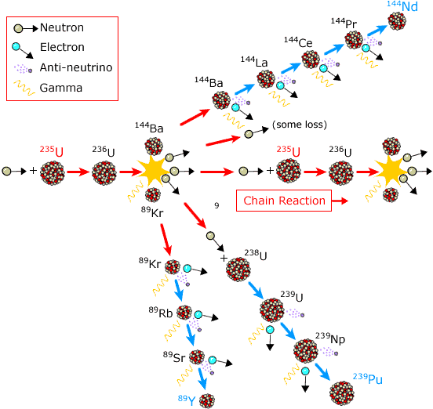
But things really break down even further:
235 U fission fission path (displayed horizontally across the figure)
Ba & Kr fission paths ( & )
238 U fission path (to lower right)
But all of these paths take time
And they continue right off the page!
BOTTOM LINES:
All SORTS OF THINGS continue fissioning
LONG after initial ²³⁵U / ²³⁸U fission stops
=> Sustained heat + radiation!
=> 2 of 3 accidents I'll soon describe
Modification of figure found at:
http://www.nobelprize.org/educational/physics/energy/fission_2.html

Slide 18
On to how nuclear fission bombs and reactors are made:
BOTH bombs and reactors set up a sustained chain reaction of nuclear fission decay
But common REACTORS require BOTH a fission reaction:
235U + 1n (slow/thermal) => (byproducts) + ~ 3 1n (fast/hot)
And a moderation reaction:
1n (fast/hot) + Moderating Atom => 1n (slow/thermal)
Working together these two reactions enable a sustained chain reaction
But this multi-step process requires a fair bit of time - at least milliseconds
Nevertheless, per the preceding discussion, with an ideal moderator (C or D₂O),
This can occur in even natural uranium ore of 0.7% ²³⁵U + 99.3% ²³⁸U

Slide 19
But bombs are different:
VIOLENT explosions require EXTREMELY fast & dense release of energy
That argues against the use of neutron moderators because:
1) A separate moderator dilutes the density of energy-release
Because the moderating atoms must replace some fissionable atoms
2) Neutrons must collide multiples times with moderator to be fully moderated
And that takes too much time when mere microseconds are significant
Uranium bombs thus use only the single less efficient reaction of:
235U + 1n (fast/hot) => (byproducts) + ~ 3 1n (fast/hot)
Less efficient because other ²³⁵U's don't like to absorb those fast/hot neutrons
But extremely fast because, when they DO absorb, it is all done in one step
Occurring in microseconds, but sustainable only with ≥ 80% ²³⁵U

Slide 20
But chain reactions ALSO require something else:
To sustain a chain reaction, EACH liberated neutron must FIND other ²³⁵U
If probability of finding another ²³⁵U <1, reaction is NOT self-sustaining
If probability of finding another ²³⁵U = 1, reaction becomes self-sustaining
If probability of finding ²³⁵U >1, reaction is self-sustaining and growing
Leading to the important (but poorly named) concept of CRITICAL MASS
Which defines the mass above which a lump of radioactive material will chain react
WRONG! Its actually much more complex . . . and much simpler
Simpler because it really does just boil down to:
The probability of a liberated neutron finding another ²³⁵U:
An Introduction to Sustainable Energy Systems: WeCanFigureThisOut.org/ENERGY/Energy_home.htm

Slide 21
Illustrative Examples:
Say that a fissioning ²³⁵U emitted exactly 3 neutrons:
Then you could have:
High mass / NO CHAIN REACTION: Low mass / CHAIN REACTION:
BECAUSE the tighter packing
makes collisions more probable!

Slide 22
So its more about the critical concentration?
Partly
But it's also about shape:
Two objects with identical concentrations AND same total mass of ²³⁵U:
NO chain reaction: YES, chain reaction:
Similar to heat, shape with lower surface to volume ratio traps more neutrons
So "critical mass" is ACTUALLY about concentration, mass, shape . . .
= It’s about PROBABILITY of neutron collision with another ²³⁵U

Slide 23
Nuclear bombs require hyper-fast assembly of supercritical mass
"Hyper-fast" because even as you approach critical mass,
the chain reaction starts up, beginning to yield vast amounts of heat
That heat then quickly, fractures, melts and vaporizes things
Which are thus propelled rapidly apart!
If/when fissioning material spreads too far apart, you loose criticality
Reverting to one of the above too dilute / too spread out configurations
And the chain reaction is then extinguished
All of which was given the very descriptive name of a FIZZLE
An Introduction to Sustainable Energy Systems: WeCanFigureThisOut.org/ENERGY/Energy_home.htm

Slide 24
But isn't "fizzle" just a euphemism for "a slow explosion"
NO!
A nuclear fizzle releases immensely less energy than a nuclear explosion
Because (again):
A fizzle's slow early energy release, which IS due to nuclear fission
drives away (via melting and vaporization) the remaining nuclear fuel
Which, now spread out, is no longer of critical mass / critical configuration
and thus can no longer sustain a fission chain reaction
Thus, only a tiny fraction of the available fissionable material ever fissions
So a fizzle produces a much, much smaller energy release
Which can be so weak it might be more "meltdown" than explosion
An Introduction to Sustainable Energy Systems: WeCanFigureThisOut.org/ENERGY/Energy_home.htm

Slide 25
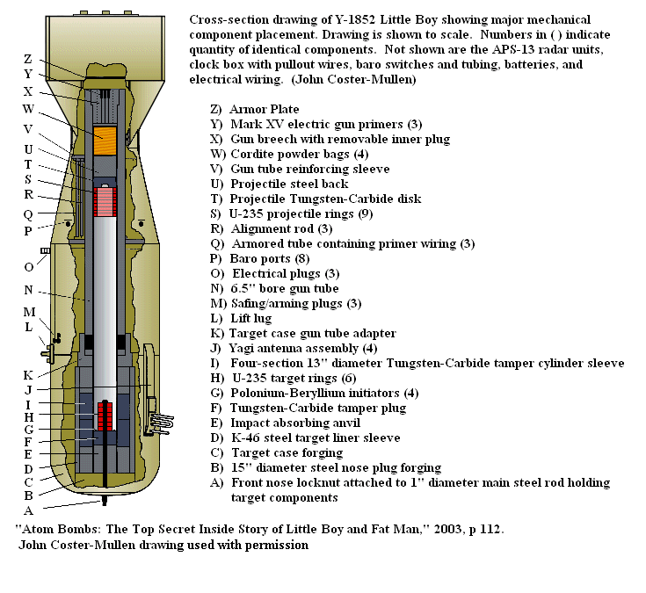
Beating that fizzle required this (over Hiroshima): "Little Boy"
http://en.wikipedia.org/wiki/Little_Boy

Slide 26
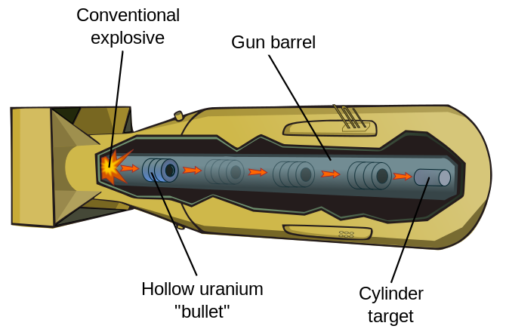
So named because it was little and relatively simple:
http://en.wikipedia.org/wiki/Little_Boy
Tube of 80% ²³⁵U SHOT (by cannon!) into position around cylinder of 80% ²³⁵U
With Neutron Mirror then also bouncing back neutrons leaking outward from tube
ONLY in this way could they BEAT the initial heat starting to push things back apart
Avoiding fizzle, getting MOST of ²³⁵U to fission => ~ Complete energy liberation

Slide 27
They didn't even test the Little Boy in advance
Reason #1) Because they were almost certain it would work
Reason #2) Because they had so little ²³⁵U
Why? Because ²³⁵U is SO HARD TO ENRICH:
235U is electronically identical to 238U: So it bonds to all the same things!
Separation must instead exploit the 1% mass difference between ²³⁵U and ²³⁸U
Requiring huge factories in which ore is passed through hundreds of cycles of
gas-diffusion barriers OR mass spectrometers OR high-speed centrifuges
Plutonium, obtained from ²³⁸U decay, is much easier to separate:
238U + 1n (hot/fast) => 239U => 239Np + β => 239Pu + β
Pu and ²³⁸U have different number of electrons, so bond to different things
²³⁹Pu can thus be chemically separated from its uranium pre-cursors

Slide 28
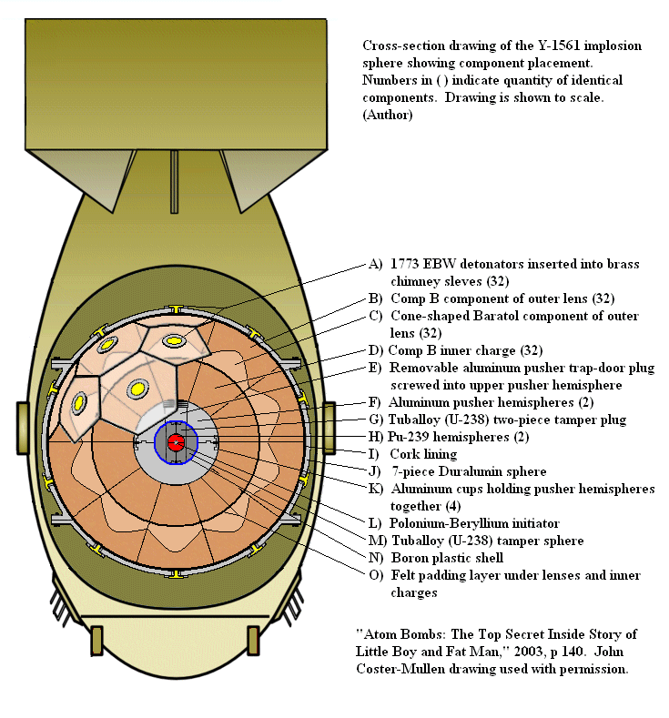
They had PLANNED to use plutonium in same Little Boy design
But the plutonium fission reaction started up so much faster
That mass would have begun blowing back apart too early
Before cannon could fully merge tube / cylinder => FIZZLE
So were driven to "Fat Man" = sphere of explosives surrounding sphere of Pu
They were still so unsure of it, that THIS is what was tested at Alamogordo NM
And then dropped on Nagasaki
Shaped conventional explosive
Hollow Plutonium Sphere
http://en.wikipedia.org/wiki/Fat_Man

Slide 29
Nuclear bombs versus reactors:
SIMILARITY: Most common reactor designs DO use the SAME ²³⁵U fission reaction
DISSIMILARITY: In bombs, when fissile masses are merged, they are critical
Facilitated by extremely rapid merge + 20X more concentrated ²³⁵U
In reactors, even if fissile masses are merged, they are subcritical
HOLD IT! But then how does a nuclear reactor continue working?
That is, how do ²³⁵U's continue fissioning at a rate higher than
the natural rate of 50% probability per 703.4 million years?
ANSWER: By deliberate addition of those NEUTRON MODERATORS
Which slow down (thermalize) neutrons liberated by one ²³⁵U's decay
increasing likelihood that they will cause another ²³⁵U to decay
So when I say MODERATOR think ENHANCEMENT of ²³⁵U fission!

Slide 30
Reactor = Subcritical mass + Accelerator + Brake
Accelerator is the above mentioned neutron moderator
Brake is the added neutron poison (absorbers) contained in the "control rods"
GOAL is to balance those competing effects to such that:
Exactly one neutron ejected by first ²³⁵U is then absorbed by a second ²³⁵U
Which then decays (and so on an so on) => Constant energy release
That balancing act is greatly aided by a detail of neutron emission:
Very few neutrons (~0.65%) are "prompt" = Released extremely quickly
Most instead take milliseconds to several seconds to emerge
Which means that the reaction can only build over seconds to minutes
Giving control rods much more time to react

Slide 31
Finally, moving on to U.S. reactors:
Which, like many/most of those used in the rest of the world, are:
Light Water Reactors (moderated and cooled by normal water)
Which cannot use natural uranium ore of 0.7% ²³⁵U + 97.3% ²³⁸U
As is possible with carbon (graphite) or heavy-water moderated designs
But which instead require the very expensive enrichment of ore to ~ 4% ²³⁵U
The cost and trouble of which can be balanced against:
The expensive and trouble of enriching heavy water
Or the-soon-to-be-discussed hazard of using flammable graphite
An Introduction to Sustainable Energy Systems: WeCanFigureThisOut.org/ENERGY/Energy_home.htm

Slide 32
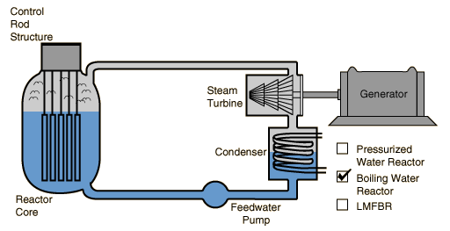
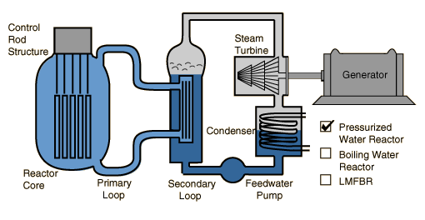
Our U.S. Light Water Reactors come in two types:
Boiling Water Reactors (BWR): Pressurized Water Reactors (PWR):
Both use the heat of ²³⁵U + ²³⁸U decay to boil water, driving a turbine generator
But their control schemes (and safety containment structures) differ as follows:
http://hyperphysics.phy-astr.gsu.edu/hbase/nucene/reactor.html
An Introduction to Sustainable Energy Systems: WeCanFigureThisOut.org/ENERGY/Energy_home.htm

Slide 33
Details of boiling water reactor (BWR) design:
With the simpler control scheme which is, in a subtle sense, more sophisticated:
4% ²³⁵U + ²³⁸U fuel pellets inside zirconium tubes (1-2 cm dia. / 3-4 m long)
= "Fuel Rods"
Plus movable "Control Rods" containing neutron poison/sink (= "brake")
Plus neutron moderator supplied by surrounding water (= "accelerator")
Water ALSO absorbs heat, boiling into the steam that drives the turbine
Control Rod
Control Rod
Fuel Rod
Fuel Rod
Fuel Rod

Slide 34
But recall that "light water" is both neutron moderator and absorber:
Moderating because neutrons are so close in mass to water's hydrogens
That colliding neutrons transfer a lot of their kinetic energy to them
Where neutrons would instead just ricochet off much more massive nuclei
Thus light water transforms hot/fast neutrons into slow/thermal neutrons
So the output of one ²³⁵U fission becomes ideal input for next ²³⁵U fission
Based on moderation alone: More water should accelerate reaction
But light water (with neutron-free hydrogens) can also absorb neutrons
Converting hydrogen nuclei from from p to n+p (= ²H = deuterium)
Based on absorption alone: More water should decelerate reaction
An Introduction to Sustainable Energy Systems: WeCanFigureThisOut.org/ENERGY/Energy_home.htm

Slide 35
Most reactors are designed so that water "moderation" dominates:
Then, if a BWR reactor overheats, water first expands and then boils:
Both spread out water molecules (especially boiling) making it harder for
Hot/fast neutrons to moderate into slow/thermal neutrons
Fewer slowed neutrons makes it much harder for ²³⁵U to fission
Which automatically turns the reactor back down!
A second level of control is added via the control rods
Which, absorbing neutrons, diminish the likelihood of fission
Third level of control added via emergency ("scram") shutdown
by injecting boric acid, the boron's of which strongly absorb neutrons
Because boiling water reactors DO allow water to boil (spreading vastly)
experts view it as being the most stable type of reactor

Slide 36
But there is a potential problem with boiling water reactors:
The turbine generators are located OUTSIDE the reactor containment structure
Because they must be more easily accessible for servicing, meaning:
Water from reactor (as steam) is allowed to exit the containment
Fortunately, pure water can become only slightly/mildly radioactive:
Some ¹H => ³H (tritium) which decays relatively slowly and benignly
An Introduction to Sustainable Energy Systems: WeCanFigureThisOut.org/ENERGY/Energy_home.htm

Slide 37
Alternate Pressurized Water Reactor (PWR):
Inspired, in part, by concern about reactor cooling water exiting containment
If water picks up impurities, THEY could become strongly radioactive
Or if fuel rods leaked, water could become massively radioactive
So instead of one water loop, there are two:
Primary loop enters reactor core then, via heat exchanger, transfers heat
ONLY secondary water/steam loop exits containment to drive turbines
http://hyperphysics.phy-astr.gsu.edu/hbase/nucene/reactor.html

Slide 38
Subtleties of Pressurized Water Reactor (PWR):
Primary loop's job is to supply enough heat to boil water in the secondary loop
It can carry a lot more heat energy if water in it remains a dense liquid (vs. vapor)
But it still has to reach temperatures ABOVE boiling so it must be pressurized
Keeping that water liquid even well above 100°C
However, the water in that primary loop is ALSO a NEUTRON MODERATOR
But, under pressurization, its water cannot expand much and can't vaporize
So degree of neutron moderation (which accelerates ²³⁵U fission reaction)
Will not automatically decrease sharply when reactor core heats up
So you loose a negative feedback mechanism that enhances
the stability of competing boiling water reactor (BWR) designs

Slide 39
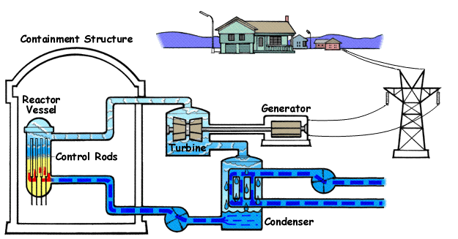
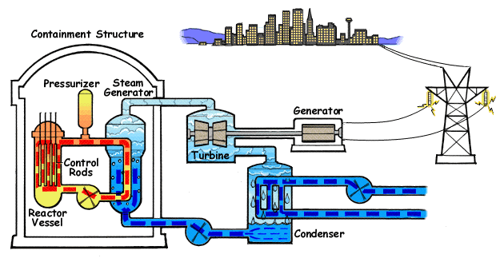
Putting basic schematics of these two designs side by side:
Boiling Water Reactor:
Pressurized Water Reactor:
www.nrc.gov/reading-rm/basic-ref/students/animated-bwr.html
www.nrc.gov/reading-rm/basic-ref/students/animated-pwr.html

Slide 40
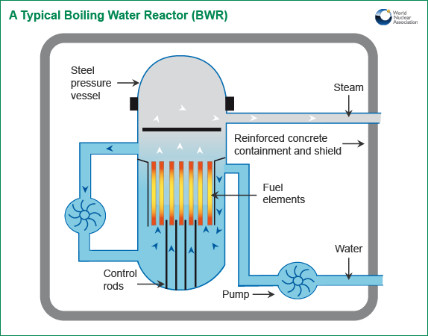
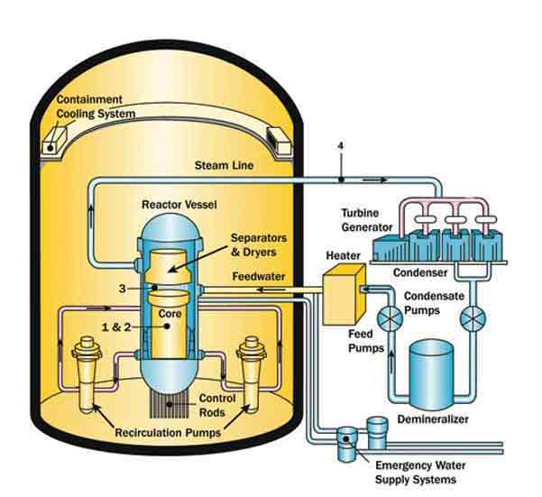
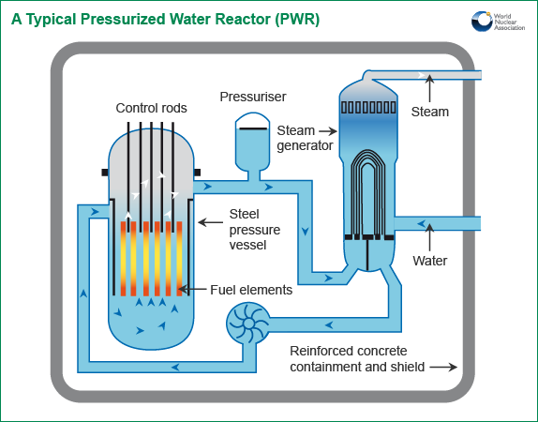
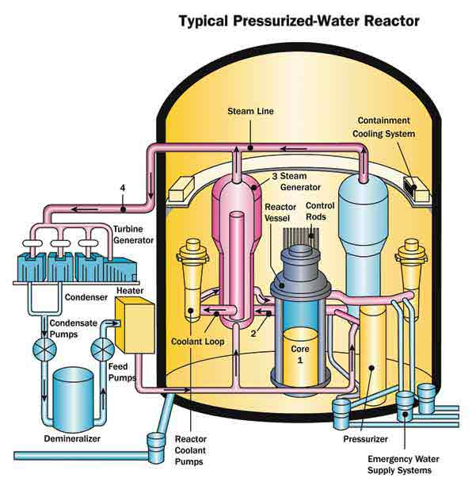
Adding a bit more technical detail:
Boiling Water Reactor:
www.world-nuclear.org/info/Nuclear-Fuel-Cycle/Power-Reactors/Nuclear-Power-Reactors/
www.nrc.gov/reactors/bwrs.html
Pressurized Water Reactor:
www.world-nuclear.org/info/Nuclear-Fuel-Cycle/Power-Reactors/Nuclear-Power-Reactors/
www.nrc.gov/reactors/pwrs.html

Slide 41
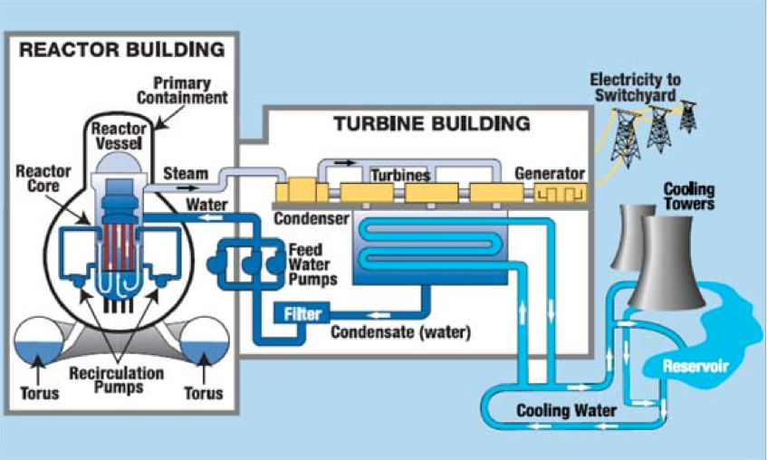
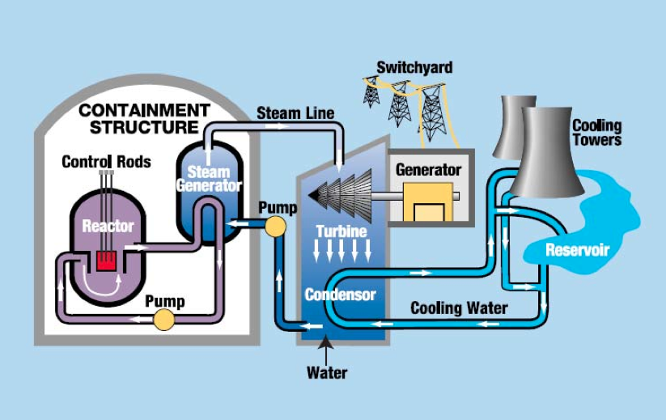
Finally: Different "hot zones" => Different containment strategies:
Boiling Water Reactor:
Strong reactor vessel containment
Weaker overall building containment
(=> conventional flat walls & roofs)
Pressurized Water Reactor:
Strong building containment of
reactor vessel & steam generator
(=> signature concrete domes)
No turbine building containment
Source: CRS Report to Congress – "Power Plants: Characteristics and Costs" (November 13, 2008) - Order Code RL34746

Slide 42
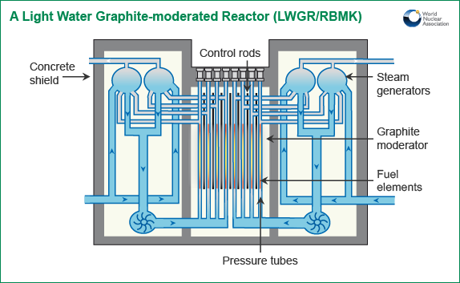
But we need to include one more type of reactor:
RBMK (Reaktor Bolshoy Moshchnosti Kanalnyy) reactor – as used at Chernobyl
http://www.world-nuclear.org/info/Nuclear-Fuel-Cycle/Power-Reactors/Appendices/RBMK-Reactors/

Slide 43
RBMK Reactors
RBMKs use partially pressurized cooling water, that is allowed to boil
Putting them somewhere between previous BWR and PWR reactors
But they use water only for heat transfer, NOT for neutron moderation
Instead, fuel rods rest in oversized metal-lined holes in blocks of graphite
With thin layer of cooling water flowing between rods and liners
Plus gas flow for heat transfer between liner and block / block to block
The graphite (alone!) produces ~ complete neutron moderation/slowing
Graphite blocks with holes/liners
for fuel rods and control rods
Fuel rods containing uranium
Control rods containing neutron poison

Slide 44
Unique goals/characteristics of RMBK reactors:
Design goals were to:
- Use much cheaper un-enriched natural uranium: 0.7% ²³⁵U + 99.3% ²³⁸U
- Produce BOTH electrical power PLUS plutonium for weapons
- Build unusually large high power reactors, at unusually low costs
Which was accomplished via:
- Complex heat transfer scheme combining thin layers of water w/ inert gas flows
- Constant, heavy, neutron moderation provided by (flammable) graphite blocks
With neutrons already moderated, water's moderation became unimportant!
- WITHOUT a heavily reinforced reactor containment vessel
As used in western reactors including both BWR and PWR designs above

Slide 45
With this background, let's figure out WHY three reactors "exploded"
An Introduction to Sustainable Energy Systems: WeCanFigureThisOut.org/ENERGY/Energy_home.htm

Slide 46
THREE MILE ISLAND (TMI) – Eastern Pennsylvania - 28 March 1979
Reactor involved (TMI #2) = Pressurized Water Reactor (Babcock & Wilcox Corp.)
Initial fault was in the secondary water cooling loop (outside reactor containment):
A filter clogged, operators tried to clean it by injecting compressed air
Resulting over-pressurized water leaked into air control line
Hours later compromised air control line caused pumps to trip off
=> Secondary loop could no longer fully remove heat from primary loop
Primary loop then overheated, reactor automatically initiated "scram" shutdown
Ramming in control rods to absorb neutron flux
But there was still HUGE amount of heat energy in the reactor core
Which was no longer being carried away by the cooling loops
An Introduction to Sustainable Energy Systems: WeCanFigureThisOut.org/ENERGY/Energy_home.htm

Slide 47
The TMI blow by blow analysis (continued):
But with the scram, three emergency pumps automatically turned on to cool core
But two of their valves had been left closed after earlier maintenance
So effectiveness of emergency cooling system was vastly reduced
Primary loop then heated so much that pressure relief valve was energized to open
When excess pressure was vented, that valve should then have closed
Limiting loss of water from that primary cooling loop
But valve instead stuck open, allowing more water to escape
Dark control room light indicated that power to open valve had been removed
But there was no light indicating whether or not valve HAD actually closed
Operators misinterpreted dark "open" light as indicating valve closure

Slide 48
The TMI blow by blow analysis (further continued):
Operators had NO instrument to directly read level of water around core
But they knew that water was in the "pressurizer" located above the reactor
So they assumed that reactor core below was still fully immersed in water
Because of pump vibrations, and fearing pressurizer would overfill (and fail):
Operators shut down pumps trying to add more water to the primary loop
But the reactor’s core was NOT fully covered by cooling water
Water pumps were vibrating because they were pumping steam
Confusion reigned for four hours until
new shift of operators finally figured out situation and began to correct
By then half of the reactor core had melted down and, driven by hydrogen
combustion, some radioactivity had already escaped from the containment vessel

Slide 49
Partial list of faults and errors:
Equipment failures:
Stuck primary loop vent valve
Indicator giving only intended state of that valve and not its true state
Lack of dedicated indicator giving water level in core
Control system which produced over 100 alarms in first minutes of failure
Management / operator / training errors:
Initial procedure for cleaning out clogged filter
Emergency cooling system valves left closed after earlier maintenance
Misinterpretation of above (badly designed) relief valve indicator
Operator mistrust of automatic safety systems (for cause?), including:
Operator override of automatic water cooling system
Repeating error that almost caused earlier accident elsewhere:
TMI management knew of that near miss, but had not told operators!

Slide 50
Report Of The President's Commission On The Accident at Three Mile Island:
"We have stated that fundamental changes must occur in organizations, procedures, and, above all, in the attitudes of people. No amount of technical "fixes" will cure this underlying problem. There have been many previous recommendations for greater safety for nuclear power plants, which have had limited impact. What we consider crucial is whether the proposed improvements are carried out by the same organizations (unchanged), with the same kinds of practices and the same attitudes that were prevalent prior to the accident.
As long as proposed improvements are carried out in a "business as usual" atmosphere, the fundamental changes necessitated by the accident at Three Mile Island cannot be realized."
("Kemeny Report," Overview, p. 24)
In light of the above, note that in 2014 I found TMI "information webpages"
posted by BOTH a key industry association AND a key federal agency
that still fail to mention central critical errors,
including failure to reopen emergency cooling valves after earlier maintenance.

Slide 51
CHERNOBYL – then USSR now Ukraine – 26 April 1986
Chernobyl's RBMK reactor used masses of graphite as a neutron moderator
This solid does not expand and then boil away as temperature increases
So, as reactor power increases, its neutron moderation does not diminish
Vs. moderating water whose loss would have dampened fission
The graphite core produced strong, continuous, neutron moderation:
Initially hot neutrons with extremely high kinetic energy
=> Many, many collisions with cooler graphite (carbon) atoms
=> Neutron kinetic energy approached that of the ambient
From then on, these cooled neutrons were almost as likely
to gain energy from collisions as lose energy from collisions
An Introduction to Sustainable Energy Systems: WeCanFigureThisOut.org/ENERGY/Energy_home.htm

Slide 52
Leading to Chernobyl's 1st positive feedback loop:
Water no longer moderated these already slowed down neutrons
However, water did still absorb neutrons, slowing nuclear fission reaction
But then, when reactor began to overheat and water started to boil:
There was less water per volume =>
There was less neutron absorption per volume =>
Leaving more neutrons to accelerate nuclear fission
This acceleration of fission, upon creation of steam bubbles, is called a:
Positive void coefficient
“Positive” in the sense that it provides positive feedback, stoking the fission reaction
So when Chernobyl started to overheat, this further accelerated the heating
An Introduction to Sustainable Energy Systems: WeCanFigureThisOut.org/ENERGY/Energy_home.htm

Slide 53
Chernobyl’s 2nd positive feedback loop: Its strange control rods
Neutron absorber
Displacer
Water
Reactor core
Control rod's job is to slow nuclear fission when it's pushed into the reactor core
But before control rod enters reactor core, its hole is filled with water
Which (per discussion above) already absorbs some neutrons
Designers wanted strongest possible drop in neutrons when absorber entered
So they decided to kill off the initial absorption of the neutrons in water,
by first pushing out water (via a "Displacer" extension of the control rod)
But that meant as control rod entered reactor, neutron population changed as:
Medium (due to water) => High (no loss in displacer) => Low (due to absorber)
In the middle (with only displacer inserted) nuclear fission accelerated
because they made the displacer out of neutron moderating graphite

Slide 54
Chernobyl’s 3nd positive feedback loop: Neutron "poisons"
I mentioned earlier that things like Xenon, Boron & Iodine are neutron poisons
Absorbing but not re-emitting any neutrons (taking them out of play)
Fission reactions themselves produce "poisons" such as these
As poisons accumulate, reactor control rods must be withdrawn farther
Compensating for poisons by reducing rod's neutron absorption
But neutrons from the reactor can also make some of these poisons radioactive
Causing them to fission into new non-poison elements
Sort of like a hot furnace burning soot out of narrowing chimney
But when reactor is turned down, neutron poisons tend to build back up
Which, in turn, drives nuclear fission rate down even further
=> Positive feedback loop trying to shut reactor down

Slide 55
But this then works in reverse when turning up reactor
If reactor has been off, or running very low, neutron poisons build back up
Normal withdrawal of control rods will then not accelerate fission as intended
So they pull out more rods than normal (or rods further) to get running
But as fission reaction finally accelerates, neutrons begin to "burn off" poisons
Causing fission reaction to further surge upwards
(NOTE: These surges are also an issue in non-RBMK reactors)
Safe way to start reactor (done elsewhere, and normally done at Chernobyl):
Leave IN enough control rods that surge cannot go supercritical
But doing a much delayed test, missing key reactor experts, they were in a hurry
And withdrew many more than the recommended number of rods

Slide 56
Three positive feedback loops => Instability => Sudden spike in fission
And, due to their abnormal procedures, they’d left themselves no margin for error
Likely leading to ("likely" because witnesses were dead / damage overwhelming):
- Steam explosion blowing lid off reactor
- Which was enough to effectively open things up
Because RBMK's were built without western-style containment
- Allowing air (w/ oxygen) to reach super hot graphite moderator blocks
Which had, to that point, been bathed in inert cooling gasses
- Causing them to near instantaneously catch fire
- Producing strong smoke plumes and thermal updrafts
Distributing radioactive debris and dust far and wide
Exceptionally bad reactor design? Or (once again): Key role of the "human factor?"

Slide 57
FUKUSHIMA DAI ICHI – 11 March 2011
Which is a location (140 miles Northeast of Tokyo) where there are SIX reactors
Four of which were involved in the accident (and critically damaged)
While the other two were shut down for maintenance at the time
I came up with reams of data on this accident, much more than on TMI or Chernobyl
But it really wasn't necessary, because this accident was easy to figure out:
It wasn't due to unpredictable equipment breakdowns
It wasn't due to operator errors
Both instead worked essentially as intended and as hoped for
It was instead due to design shortcomings
That were longstanding and well known (indeed known for decades!)
But accepted by designers, utility company, and government regulators

Slide 58
Fukushima design shortcoming #1 (shared by ~ all reactors):
Turning a reactor off doesn't really turn it off
A reactor is turned off (including in emergency "scram") by inserting control rods
=> Neutron poisons absorb so many neutrons that ²³⁵U stops fissioning
But firstly: There is still a huge amount of heat in the reactor core
And while the core itself may be able to withstand these temperatures
Because it employs exotic/expensive high temperature materials
Steels of reactor shell and piping may not withstand such temperatures
And secondly: Fission is not an instantaneous process
²³⁵U does not => End products in one quick energy releasing step
It instead decays into something else, which decays to something else . . .
With each radioactive decay along the way releasing more energy

Slide 59
Meaning that while control rods stop ²³⁵U + ²³⁸U fission:
The overall fission decay process continues
Until ALL radioactive products
Have decayed into final NON-radioactive elements
Which means control rods cannot instantaneously cut energy release to zero
Instead, energy release may only fall by ~ 95%
With the remaining 5% (due to radioactive decay of fission products)
then taking hours or days to fall away
STORED ENERGY in core + FISSION ENERGY STILL BEING PRODUCED
=> Reactor MUST be actively cooled for additional day/days
"Active cooling" = Electrically powered, fully functioning cooling pumps

Slide 60
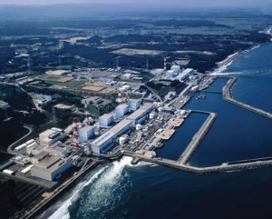
So with days of active cooling essential, where was Fukushima built?
On the edge of one of the world's most seismically active / tsunami prone coasts:
And where were the back-up generators for these essential pumps placed?
In the basements (i.e. as close to sea level as you could possibly put them)
Why locate plant and pumps essentially AT sea level?
To save a little money by using smaller water cooling pumps and piping?
www.hsci2012.org/is-the-fukushima-daiichi-nuclear-disaster-a-threat-to-west-coast-usa/
An Introduction to Sustainable Energy Systems: WeCanFigureThisOut.org/ENERGY/Energy_home.htm

Slide 61
Tsunami protection (?)
Immediately offshore a system of barriers WAS built (at right edge of previous photo)
With design goal of blocking tsunami's of up to 10 METERS in height
But subsequent studies suggested that risk of larger tsunamis was too high
And that barrier height should be significantly increased
TEPCO considered these studies but decided against higher barriers
Fearing that admission of error might lead to calls for
similar barriers, or barrier heightening, at nuclear plants elsewhere
(Including at sites where tsunami threat was less acute)
Instead they moved SOME of the backup generators to the top of the hill
But they left power lines / circuit breakers in the oceanside basements
Where they were flooded when the 14 METER tsunami hit
So three now uncooled reactors began to melt-down

Slide 62
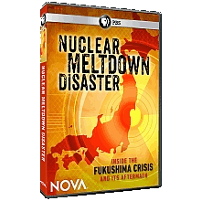
A Short Digression:
To fully understand my empathy for the Fukushima plant operators,
and my disgust with TEPCO and Japanese Government "regulators"
I STRONGLY RECOMMEND viewing this PBS Nova documentary:
Available to Public TV members via their PBS station
Or viewable by all at this YouTube link

Slide 63
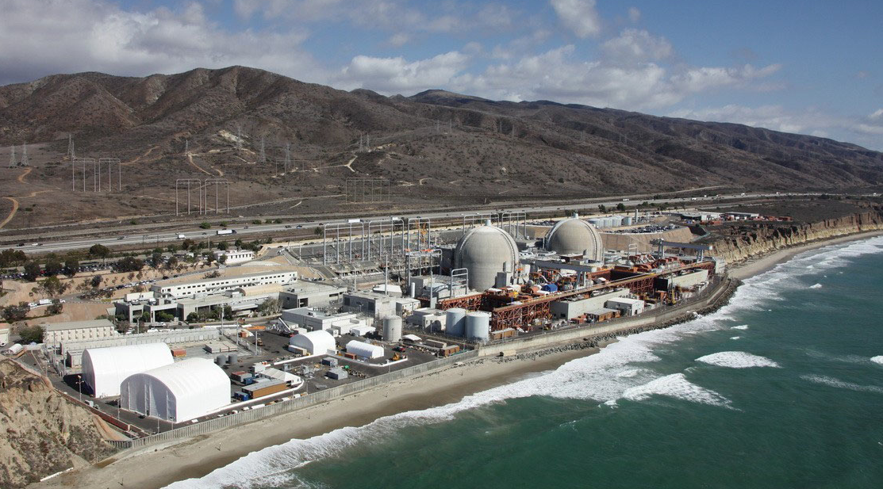
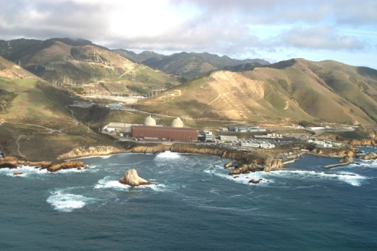
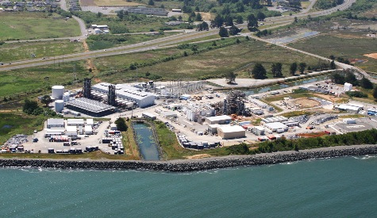
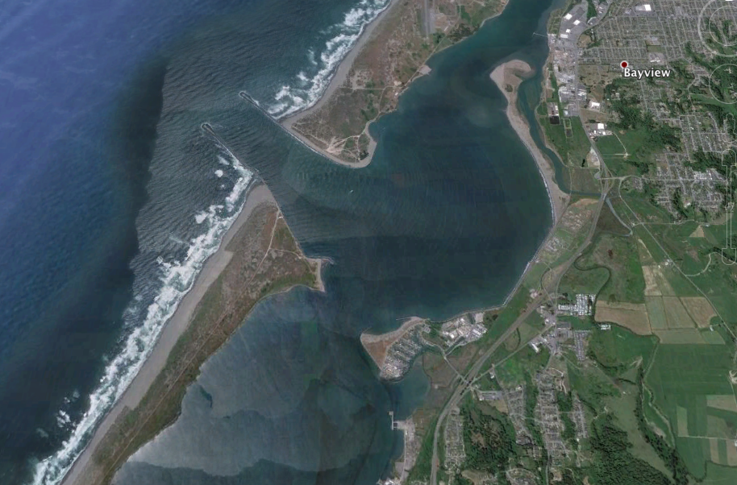
Have we in the U.S. been smarter, wiser, or less penny pinching?
Beachfront / at sea level:
Just above sea level:
SAN ONOFRE CALIFORNIA (closing)
www.kpbs.org/news/2011/mar/24/san-onofre-operators-welcome-nrc-review/
DIABLO CANYON CALIFORNIA (closure planned)
www.ojaipost.com/2011/03/diablo-canyon-nuclear-plant/
Beachfront / at sea level:
Minor natural protection
(Google Earth)
X
HUMBOLDT BAY CALIFORNIA (closing)
en.wikipedia.org/wiki/Humboldt_Bay_Nuclear_Power_Plant

Slide 64
Fukushima design shortcoming #2 (shared by ~ all reactors):
Spent nuclear fuel is stored inside the reactor enclosure
"Spent fuel" is really not all that spent:
Atoms are still fissioning (in ever decreasing numbers)
for hours, days, years, centuries and millennia afterwards
And no country has yet agreed upon a long term storage site for this "spent" fuel
Further, ≤ 25% of ²³⁵U & ²³⁸U fissions over the ~ 2 years it's in the reactor
Providing a reason to hold on to it for later re-enrichment and reuse
With no place to go, it is now generally stored AT the reactor site, indefinitely
It exits the reactor still highly radioactive, so one wants to minimize its handling
Leading to common practice of storing it in INSIDE the reactor building
Until, less radioactive, it's moved to another facility at the site

Slide 65
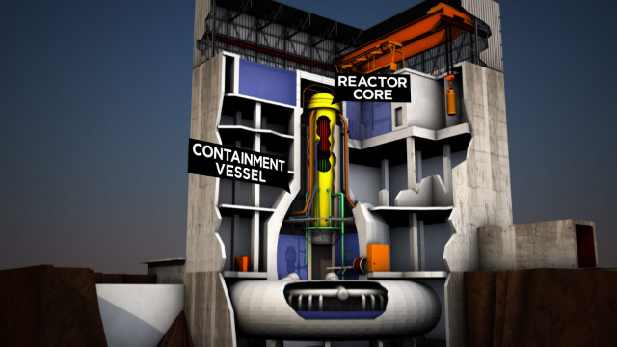
This increases radioactive material within the reactor building
Stored spent fuel can easily exceed the amount INSIDE the reactor
And thus total amount of radioactive material doubles, triples, quadruples . . .
That "spent" fuel, still fissioning, must also be cooled, so it is held in water pools:
Spent fuel storage pools
Vermont Yankee Nuclear Plant with same GE BWR design as Fukushima
www.cnn.com/2012/02/17/us/us-nuclear-reactor-concerns/

Slide 66
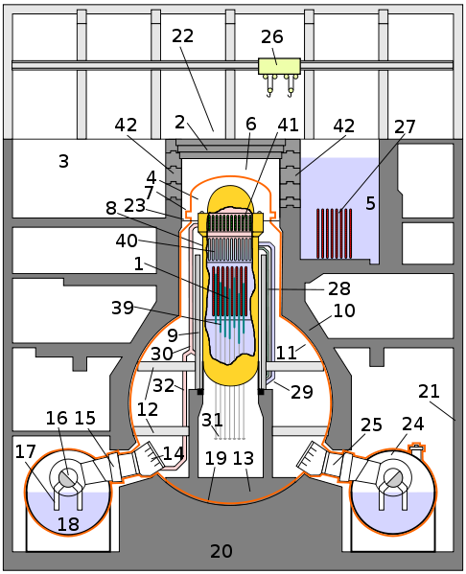
Or diagrammatically:
Crane for fuel rod loading / unloading
"Spent" fuel rod storage pool
Reactor vessel
Reinforced reactor enclosure
High position of storage pool DOES make it quicker and easier to reach
But it is already outside of the main reinforced reactor enclosure
And, being high above the reactor, it is susceptible to damage and water loss
http://en.wikipedia.org/wiki/Fukushima_Daiichi_Nuclear_Power_Plant

Slide 67
Fukushima design shortcoming #3 (shared by ~ all reactors):
High temperature catalytic decomposition of H₂O by zirconium
Fuel rods consist of enriched ²³⁵U held in zirconium metal alloy tubes
Because it's one of very few materials that can withstand full reactor heat!
But at the 2000°C temperatures of an approaching/ongoing meltdown
Zirconium catalyzes steam/water decomposition: 2 H₂O => 2 H₂ + O₂
These gases accumulate inside reactor until they reach an explosive level
And then an abundance of hot things can cause them to ignite:
2 H₂ + O₂ => 2 H₂O + large amount of energy (=explosion)
Despite the meltdowns, radiation HAD been confined to the reactor buildings
Because these "Containment Structures" had been doing their job!
But hydrogen + oxygen explosions now blew open the containments!

Slide 68
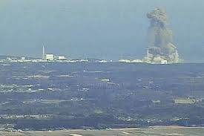
http://www.mirror.co.uk/news/uk-news/japan-nuclear-meltdown-fears-continue-176620
Were these "nuclear explosions?" NO!
Were "nuclear fizzles" NO!
These were classic chemical explosions, here: 2 H₂ + O₂ => 2 H₂O
And their energy was immensely less than even the earliest nuclear bombs
Even though fission heat drove zirconium to catalyze H₂ + O₂ liberation
And net effect was widespread dispersion of radioactive materials =
A DIRTY BOMB: Radioactive materials dispersed by conventional explosives

Slide 69
A hydrogen explosion also occurred at Three Mile Island (thirty two years earlier)
High temperature zirconium catalysis of water was also identified as the cause
E.G. in the Presidential Commission's Report on TMI
And that hydrogen chemical explosion also moved the accident from
a contained meltdown to an external radiation release
That is, hydrogen explosion converted a problem inside a single reactor building
into the beginnings of a large area environmental disaster
But fortunately, the TMI hydrogen + oxygen explosion was much, much smaller
and the damage to the containment was proportionally reduced
such that radiation leakage at TMI was minimal
And it took a 2nd go round (at Fukushima) to fully play out this disaster scenario:

Slide 70
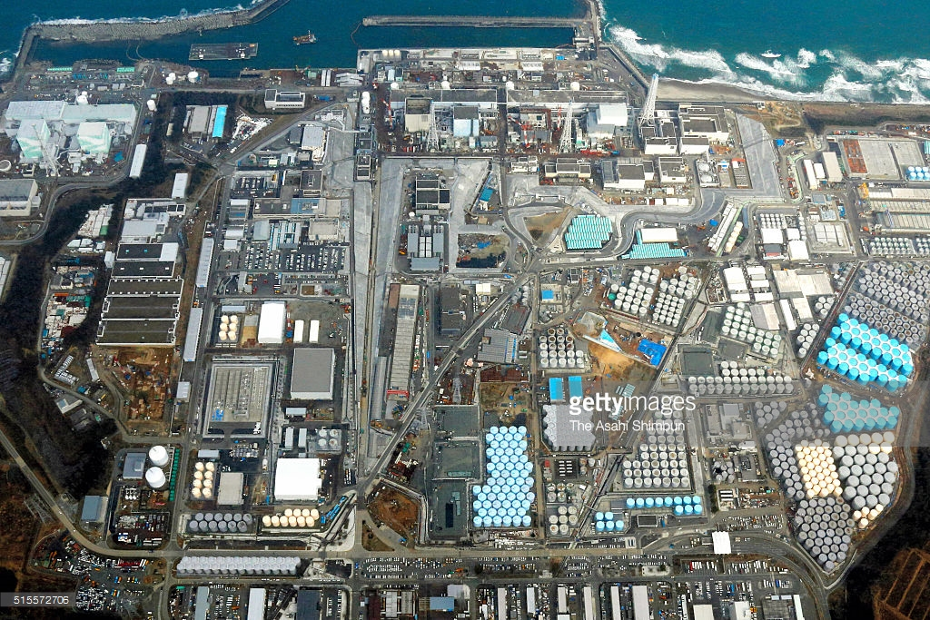
Fukushima: Before and After
Barely discernible seaside reactors + surrounding countryside:
Barely discernible seaside reactors + massive clean-up / waste-storage facility
Left: http://metro.co.uk/2011/03/14/pictures-japan-earthquake-aftermath-3053782/combination-photo-shows-satellite-images-of-fukushima-daiichi-nuclear-power-plant-in-japan-taken-by-the-geoeye-1-satellite-on-november-15-2009-l-and-on-march-11-2011-after-magnitude-8-9-earthquak/
Right: http://www.gettyimages.de/ereignis/fukushima-daiichi-nuclear-power-plant-five-years-after-meltdown-610095217#in-this-aerial-image-tokyo-electric-power-cos-fukushima-daiichi-on-picture-id515572706

Slide 71
Fukushima in the context of the two earlier accidents:
All THREE of Fukushima's critical shortcomings were well known
Two (plant site / spent fuel storage) had easy (but not inexpensive) fixes
Third (zirconium catalysis of H₂O) had also caused TMI's radiation release
And while its elimination may indeed be difficult
32 years passed without any significant effort to eliminate it!
Making that 32 year old TMI Presidential Commission Report seem prophetic:
"No amount of technical 'fixes' will cure this underlying problem.
As long as proposed improvements are carried out in a 'business as usual'
atmosphere, the fundamental changes necessitated by the accident at
Three Mile Island cannot be realized"

Slide 72
A final criticism of nuclear: "It's carbon footprint is NOT really zero!"
Why? Because nuclear reactors use massive amounts of concrete
And the production of concrete liberates huge amounts of CO₂
This criticism is also leveled at hydroelectric dams
To test its validity for nuclear power plants,
let me now adapt the analysis I made in my Hydro Power (pptx / pdf / key) notes,
repeating some of its content in the interest
of keeping this note set on Nuclear largely self-contained
An Introduction to Sustainable Energy Systems: WeCanFigureThisOut.org/ENERGY/Energy_home.htm

Slide 73
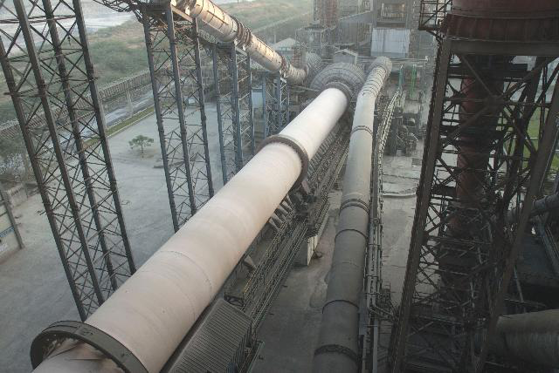
Concrete: What is it?
Concrete consists of gravel ("aggregate") glued together with a cement
Portland cement is the most commonly used modern glue
It contains calcium silicates (e.g., Ca₃SiO₅ and Ca₂SiO₄) which,
when exposed to water, form hydrates that bind the gravel together ¹
The source of that Ca is naturally occurring limestone (CaCO₃)
Ca is liberated by heating the limestone at 1400-1600°C in HUGE rotating kilns: ²
1) Portland cement science:
http://matse1.matse.illinois.edu/concrete/prin.html
2) Photo: https://www.cemnet.com/Articles/story/39950/acc-s-mega-kiln-line-project.html

Slide 74
Concrete's Carbon Footprint:
The above process has a huge carbon footprint due to:
- Burning of carbon fossil fuels to produce the 1400-1600°C kiln temperatures
- The need to constantly heat those massive kilns, even when not in production
- The release of CO₂ that occurs as Ca is liberated from the limestone (CaCO₃)
The now censored EPA Inventory of US Greenhouse Gas Emissions & Sinks reported ¹
that 2012 U.S. Portland cement production produced a carbon footprint of:
35 million metric tonnes CO₂ equivalent = 38.5 million tons CO₂ equivalent
Annual U.S. Portland cement production is ~ 86 million tons ² and thus:
1 ton of Portland cement => 0.45 tons of CO₂ equivalent released
Concrete (aggregate + Portland cement) is ~ 11% Portland cement by weight ³ =>
1 ton of Concrete => 0.05 tons of CO₂ equivalent released
1) Deleted from the EPA website in April of 2017 "under the leadership of President Trump and Administrator Pruitt."
(but my copy can still be viewed/downloaded at THIS LINK)
2) www.cement.org 3) www.cement.org/cement-concrete-basics/concrete-materials

Slide 75
Using this to compute Nuclear's carbon footprint due to concrete:
A "typical" nuclear plant requires "up to 350,000 cubic yards" of concrete ¹
Which, given concrete's density ² of 1.9 tons/yd³ => 665,000 tons Concrete
Which is 11% Portland cement => 73,000 tons Portland cement
That typical nuclear plant produces ~ 1.5 GW of electrical power
Ratio of nuclear plant Portland cement use to power produced:
= 73 kilo-tons cement /1.5 GW => 0.049 tons Portland cement / kW
And given that Nuclear plants operate for at least 40 years, this translates into:
= 0.0012 tons Portland cement / kW-yr for a nuclear plant
Total U.S. power is ~ ½ Tera-Watts. Nuclear produces 19.7% => 9.8 x 10⁷ kW
Which would require 117,600 tons Portland cement / yr, and thus:
Total U.S. nuclear footprint = 52,920 tons of CO₂ equivalent
1) www.concreteconstruction.net/construction/construction-of-nuclear-power-stations.aspx
2) http://hypertextbook.com/facts/1999/KatrinaJones.shtml

Slide 76
Comparing this to Fossil Fuel power plant footprints:
Where Do We Go from Here? (pptx / pdf / key) analysis of carbon tax impact, found that:
Conventional Coal => 0.001 metric tonne CO₂ eq. / kW-hr => 9.6 ton / kW-yr
OCGT Natural Gas => 0.0007 metric tonne CO₂ eq. / kW-hr => 6.7 ton / kW-yr
CCGT Natural Gas => 0.00045 metric tonne CO₂ eq. / kW-hr => 4.3 ton / kW-yr
In 2016 coal provided 30.4% of U.S. power => 1.52 x 10⁸ kW
Carbon footprint = (1.52 x10⁸ kW)(9.6 ton/kW-yr) = 1.5 x 10⁹ tons CO₂ / yr
= 28,300 times Nuclear's current carbon footprint
In 2016 natural gas provided 33.8% of U.S. power => 1.69 x 10⁸ kW
Which, if it were produced using half OCGT and half CCGT, would represent
Carbon footprint = (1.69 x10⁸ kW)(5.5 ton/kW-yr) = 9.3 x 10⁸ tons CO₂ / yr
= 17,600 times Nuclear's current carbon footprint
Nuclear's CO₂ footprint is MINISCULE compared to our fossil fuel plants!

Slide 77
Comparing carbon footprint for each kW-hour of power you consume:
From top of preceding page, converting kW-yr to kW-h, and ton to kg:
Conventional Coal Power: 9.6 ton CO₂ eq. / kW-yr=> 0.99 kg CO₂ eq. / kW-hr
OCGT Natural Gas Power: 6.7 ton CO₂ eq. / kW-yr => 0.69 kg CO₂ eq. / kW-hr
CCGT Natural Gas Power: 4.3 ton CO₂ eq. / kW-yr => 0.44 kg CO₂ eq. / kW-hr
From two pages ago, converting GW-yr to kW-h, and ton to kg:
Nuclear Power: 52,920 ton CO₂ eq. / 98 GW-yr => 0.000055 kg CO₂ eq. / kW-hr
Nuclear's carbon footprint / kW-hr is ~ 10,000 lower than for fossil fuels
An Introduction to Sustainable Energy Systems: WeCanFigureThisOut.org/ENERGY/Energy_home.htm

Slide 78
Other WeCanFigureThisOut.org note sets on nuclear energy:
A side trip to investigate a very strange possibility:
Prehistoric Natural Nuclear Reactors?
Plus three note sets on the possible future of nuclear energy:
Gen III/III+ Reactors: Confronting Cost & Operational Safety
Gen IV Reactors: Two Designs that Might Radically Reduce Nuclear Waste
Other Gen IV Nuclear Reactors
For links to these note sets (and their accompanying resources webpages) visit:
www.WeCanFigureThisOut.org/ENERGY/Energy_home.htm

Slide 79
Credits / Acknowledgements
Some materials used in this class were developed under a National Science Foundation "Research Initiation Grant in Engineering Education" (RIGEE).
Other materials, including the "Virtual Lab" science education website, were developed under even earlier NSF "Course, Curriculum and Laboratory Improvement" (CCLI) and "Nanoscience Undergraduate Education" (NUE) awards.
This set of notes was authored by John C. Bean who also created all figures not explicitly credited above.
Copyright John C. Bean
(However, permission is granted for use by individual instructors in non-profit academic institutions)
An Introduction to Sustainable Energy Systems: WeCanFigureThisOut.org/ENERGY/Energy_home.htm

