Slide 1
Sustainable Energy – My Exploration
John C. Bean
Outline
How I got interested in Sustainable Energy:
Great expectations meet cold reality
Including the hollowness of some apparently great ideas, such as:
"Going off the Grid!" OR "Buying an earth-friendly electric car!"
Leading me to another inconvenient truth: It's all about sustainable energy SYSTEMS
Which almost no one had studied (including me) but which, when studied, offer hope
A conclusion that led me to create this class / website
Looking ahead:
Why you really should follow my basic science + "back-of-the-envelope" calculations
Then a quick but important lesson about Energy vs. Power:
Their simple but important distinction – that we muck up by using crazy units
(Written / Revised: July 2019)

Slide 2
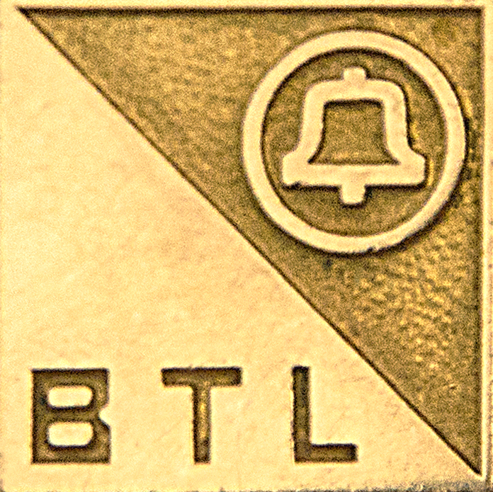
I am not a specialist in energy
But I am an applied scientist, with deep roots in the field of "optoelectronics"
That field focuses on the conversion between light and electrons – More accurately:
The use of light energy to liberate electrons from their bonds
Or the emission of light when electrons fall back into their bonds
At Bell Labs, we used this to build digital fiber-optic telecommunication systems
Which required extremely fast, but not necessarily efficient, conversion
But another optoelectronic device targets conversion efficiency, and not speed:
The photovoltaic cell (a.k.a. "solar cell") – also pioneered by Bell Labs
(From their pictorial explanation
in my first solar energy note set):
An Introduction to Sustainable Energy Systems: WeCanFigureThisOut.org/ENERGY/Energy_home.htm

Slide 3
So while I am not a specialist in energy
Optoelectronic devices ARE based on the same physics and the same materials
Which meant that I've traveled in pretty much the same scientific circles
And I've thus met a lot of people working on solar energy
Including friends who went on to found two U.S. solar energy companies
Those colleagues extolled the virtues of, and progress in, solar energy development
Pronouncing, for instance, that:
"When cost drops below $X.YZ per watt
the use of solar energy is going to explode!"
Then cost dropped to that level, but solar energy did NOT explode
An Introduction to Sustainable Energy Systems: WeCanFigureThisOut.org/ENERGY/Energy_home.htm

Slide 4
Which was not only professionally disappointing – it got personal!
Because I'd become a father, and then a grandfather
And I worry a LOT about the future my little granddaughters will face
That compelled me to figure out WHY my friends' dreams were falling short
Leading me, over the better part of decade, to pour over almost every
energy news article, paper and book that I came across
Which yielded an epiphany when I read David J.C. Mackay's extraordinary book:
Sustainable Energy: Without the Hot Air ¹
Because MacKay, based on his own crusade for understanding, taught me that:
It's all about building viable energy SYSTEMS!
1) Which is available as a very reasonably priced paperback, or via free fully authorized downloadable chapters at:
https://www.withouthotair.com/

Slide 5
Or to put it another way:
Energy things, even fantastic energy things,
will not just click together to give us the clean sustainable energy we need
That will happen only if these "things" work well together
Supporting each other's strengths and weaknesses
And doing so at an acceptable cost (both monetary and ecological)
But what made MacKay's book so convincing was that:
He didn't argue this point - he demonstrated it (time and time again):
Via back-of-the-envelope calculations
drawing upon little more than high school science

Slide 6
I've long embraced the same learning & teaching technique
So let me now provide a preview of this class / website
via a couple of my own (quick & illustrated) calculations:

Slide 7
For such calculations we don't need superb accuracy:
Accuracy is required when you get around to BUILDING something
But my focus is on deciding if we should even TRY building it!
For that decision you don't need superb accuracy
But you do need to have important "ball park numbers" at your finger tips
Things like:
Average U.S. household consumes 901 kW-hours of energy / month
Maximum solar power to the earth's surface is ~ 1 kW / m²
And, if you're talking about cars, 1 horsepower is ~ ¾ kW
And, it turns out that such numbers are a lot easier to keep in your head
if you sacrifice a little accuracy by using simpler, rounded, numbers
An Introduction to Sustainable Energy Systems: WeCanFigureThisOut.org/ENERGY/Energy_home.htm

Slide 8
Onward: A personal energy fix is really appealing
Especially when contemplation of whole energy systems is overwhelming and/or
we're completely bummed by the collapse of U.S. political leadership
Bloggers thus extol simple solutions, such as just "Going Off the Grid!"
Which, most commonly, calls for covering your rooftop with solar cells
Let's examine this possibility (sampling some upcoming class / website material):
The average U.S. household uses 901 kilowatt-hours of energy per month ¹
So for a thirty day month that works out to an average power consumption of:
Power_{household average} = (901 kW-hrs) / (30 x 24 hrs) = 1-¼ kilowatts
1) U.S. Energy Information Administration FAQs: https://www.eia.gov/tools/faqs/faq.php?id=97&t=3

Slide 9
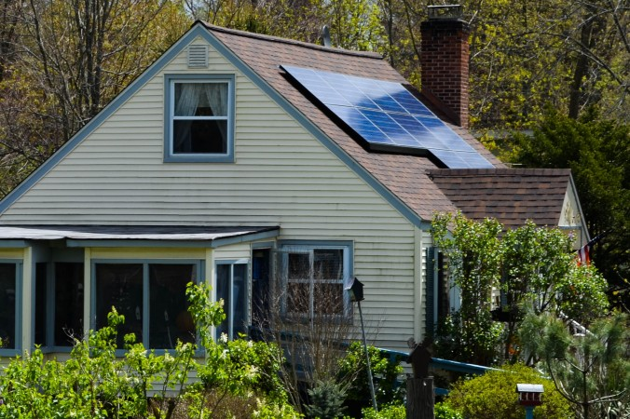
So then, how many solar cells will our home require?
At noon, in the summer, with clear skies, solar power to the earth's surface is:
Power_{peak solar} ~ 1 kilowatts per square meter of surface area
The best solar cells convert sunlight at about 20% efficiency and thus:
Power_{peak solar electricity} ~ 200 watts per square meter of solar cells
To get our required 1-¼ kW per household, we'd the need ~ 6 m² of solar cells
Something like this, which appears both do-able and likely affordable:
Figure:
http://www.theepochtimes.com/n3/2054773-utilities-partner-with-solar-companies-to-bring-energy-to-the-grid/

Slide 10
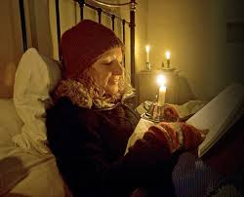
But inside that house, at night, it would look like this:
Now this photo actually depicts nighttime inside a Victorian era farm house
But you'd have no more nighttime power inside a purely-solar-powered home
Photo: http://www.dailymail.co.uk/femail/article-1241772/Im-frozen-time-What-like-live-TVs-Victorian-Farm-electricity-running-water-outside-loo-5c.html

Slide 11
UNLESS you store a lot of that daytime solar energy!
Which is going to require a lot of expensive / bulky storage batteries
AND a lot more solar cells
because our daily average U.S. household power is 1-1/4 kW
So when the sun IS shining, we need to collect a lot more than 1-1/4 kW
Let's first run through the facts in words, then calculate based on a simple figure:
- On average the sun is up 50% of the time = 12 hours / day
- Once it rises, solar intensity increases until noon, then falls toward sunset
- Maximum solar energy intensity = 1 kW / m²
But that occurs ONLY AT NOON, IF THE SUN IS DIRECTLY OVERHEAD
Which only happens in summer, in some parts of the world
- And intensity plummets with heavy air pollution and/or clouds

Slide 12
Putting all of that into a figure depicting our average day:
Yellow = Clear summer day Gray = Non-summer and/or cloudy day
Green = An eyeball approximation of average day's solar power
Area of triangle = power x time = average solar ENERGY per day per square meter
= (1/2) (base) (height) = (1/2)(12 hours)(0.5 kW/m²) = 3 kW-hours/m²
(1/8 th of what we might have carelessly calculated from 1 kW/m² x 1 day!)
1 kW / m²
Incident Solar Power
0.5 kW / m²
0 kW / m²
12 AM
6 AM
12 PM
6 PM
12 AM

Slide 13
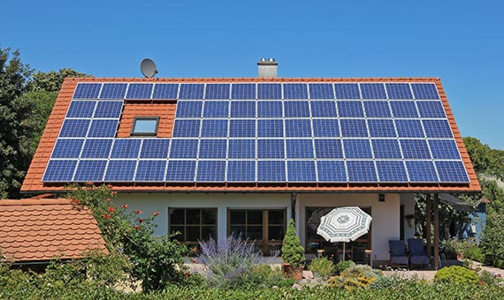
With that now averaged solar energy:
With quality solar cells converting sun power to electrical power at ~20% efficiency
We'd generate ~ (0.2)(3 kW-hr/m²) ~ 0.6 kW-hours/m² of energy per day
But a U.S. household's time averaged power consumption of power is 1-¼ kW, thus
We'd consume ~ (24 hours)(1.25 kW) = 30 kW-hrs of energy per day
So that typical household, now also packed with batteries, would need:
~ (30 kW-hrs) / (0.6 kW-hrs/m²) = 50 square meters of solar cells
Which would look more like this:
(A lot less do-able & affordable!)
Photo: http://www.benarasolar.com/our-product-range/rooftops/

Slide 14
But if there was a LONG stretch of bad daytime weather:
And doesn't every year include a couple weeks of dark unbroken clouds?
Then evenings would soon once again look like this:
UNLESS we ALSO maintained a backup electrical connection to the good old GRID
And there goes the first of our personal energy fixes right out the window!
An Introduction to Sustainable Energy Systems: WeCanFigureThisOut.org/ENERGY/Energy_home.htm

Slide 15
With the GRID back in the picture, a more plausible alternative is:
Share large solar farms - because they are now about twice as cost-effective
Locate them all over the country - to take maximum advantage of
regions with more intense sun and better weather (such as our Southwest)
Requiring efficient long-distance transmission of electrical power
Which, we'll learn, is actually not possible with today's power line technology
So you begin to see why MacKay claimed it was all about ENERGY SYSTEMS
Which quickly become extremely complex (and in need of innovation)
So let's consider another alternative which alone might not solve the problem,
but would surely represent a big personal contribution towards a solution:
An Introduction to Sustainable Energy Systems: WeCanFigureThisOut.org/ENERGY/Energy_home.htm

Slide 16
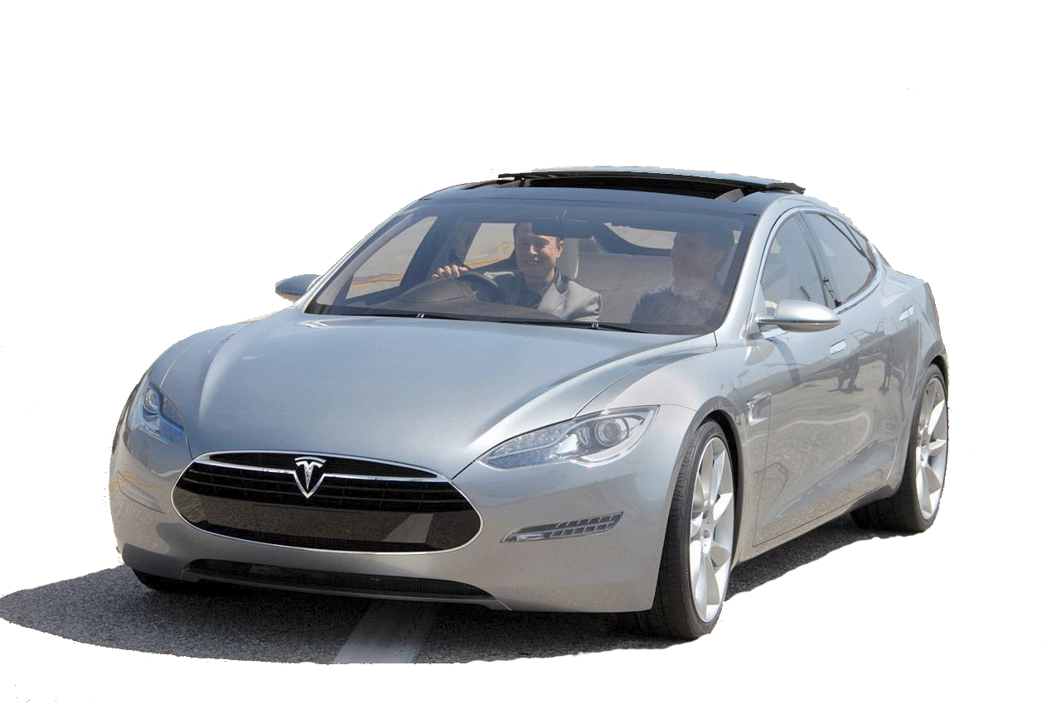
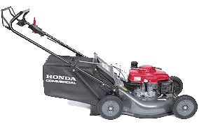
Buy an earth-friendly electric car!
Maybe even one of these, from Elon Musk:
But where would it get power?
Well, why not cover it with solar cells?
Calculating: ~ (3 m² ) (1 kW /m²) (20% power conversion efficiency)
=> 600 watts (peak) ~ 0.8 horsepower, at noon, on a sunny summer day
=> 0 watts (or horsepower) before dawn / after sunset
OK, but loaded with batteries, it could charge in a sunny parking while I'm at work!
Calculating: ~ 300 watts (average) over 8 hours => 2.4 kW-hrs ~ 3.2 hsp-hrs
Which you could then USE during your 1 hour commutes morning and evening
Which would give you an average of 3.2 hsp-hrs / 2 hrs = 1.6 Horsepower!
Pssst! I've got a lawn mower with twice that horsepower:

Slide 17
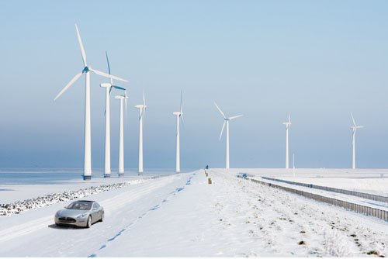
So (again) you'd better rely on the GRID to charge those batteries!
But that Grid could also be earth-friendly if it were based on something like this
Which would thereby maintain the earth-friendliness of your electric car!
Except that, at present, only ~ 7% of U.S. power is supplied by wind
and less than 2% by solar ¹
1) A state-by-state breakdown of power plant types is given in my lecture on Carbon Fuels
Background photo: https://cleantechnica.com/2014/01/24/forget-intermittency-nrel-says-wind-energy-can-boost-grid-reliability/

Slide 18
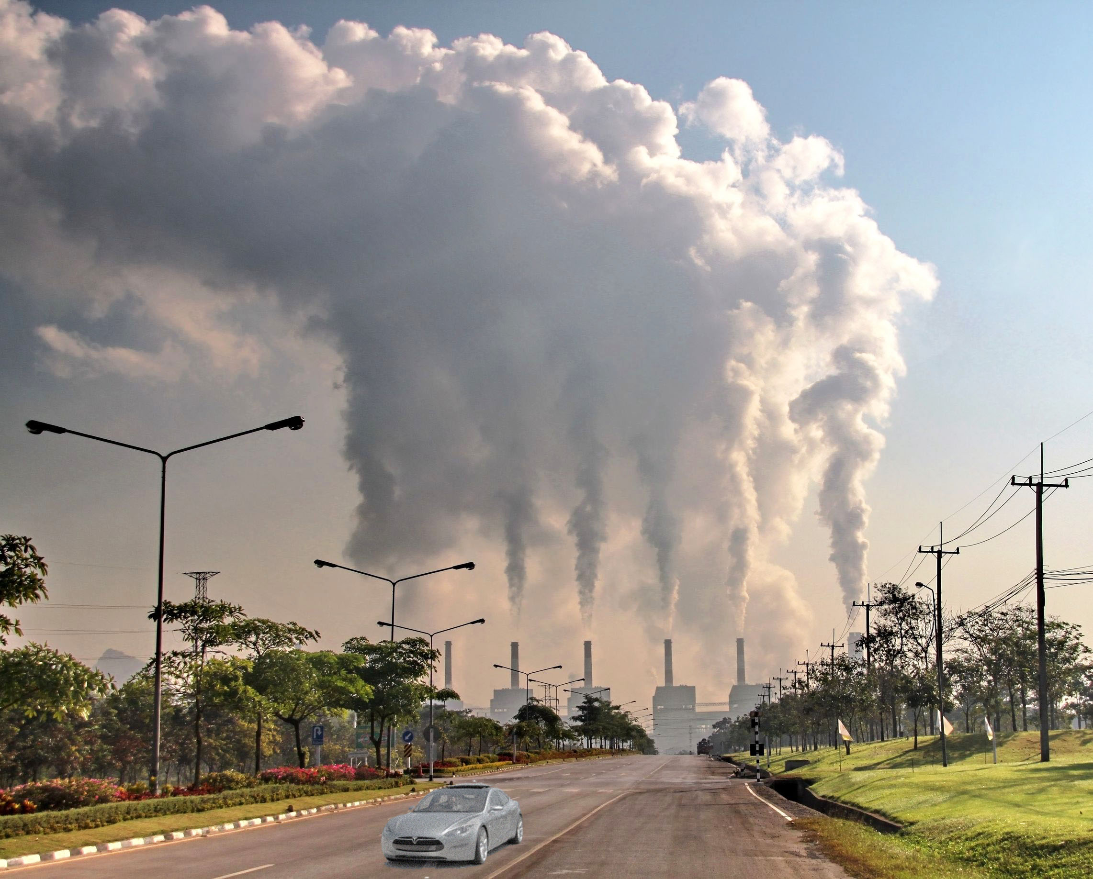
Whereas ~ 27% is now supplied by coal, and another 35% by gas ¹
For coal-based power a better illustration of you and your Tesla would be:
NOT so earth friendly!
NOTE: Natural-gas power plants CAN have a carbon footprint up to 50% smaller
But only if they use technology explained in my note set on Fossil Fuels (pptx / pdf / key)
1 (For an overview of U.S. energy, see my note set U.S. Energy Production and Consumption (pptx / pdf / key)
Background photo bought from: ungnoilookjeab/123RF.com

Slide 19
Conclusion? Single energy technologies just cannot stand alone!
Our rooftop solar cells needed batteries to power our homes at night
And to overcome spells of bad weather, we still need our Grid connection
Which works better if it can draw upon solar energy from far away . . .
And lawn mowers provide better transportation than a Grid-deprived electric car
But that electric car is no longer earth-friendly when plugged into the U.S. Grid
So we must push for big improvements in the way that Grid is powered
(Countering our "leadership's" efforts to make the Grid a lot worse!)
THESE are some of the (many!) reasons that David MacKay (and I) conclude that:
Plausible solutions require the re-invention of WHOLE ENERGY SYSTEMS
Which is why this class/website is all about such whole energy systems
An Introduction to Sustainable Energy Systems: WeCanFigureThisOut.org/ENERGY/Energy_home.htm

Slide 20
But energy systems are incredibly complex PUZZLES
In which one energy technology is just a single piece
And those pieces are often really, really frustrating
Because their shapes are often poorly defined, or even still changing!
And assembling them into an acceptable system requires more than technology
In fact, that puzzle's assembly generally requires / involves:
Science + economics + politics + journalism + sociology + pop culture . . .
Image adapted from: http://determinedtosee.com/?p=1032

Slide 21
"But I'm not sure that I can handle all of that!"
"Because I don't really have enough time"
OR
"I don't really have that broad an interest"
OR
"I don't really have a strong enough science or technology background"
In response, let me quote the farewell card sent to me by a former student:
"This is your world.
Shape it or someone else will."
That quotation was attributed to Gary Lew

Slide 22
So bear with me / stay with me
David MacKay wrote a superb book (downloadable, for free, from his website):
Sustainable Energy without the Hot Air ¹
And I have long specialized at introducing students to technological fields
With significant success (see this website's about webpage: link)
BOTH David's book and I also target students (and citizens) of ALL backgrounds
BOTH of us teach via sensible, comprehensible, word explanations,
calling upon illustrations, based upon science you DID study in high school
(which we both take the time to remind you about)
If you do bear with me / stay with me, you will be empowering yourself
by eliminating dependence on "experts" in favor of your own answers
1) Downloadable at: https://www.withouthotair.com/

Slide 23
You are probably still skeptical
I know that many of my in-classroom students certainly still were at this point
But David and I will work to convince you
In the meantime let me close by clearing up a possible earlier point of confusion:
An Introduction to Sustainable Energy Systems: WeCanFigureThisOut.org/ENERGY/Energy_home.htm

Slide 24
Power vs. Energy
Are they the same? NO! Are they closely related? YES!
POWER = How FAST we produce or use ENERGY
Which means that Energy = The sum (over time) of power produced / used
Although that sum must become an "integral" if the power is varying
The MKS metric unit of ENERGY is a Joule
The MKS metric unit of POWER is a Watt = 1 Joule / second
I do use the metric system because:
It is what is used everywhere else in the world
Where much/most of even "our" technology is now manufactured
And metric is simpler than the "Imperial System" now abandoned by even the British
An Introduction to Sustainable Energy Systems: WeCanFigureThisOut.org/ENERGY/Energy_home.htm

Slide 25
But, for some crazy reason, energy people muck it up!
Because they seem to despise the metric energy unit of Joules
And to avoid (virtually EVER) using Joules, they invert things:
1 Watt = 1 Joule / second => 1 Joule = 1 Watt-second
But 1 Watt-second turns out to be a very small amount of energy
And one second is not all that much time
So energy people instead prefer expressing ENERGY in units of a:
kilowatt-hour = (1000 Watts)(3600 seconds) = 3.6 million Joules
Though (to enhance the confusion?) they then often switch from:
kilowatts to megawatts (10⁶) or gigawatts (10⁹) or even terawatts (10¹²)
and from hours to months or even to years
An Introduction to Sustainable Energy Systems: WeCanFigureThisOut.org/ENERGY/Energy_home.htm

Slide 26
And ancient/largely-abandoned units still try to sneak in:
Examples of which include:
A British Thermal Unit (~ energy of completely burning down one match): ¹
= a bit more than ¼ watt-hour ~ 1055 Joules
A Ton (used in air conditioning = cooling energy of 1 ton of melting ice): ²
= 12,000 British Thermal Units = 3.5 kilowatt-hours = 12.6 million Joules
A Horsepower (self-explanatory):
= a hair less than ¾ kilowatt
Nevertheless - To finally wrap this presentation up:
1) https://www.eia.gov/energyexplained/index.cfm?page=about_btu
2) http://www.energyvanguard.com/blog/55629/Why-Is-Air-Conditioner-Capacity-Measured-in-Tons

Slide 27
Important takeaway from this mini Energy vs. Power lesson:
If an article claims (as they frequently do!!) that a new technology or power plant:
Produces XYZ kilowatts of energy!
The author doesn't know what he/she is talking about and his/her
article (website / press release / politician's speech) should probably be ignored
And while it is technically correct to state that the technology or power plant:
Produces XYZ kilowatt-hours of energy!
That claim is useless if you aren't told over what interval that energy is produced
That is, give me a tiny hand-cranked generator, and a whole lot of time,
and I too could create XYZ kilowatt-hours of energy (if I live long enough!)
= Why the distinction between Energy and Power IS ultimately very important

Slide 28
Credits / Acknowledgements
Some materials used in this class were developed under a National Science Foundation "Research Initiation Grant in Engineering Education" (RIGEE).
Other materials, including the WeCanFigureThisOut.org "Virtual Lab" science education website, were developed under even earlier NSF "Course, Curriculum and Laboratory Improvement" (CCLI) and "Nanoscience Undergraduate Education" (NUE) awards.
This set of notes was authored by John C. Bean who also created all figures not explicitly credited above.
Copyright John C. Bean
(However, permission is granted for use by individual instructors in non-profit academic institutions)
An Introduction to Sustainable Energy Systems: WeCanFigureThisOut.org/ENERGY/Energy_home.htm

